Slide 1
DMA Enforcement Workshops
Alphabet
Brussels, 21 March 2024

Slide 2
Regulatory landscape - Platforms
Agenda
9:00 – 9:15 | Introductory remarks by the Commission
09:15 – 10:35 | Session 1 – Google Android and Search Data (Article 6(3), 6(7) and 6(11) DMA)
10:35 – 11:05 | Coffee break
11:05 – 12:25 | Session 2 – Google Play (Articles 5(4), 5(7) and 6(4) DMA)
12:25 – 13:15 | Lunch break
13:15 – 14:45 | Session 3 – Google Search (Article 6(5) DMA)
14:45 – 15:10 | Coffee break
15:10 – 16:30 | Session 4 – Data-related provisions (Articles 5(2), 6(9) and 6(10) DMA)
16:30 – 16:45 | Closing remarks
16:45 | End of workshop

Slide 3
Regulatory landscape - Platforms
Rules of engagement
No reference to ongoing or past proceedings
No attacks; questions should be civilized / constructive
The Commission will moderate the discussions. Its role will be to steer the discussion
The Commission will not provide legal interpretations / take any positions
No sharing of business sensitive information
Goal is to hear stakeholders’ feedback on the concrete compliance solutions
We may not be able to take all comments and questions. Any observations can be sent to EC-DMA@ec.europa.eu

Slide 4
Regulatory landscape - Platforms
Rules of engagement
Always state your name and organisation (in room and via slido)
Questions and comments should be
clear and short = 2 min max,
relevant and on-topic of the specific DMA obligation,
constructive.
One question or comment per intervention
Online questions and comments via: https://app.sli.do/event/dC4mpnSDsJKepsfEQx91B6
slido.com - # 3029563

Slide 5
Session 1
Google Android and Search Data (Articles 6(3), 6(7) and 6(11) DMA)

Slide 6
Art. 6(3) DMA
“The gatekeeper shall allow and technically enable end users to easily un-install any software applications on the operating system of the gatekeeper, without prejudice to the possibility for that gatekeeper to restrict such un-installation in relation to software applications that are essential for the functioning of the operating system or of the device and which cannot technically be offered on a standalone basis by third parties.
The gatekeeper shall allow and technically enable end users to easily change default settings on the operating system, virtual assistant and web browser of the gatekeeper that direct or steer end users to products or services provided by the gatekeeper. That includes prompting end users, at the moment of the end users’ first use of an online search engine, virtual assistant or web browser of the gatekeeper listed in the designation decision pursuant to Article 3(9), to choose, from a list of the main available service providers, the online search engine, virtual assistant or web browser to which the operating system of the gatekeeper directs or steers users by default, and the online search engine to which the virtual assistant and the web browser of the gatekeeper directs or steers users by default.”

Slide 7
Article 6(7)
“The gatekeeper shall allow providers of services and providers of hardware, free of charge, effective interoperability with, and access for the purposes of interoperability to, the same hardware and software features accessed or controlled via the operating system or virtual assistant listed in the designation decision pursuant to Article 3(9) as are available to services or hardware provided by the gatekeeper. Furthermore, the gatekeeper shall allow business users and alternative providers of services provided together with, or in support of, core platform services, free of charge, effective interoperability with, and access for the purposes of interoperability to, the same operating system, hardware or software features, regardless of whether those features are part of the operating system, as are available to, or used by, that gatekeeper when providing such services.
The gatekeeper shall not be prevented from taking strictly necessary and proportionate measures to ensure that interoperability does not compromise the integrity of the operating system, virtual assistant, hardware or software features provided by the gatekeeper, provided that such measures are duly justified by the gatekeeper.”

Slide 8
Article 6(11)
“The gatekeeper shall provide to any third-party undertaking providing online search engines, at its request, with access on fair, reasonable and non-discriminatory terms to ranking, query, click and view data in relation to free and paid search generated by end users on its online search engines. Any such query, click and view data that constitutes personal data shall be anonymised.”

Slide 9
EC Alphabet Workshop DMA Art. 6(3) & Art. 6(11)
March 21, 2024

Slide 10
Art. 6(3)
Choice Screens

Slide 11
A set of principles to comply with DMA 6(3)
01
Fair Inclusion
02
Consistency
03
Neutral Design
04
Optimal Experience
05
Respect

Slide 12
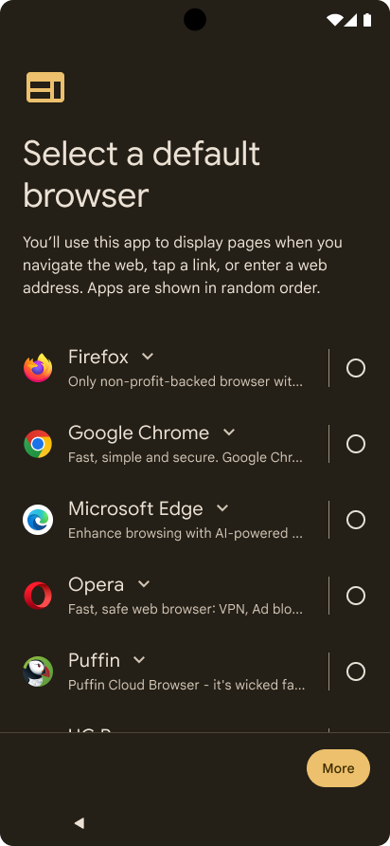
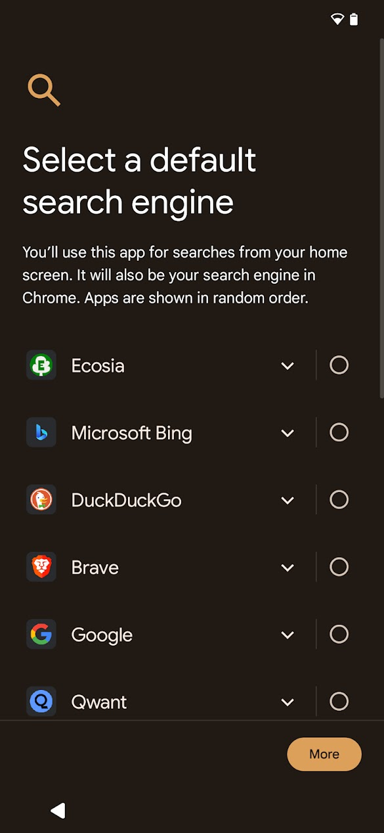
Android browser and search choice screens for DMA
Choice screen design reflects industry feedback
During device set-up
Choice is non-skippable
Neutral design, no Google branding
Per-device, no cross-device syncing
Browser default not shown if 3rd party default
Fully randomized list (stratified until May)
Full descriptions revealed via chevron (more visibility after May)
Forced scrolling to reveal all options before choice
3rd party app downloaded automatically
Choice propagates to search widget, Chrome, text search and other search tools

Slide 13
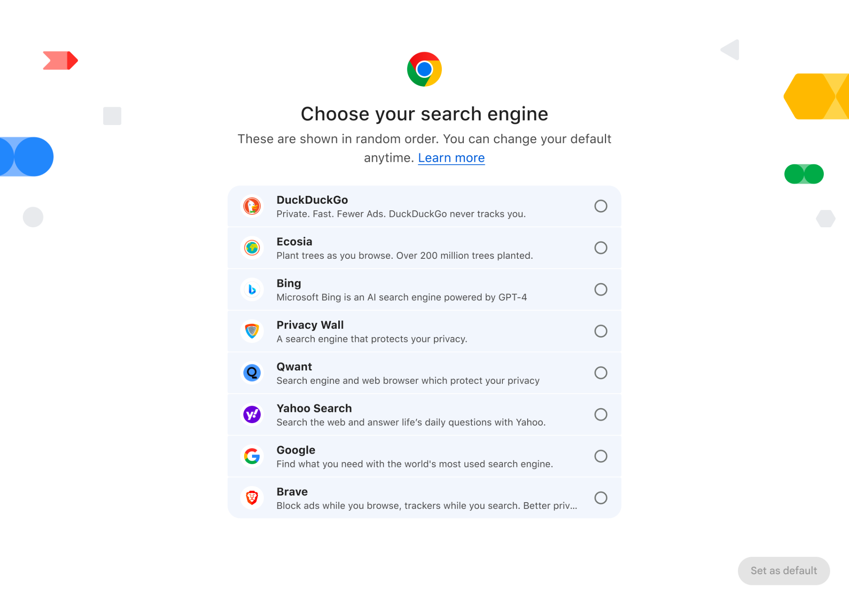
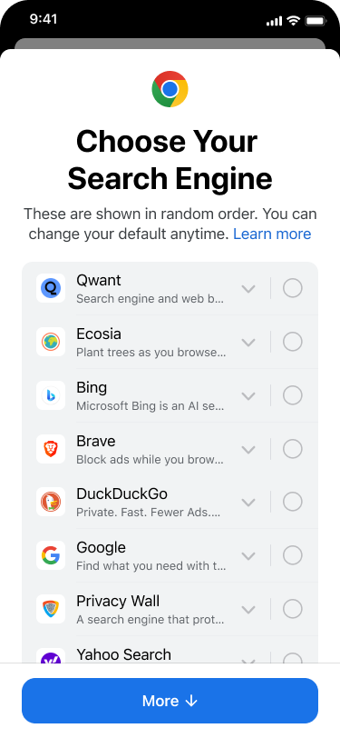
Chrome search choice screens for DMA
Choice screen design reflects industry feedback
Non-skippable
On new and existing Chrome installs on iOS & Desktop
Suppressed for users who have a 3P default search engine
Fully randomized list
Forced scrolling if not all providers fit on page
Visible descriptions
Per-device, no cross-device syncing
Desktop
iOS

Slide 14
DMA choice screen roll-out
01
Google Pixel phones & tablets
02
Android 3rd party OEM phones & tablets
03
Chrome on desktop and iOS (phones & tablets)
Pixel
Android
Chrome

Slide 15
Google Pixel roll-out
Pixel
Existing Devices
The update containing both browser and search choice screens has been made available to all existing EEA Pixel (Phone & Tablet) users over the last week.
Choice screens expected to be seen by 97% of users of Pixel devices by end of March 2024.
New Devices
The choice screens are shown on all new Pixel Phones & Tablets in the EEA since March 7. Full randomization and immediately visible descriptions will be ready from May.

Slide 16
Roll-out on Android 3rd party OEM phones & tablets
Ecosystem roll-out by Google
Technical assets delivered to OEMs (updated assets made available in May 2024 with full randomization)
New device models: Mandatory requirement for OEMs published to add choice screens for new device models as of March 7th
Existing device models: Recommendation published to add choice screens
User roll-out by OEMs
New device models: OEMs must implement the choice screens → Ramp up depends on launches and sales
Existing device models: OEMs are encouraged to update devices with choice screens (e.g., partner info portals, bootcamps, bespoke outreach) → Ramp up depends on OEMs
→ Pre-DMA choice screens will remain, too
January 9th, 2024
March 7th, 2024

Slide 17
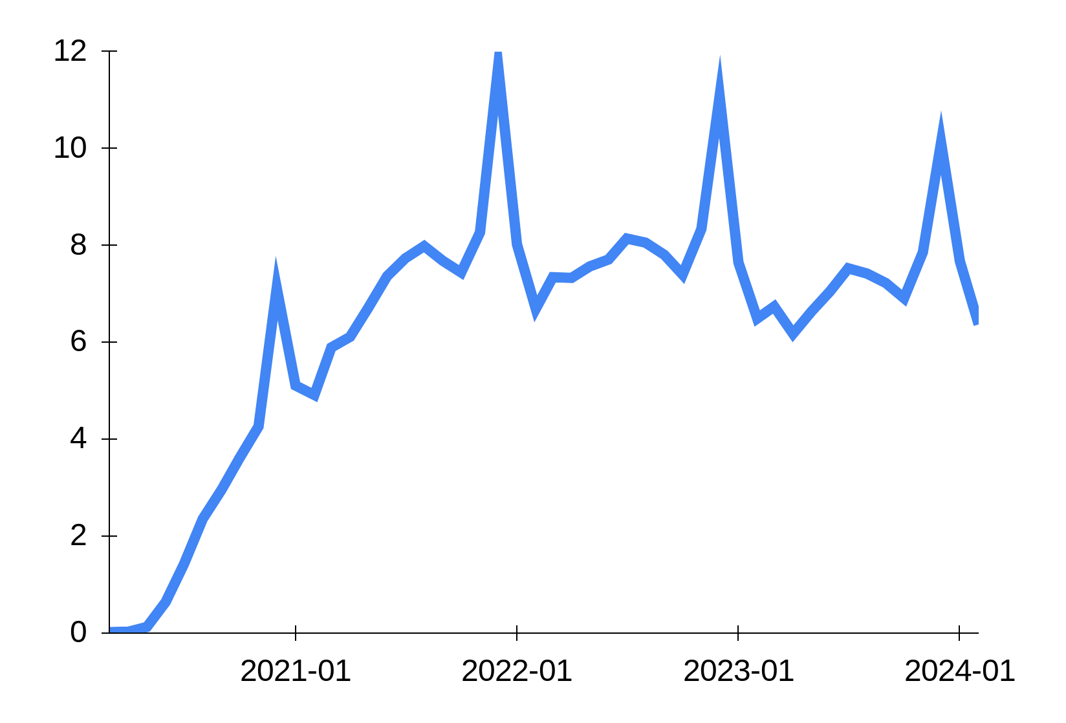
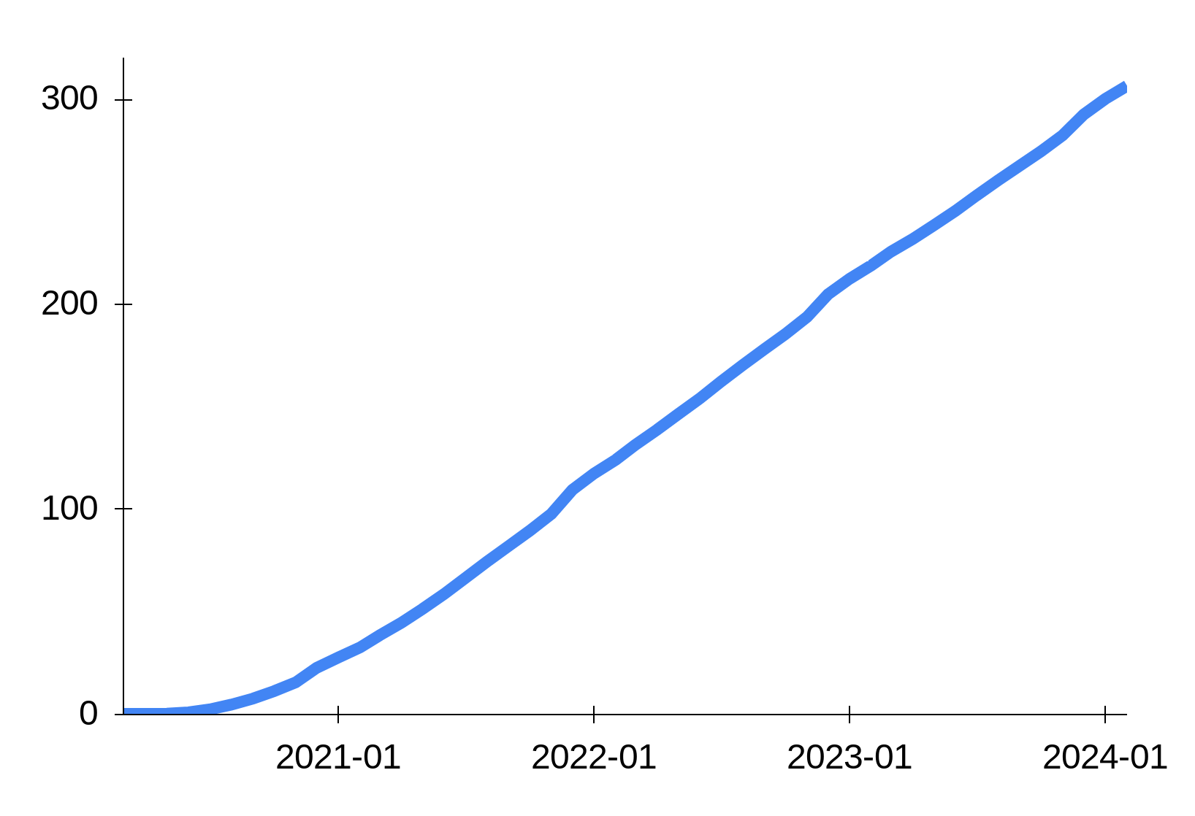
Roll-out on Android 3rd party OEM phones & tablets
Previous Android Choice Screens (Millions)
Cumulative Previous Android Choice Screens (Millions)
Gradual ramp in first months
Holiday seasons
The previous Android EU choice screen was also required as of March. However, 2020 was a ‘special year’ (pandemic: launches delayed, factories closed, shipments affected, weak consumer demand).
We expect rollout of DMA choice screens to be significantly faster than the previous Android choice screen

Slide 18
Chrome search choice screen roll-out on desktop and iOS phones & tablets
Roll out
The search choice screen will be shown on both new and existing Chrome installs on iOS and desktop devices.
Timeline
To address industry feedback and implement additional changes, targeting to start the roll out mid May with Chrome’s M125 release.
We are aiming for search choice screens on Chrome to reach 150-200 million devices by Summer.

Slide 19
Art. 6(11)
Google Search Data Sharing

Slide 20
Search Data Licensing Program
Key features
Over one billion distinct queries across all 30 EEA countries
Over 1.5 TiB of anonymized search data per quarter with around 53 billion rows covering:
query string
extensive information on the Google results shown and their ranking
Competitive pricing, and flexibility to only take and pay for subsets of the dataset

Slide 21
Overview of dataset
Data Fields
Organization
Query string
Country
Device type
Query count
Result (URL or result type)
Average rank
Impression count
Click count
Distinct query → per country → by device type
PLUS
Query volume for that combination
Individual results for that combination with data on:
Impression count
Average rank
Click count
Geographic coverage
All EEA Member States

Slide 22
How we anonymize the dataset and protect personal data
Frequency thresholding to protect personal data
To protect the personal data of users the Dataset is anonymised based on frequency thresholding
The Dataset will include all queries entered by at least 30 signed-in users globally over the 13 months before the end of the relevant quarter
Data on results (rank, clicks, views) is provided for results viewed by at least 5 signed-in users in a given country and per device type
Additional mechanisms to recover data that does not pass frequency thresholds
~July ‘24 ー aiming to launch mechanisms to recover additional data in a privacy-safe manner

Slide 23
Flexibility, Scale & Choice
Our dataset package and pricing reflects the need to provide optionality for those search engines that may only operate in some jurisdictions or only need a portion of the data.
Data volume
The full Dataset size is c. 1.5 TiB per quarter with c. 53 billion rows with query level-data organised by unique query across EEA countries
Scope options
Licensees can choose to licence and only pay for subsets of the Dataset for:
individual countries or the EEA as a whole, and
full dataset or a 10% or 50% sample for each individual country or the EEA as a whole
Licensees can opt for different datasets each quarter
Pricing
Licence rates start from €3 per thousand distinct queries, with corresponding discounts if licensees choose to only take subsets of the Dataset

Slide 24
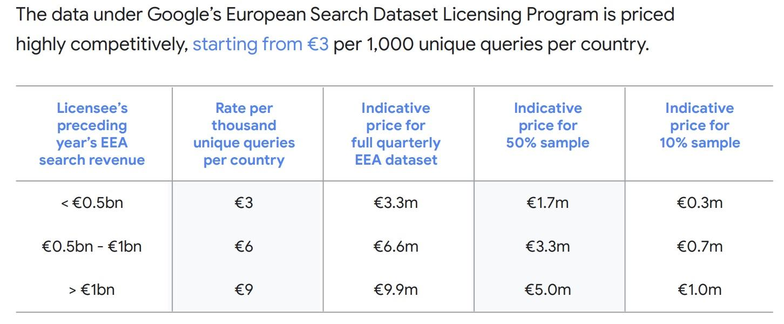
Pricing Flexibility

Slide 25
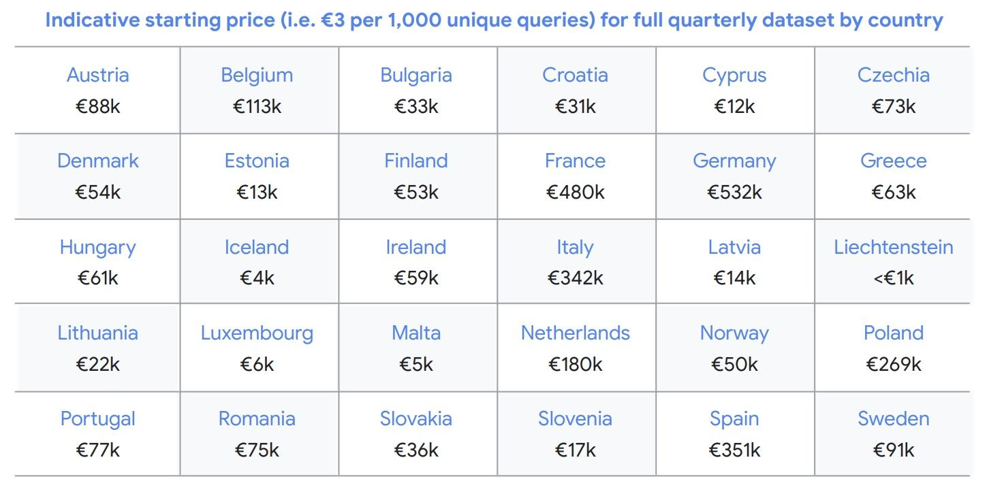
Pricing Flexibility

Slide 26
Delivery of the Dataset
Frequency
Data is aggregated over a quarter and released after the end of the following quarter, e.g., 2024 Q1 data is released on 1 July 2024
Format
The data is provided in the JSON open standard format
Delivery method
Licensees will be able to download the data via Google Cloud

Slide 27
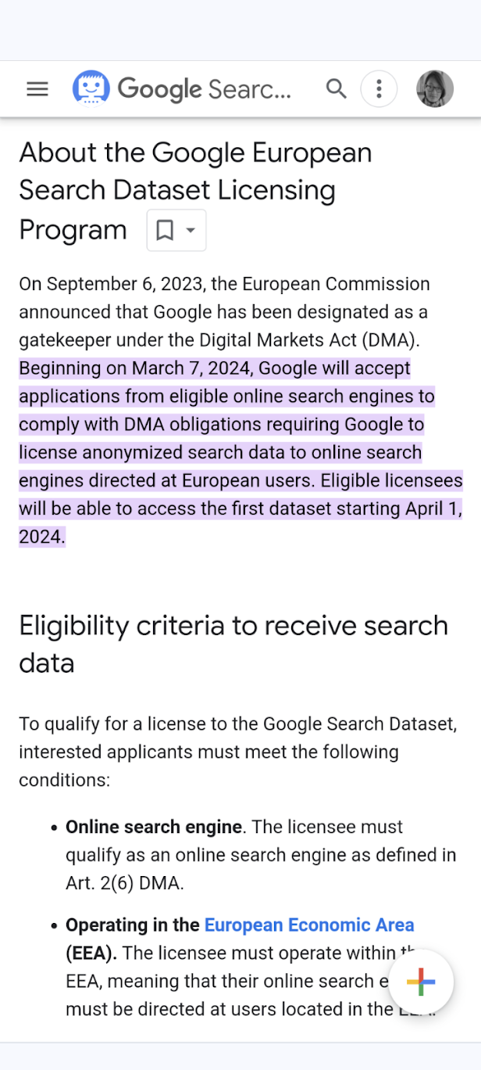
How to Apply & Eligibility
How to apply for a licence and eligibility criteria
Participation in Google’s European Search Dataset Licensing Program is subject to contract
Application for a licence is easy and straightforward. To indicate interest to take a licence and for further information on the licensing process contact:
ESDLP-partnerships@google.com
To qualify for a licence, interested licensees must meet the following conditions:
Qualify as an online search engine under Art. 2(6) DMA operating in the EEA
Have a track record of safeguarding user data to a high standard
Establish that it is financially viable
No connection to non-EEA state actors
No Search Engine Optimization (SEO) business
The application process is open, and the first dataset will be made available from 1 April 2024

Slide 28
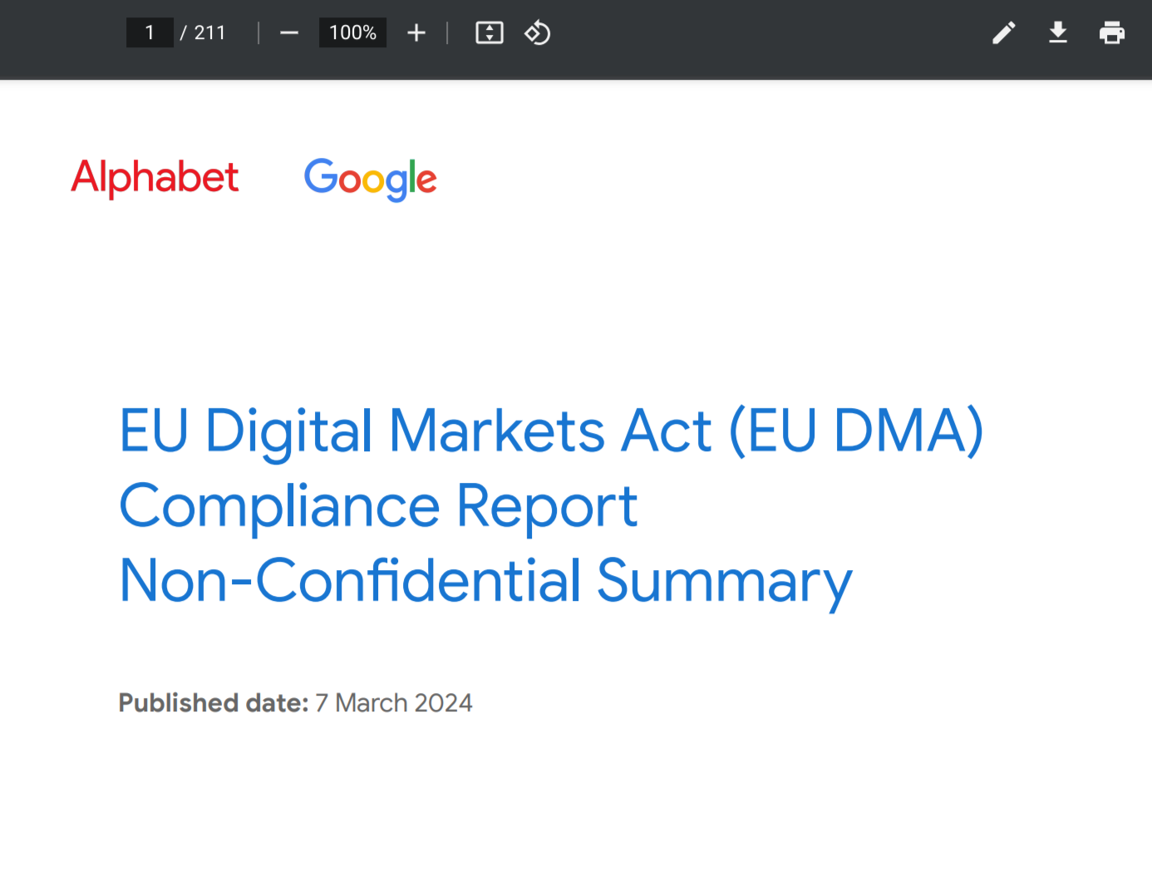
Public Resources
Compliance Report
Search Chapter
PDF Download Center
Google Transparency Report
General Support Page for Interested Parties
Google European Search Dataset Licensing Program
Contact Information to Express Interest
ESDLP-partnerships@
google.com
Questions on Privacy & Anonymization
ESDLP-privacy@
google.com

Slide 29
Thank you!

Slide 30
Regulatory landscape - Platforms
Rules of engagement
Always state your name and organisation (in room and via slido)
Questions and comments should be
clear and short = 2 min max,
relevant and on-topic of the specific DMA obligation,
constructive.
One question or comment per intervention
Online questions and comments via: https://app.sli.do/event/dC4mpnSDsJKepsfEQx91B6
slido.com - # 3029563

Slide 31
Coffee break

Slide 32
Session 2
Google Play (Articles 5(4), 5(7) and 6(4) DMA)

Slide 33
Art. 5(4) DMA
“The gatekeeper shall allow business users, free of charge, to communicate and promote offers, including under different conditions, to end users acquired via its core platform service or through other channels, and to conclude contracts with those end users, regardless of whether, for that purpose, they use the core platform services of the gatekeeper.”

Slide 34
Article 5(7)
“The gatekeeper shall not require end users to use, or business users to use, to offer, or to interoperate with, an identification service, a web browser engine or a payment service, or technical services that support the provision of payment services, such as payment systems for in-app purchases, of that gatekeeper in the context of services provided by the business users using that gatekeeper’s core platform services.”

Slide 35
Article 6(4)
“The gatekeeper shall allow and technically enable the installation and effective use of third-party software applications or software application stores using, or interoperating with, its operating system and allow those software applications or software application stores to be accessed by means other than the relevant core platform services of that gatekeeper. The gatekeeper shall, where applicable, not prevent the downloaded third-party software applications or software application stores from prompting end users to decide whether they want to set that downloaded software application or software application store as their default. The gatekeeper shall technically enable end users who decide to set that downloaded software application or software application store as their default to carry out that change easily.
The gatekeeper shall not be prevented from taking, to the extent that they are strictly necessary and proportionate, measures to ensure that third-party software applications or software application stores do not endanger the integrity of the hardware or operating system provided by the gatekeeper, provided that such measures are duly justified by the gatekeeper.
Furthermore, the gatekeeper shall not be prevented from applying, to the extent that they are strictly necessary and proportionate, measures and settings other than default settings, enabling end users to effectively protect security in relation to third-party software applications or software application stores, provided that such measures and settings other than default settings are duly justified by the gatekeeper.”

Slide 36
EC Alphabet Workshop
DMA Art. 6(4), 5(7), 5(4)
Google Play / Android
March 21, 2024

Slide 37
Third-party apps and app stores on Android

Slide 38
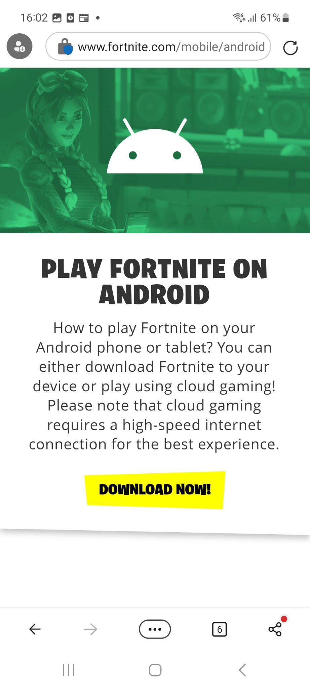
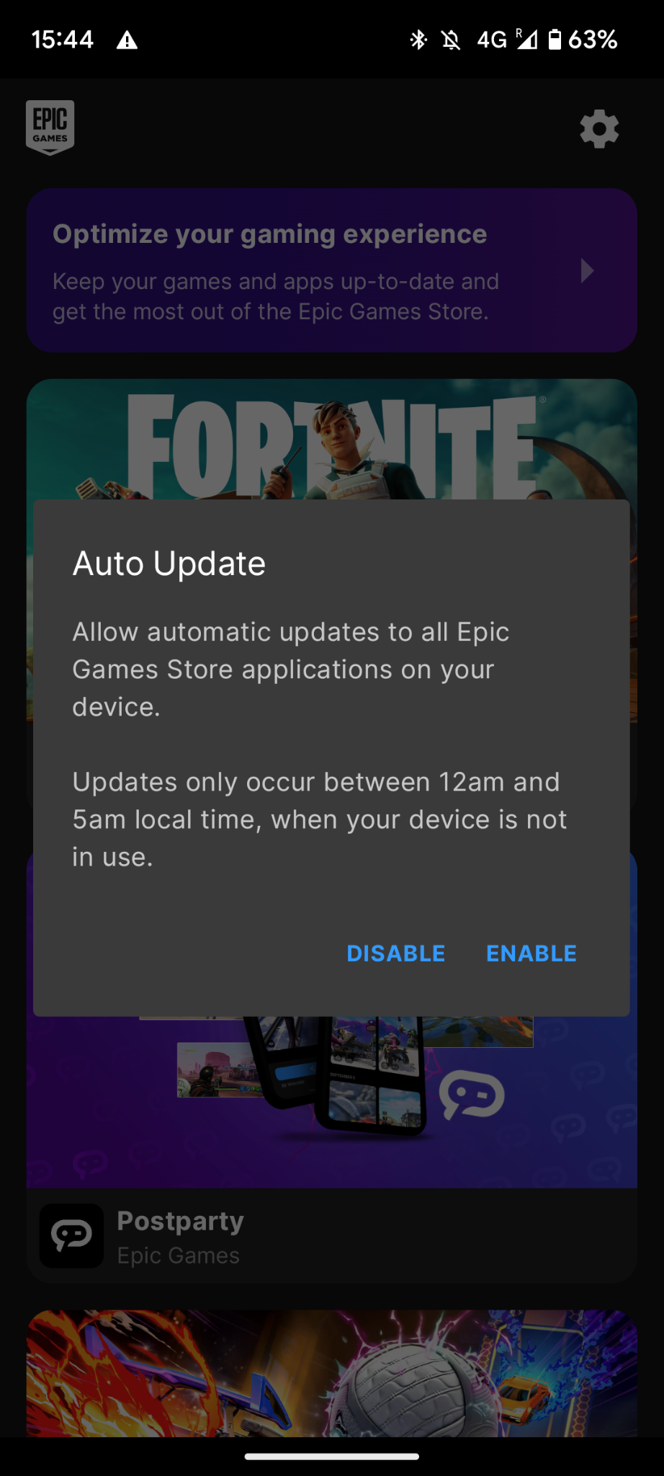
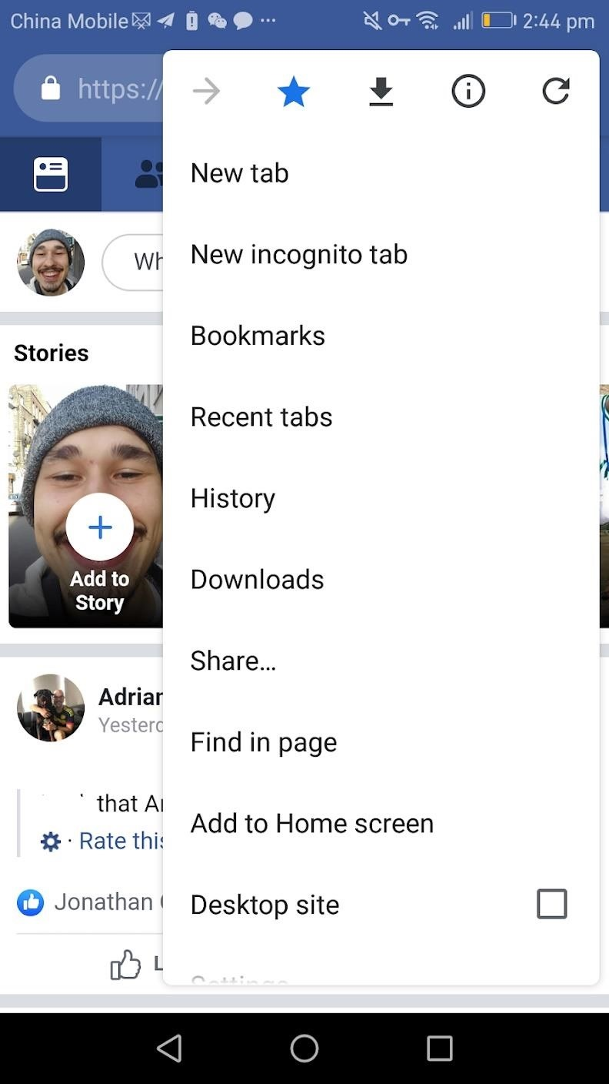
Android provides multiple opportunities for developers to distribute apps
We allow 3P app stores without charge
We allow sideloading without charge
We allow automatic updates of sideloaded apps and app stores
We allow Progressive Web Apps

Slide 39
Alternative Billing Systems

Slide 40
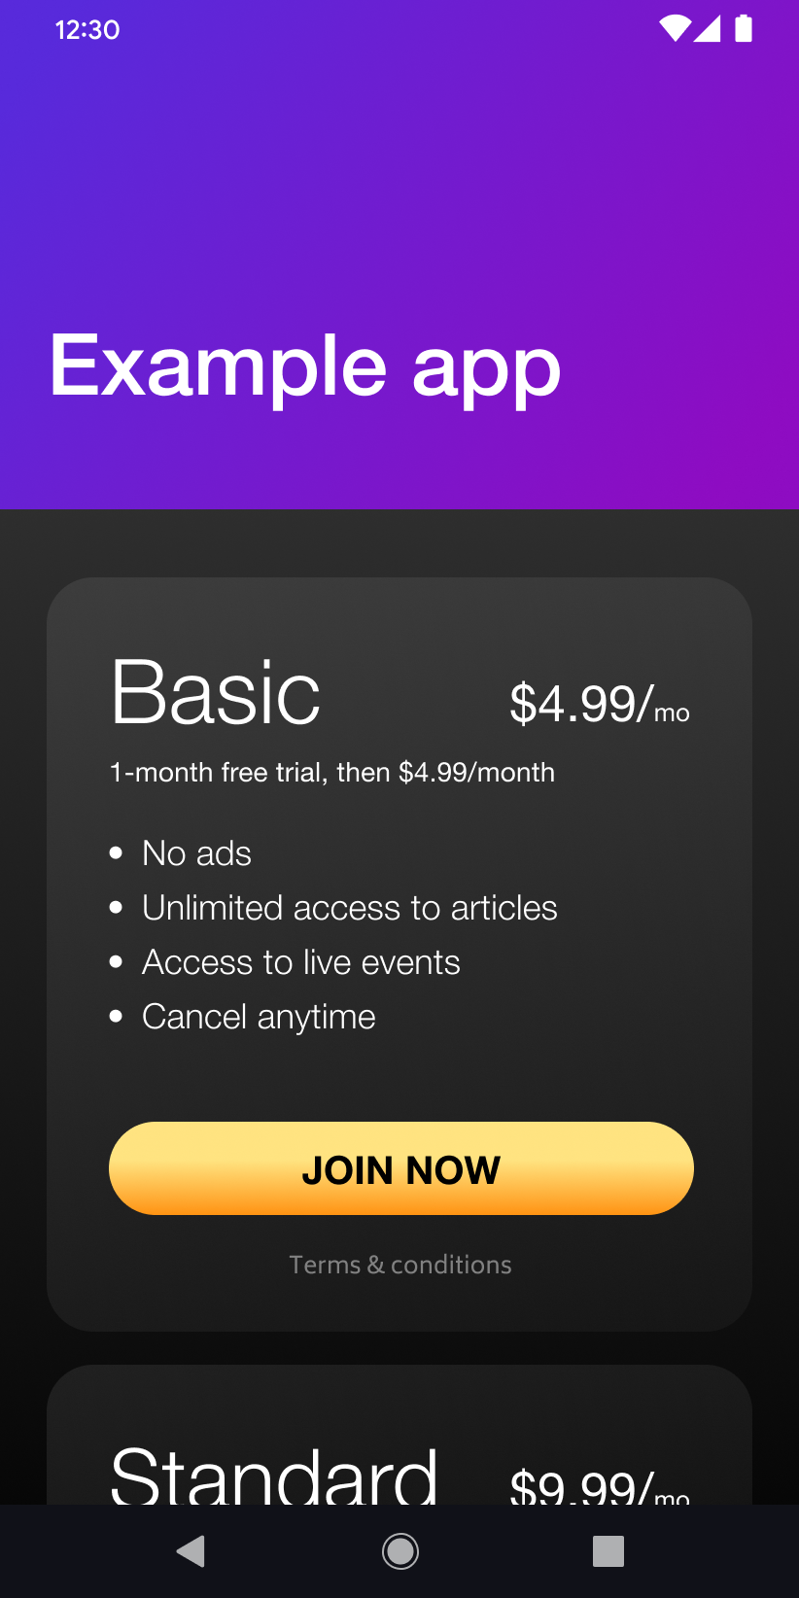
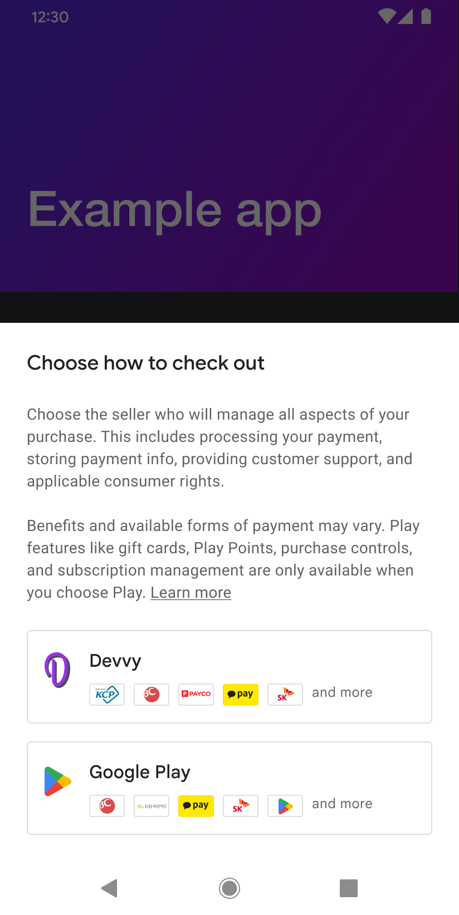
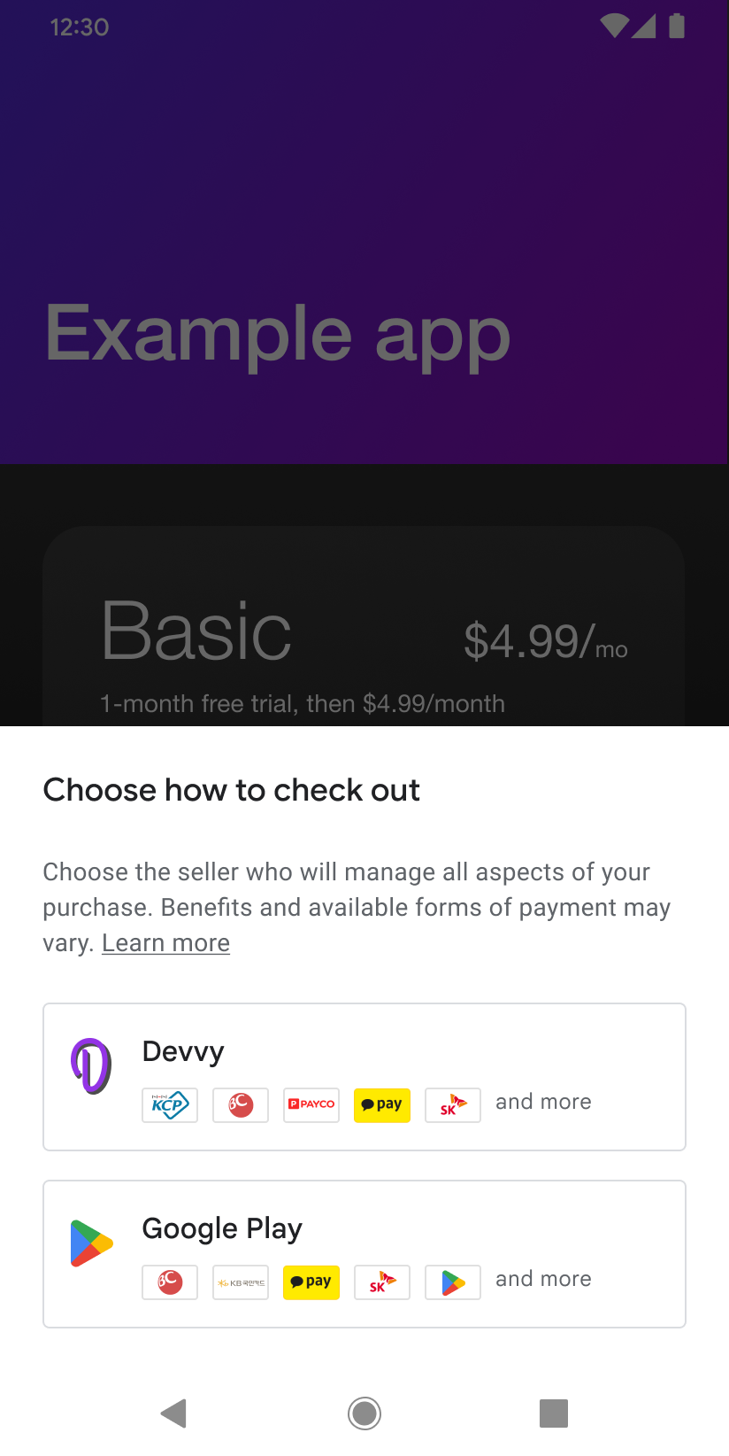
Developers can choose alternative billing systems and mix & match
User Choice Billing Program
This allows developers to offer their own billing system alongside Google Play Billing.
The EEA Program
Eligible developers can choose to offer their users only their own billing system, with no option to use Google Play Billing.
Combined info + choice (first time)
Combined info + choice (onwards)
Info screen shown first time only

Slide 41
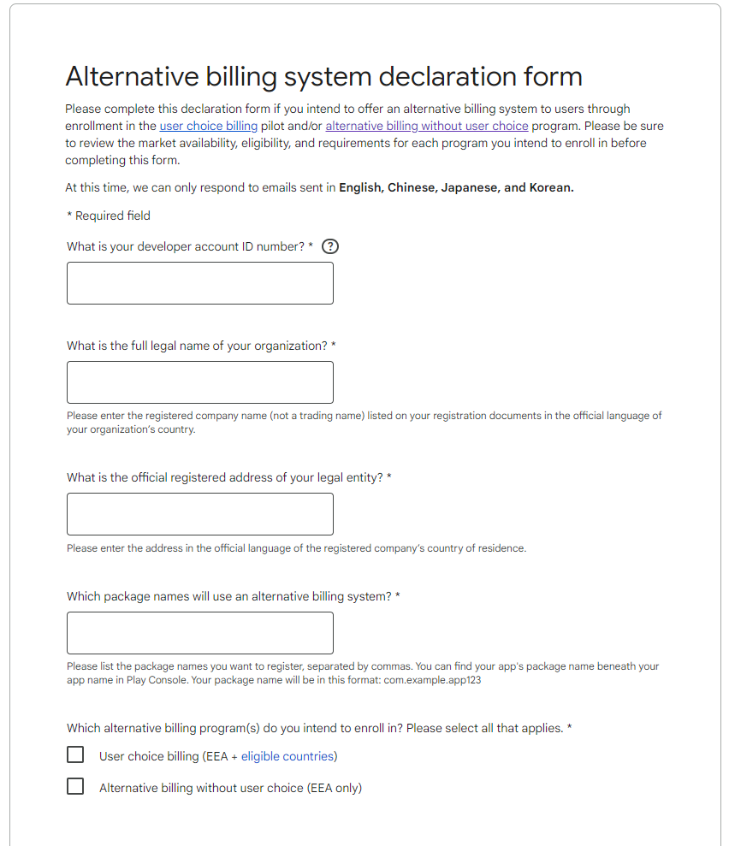
How can developers sign up for Google’s alternative billing programs?
App developers that are interested in participating in Google’s alternative billing programs can find out more information and sign up at:
The User Choice Billing program:
https://support.google.com/googleplay/android-developer/answer/13821247
The EEA program:
https://support.google.com/googleplay/android-developer/answer/12348241

Slide 42
In-app promotions of external offers

Slide 43
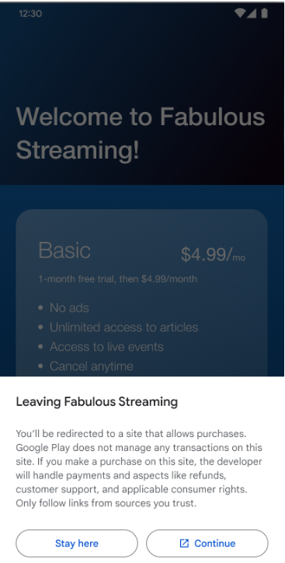
We enable developers to show in-app promotions of external offers
We have created an External Offers Program that enables developers to promote external offers within their apps
Developers have broad freedom to design in-app promotions that can lead users outside the app via hyperlinks (linkouts)
Developers can show multiple linkouts to different destinations
Developers are free to decide whether to show linkouts at the user level: developers can choose to show linkouts only to certain users

Slide 44
Our fee model for the External Offer Program provides developers with great flexibility
Fees for auto-renewing subscriptions
Period | Auto renewing fees
Within two years of initial acquisition of the user | Initial acquisition fee of 5% + Ongoing Services fee of 7%
After two years of initial acquisition of the user | If dev retains Play’s ongoing services: 7% If dev opts out of Play’s ongoing services: 0%
No fixed upfront fees
No perpetual fees
Initial acquisition fee ends after 2 years
Opt-out for ongoing service fee
No fees charged for non-Play apps
Fees for other digital content that is consumable in the app
Period | Fee charged
Within two years of initial acquisition of the user | Initial acquisition fee of 10% + Ongoing Services fee of 17%
After two years of initial acquisition of the user | If dev retains Play’s ongoing services: 17% If dev opts out of Play’s ongoing services: 0%

Slide 45
Play provides value via its trusted environment where users and developers can transact in confidence
Security framework that keeps users and developers safe. In 2022, Play:
Prevented over USD 2 billion in fraudulent and abusive transactions
Prevented 1.43 million policy-violating apps from being published on Play
Blocked 208,000 bad accounts and blocked or disabled over 300 million spam user accounts
Developer tools to test, build, and optimise apps, and to engage, re-engage and monetise users
Apps that use Play’s testing tools have on average three times the amount of app installs and user engagement compared to those that do not
Lifecycle value of Play
Infrastructure to distribute, update, and reinstall apps
Play developers update their apps every single month. On EU mobile devices that have Play installed, Play delivers approximately 18 app updates per week per device

Slide 46
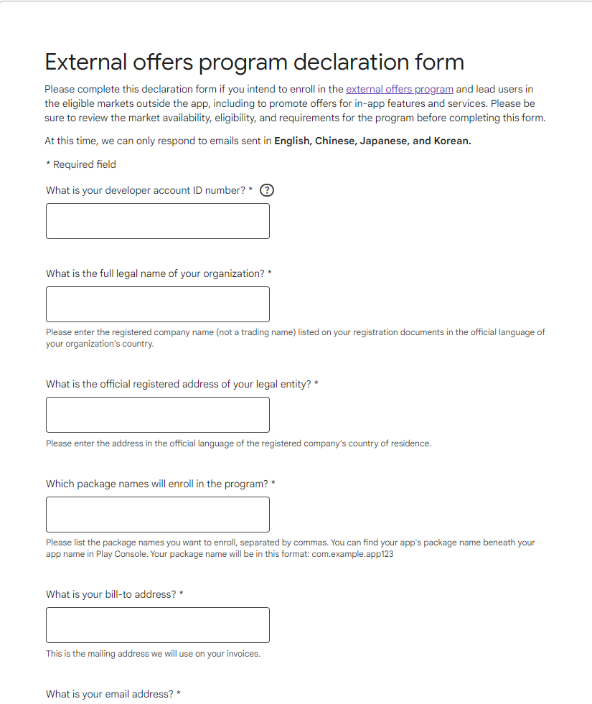
How can developers sign up to the External Offers program?
App developers that are interested in participating in the External Offers program can find out more information and sign up at:
support.google.com/googleplay/android-developer/answer/14539286

Slide 47
Thank you!

Slide 48
Regulatory landscape - Platforms
Rules of engagement
Always state your name and organisation (in room and via slido)
Questions and comments should be
clear and short = 2 min max,
relevant and on-topic of the specific DMA obligation,
constructive.
One question or comment per intervention
Online questions and comments via: https://app.sli.do/event/dC4mpnSDsJKepsfEQx91B6
slido.com - # 3029563

Slide 49
Lunch break

Slide 50
Session 3
Google Search
(Art. 6(5) DMA)

Slide 51
Article 6(5)
“The gatekeeper shall not treat more favourably, in ranking and related indexing and crawling, services and products offered by the gatekeeper itself than similar services or products of a third party.
The gatekeeper shall apply transparent, fair and non-discriminatory conditions to such ranking.”

Slide 52
EC Alphabet Workshop
DMA Art. 6(5)
Google Search
March 21, 2024

Slide 53
Subtractions from Search

Slide 54
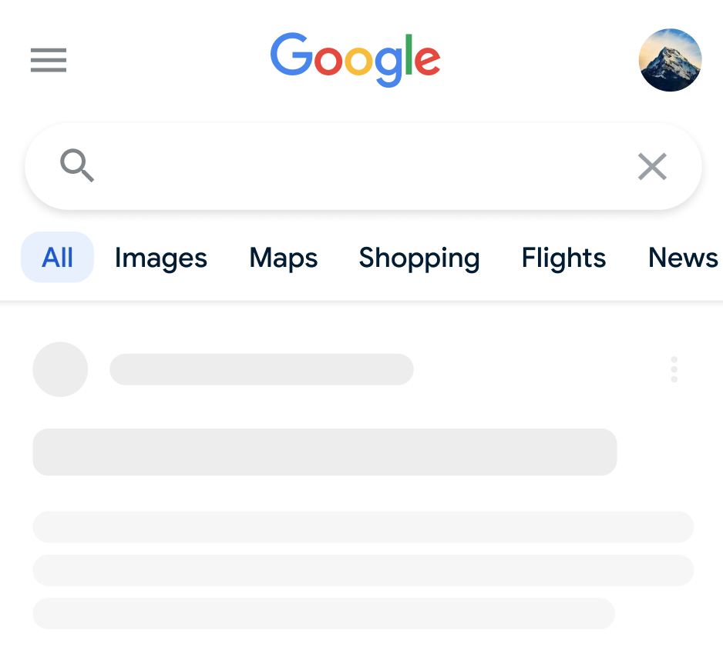
We removed reserved links from Search to Google services
1
No reserved links to separate Google VSSs
2
No links from maps on Search to Google services
3
No separate Google VSS entry point under search bar
No clicks go to Google services
No clicks on the map go to Google services

Slide 55
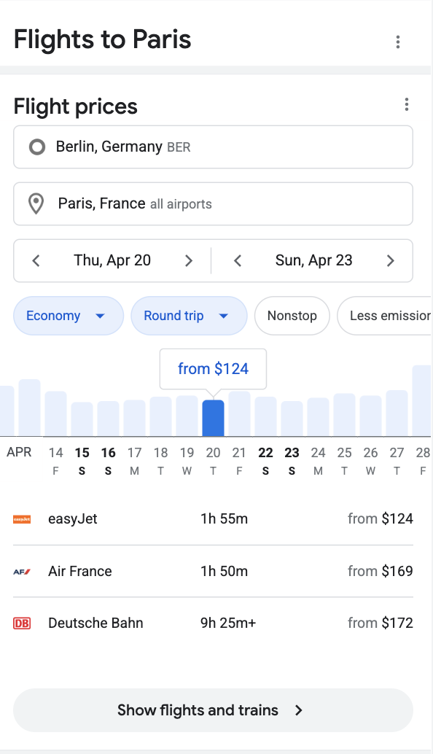
We removed several 1P UIs from Search
Before: 1P Google Flights unit on Search
After: no flights unit
Clicks go to Google Flights service

Slide 56
New Opportunities for VSSs

Slide 57
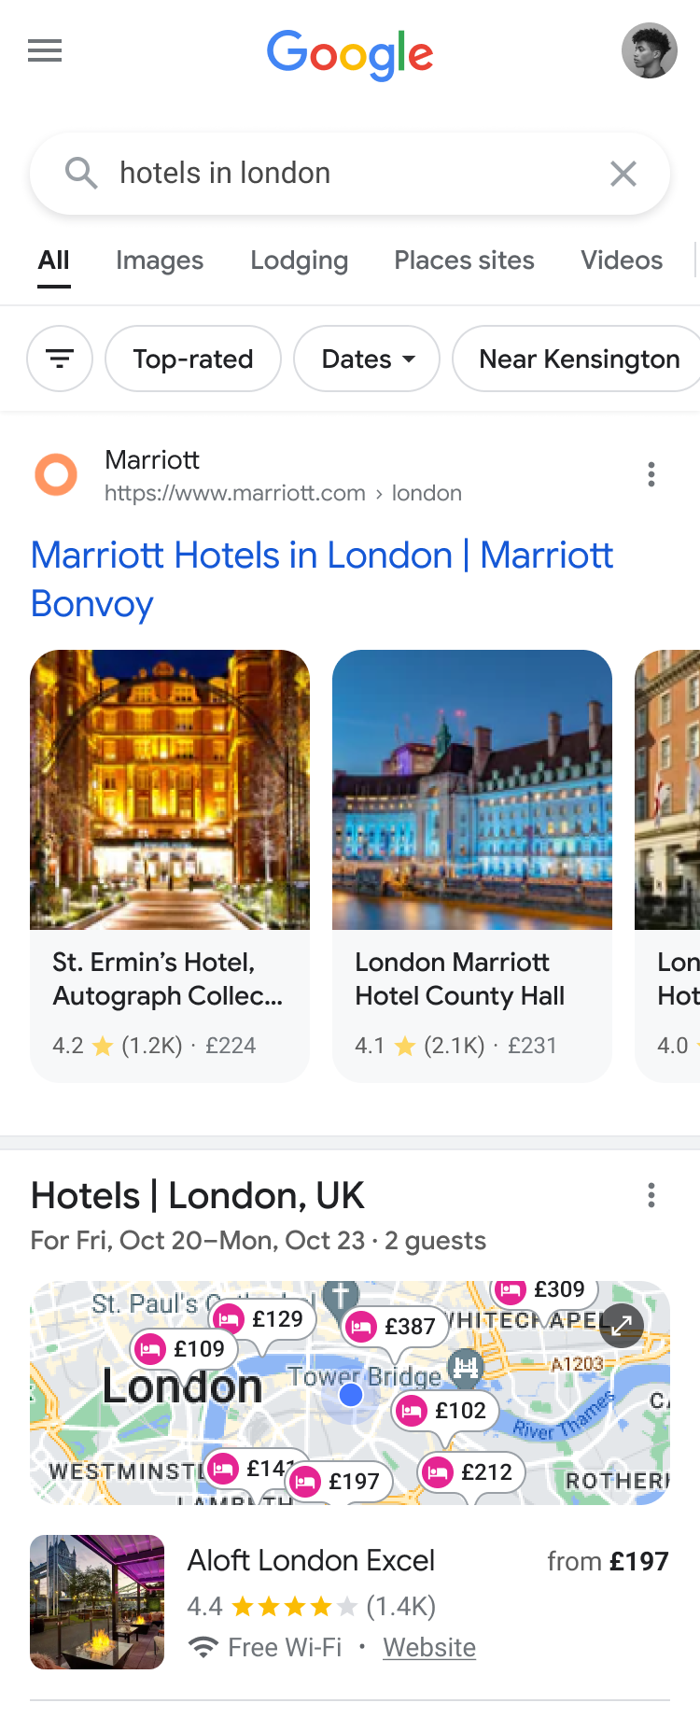
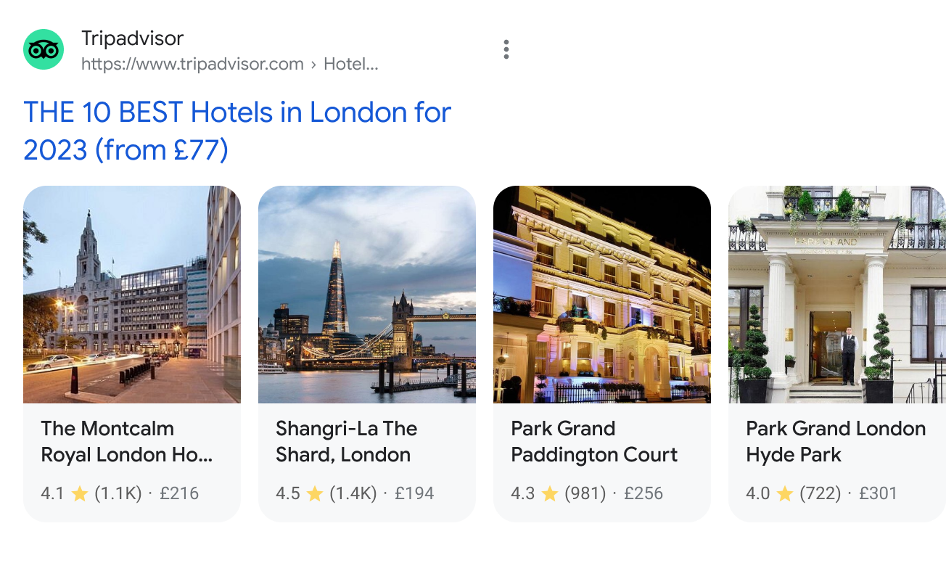
Richer individual results for VSSs

Slide 58
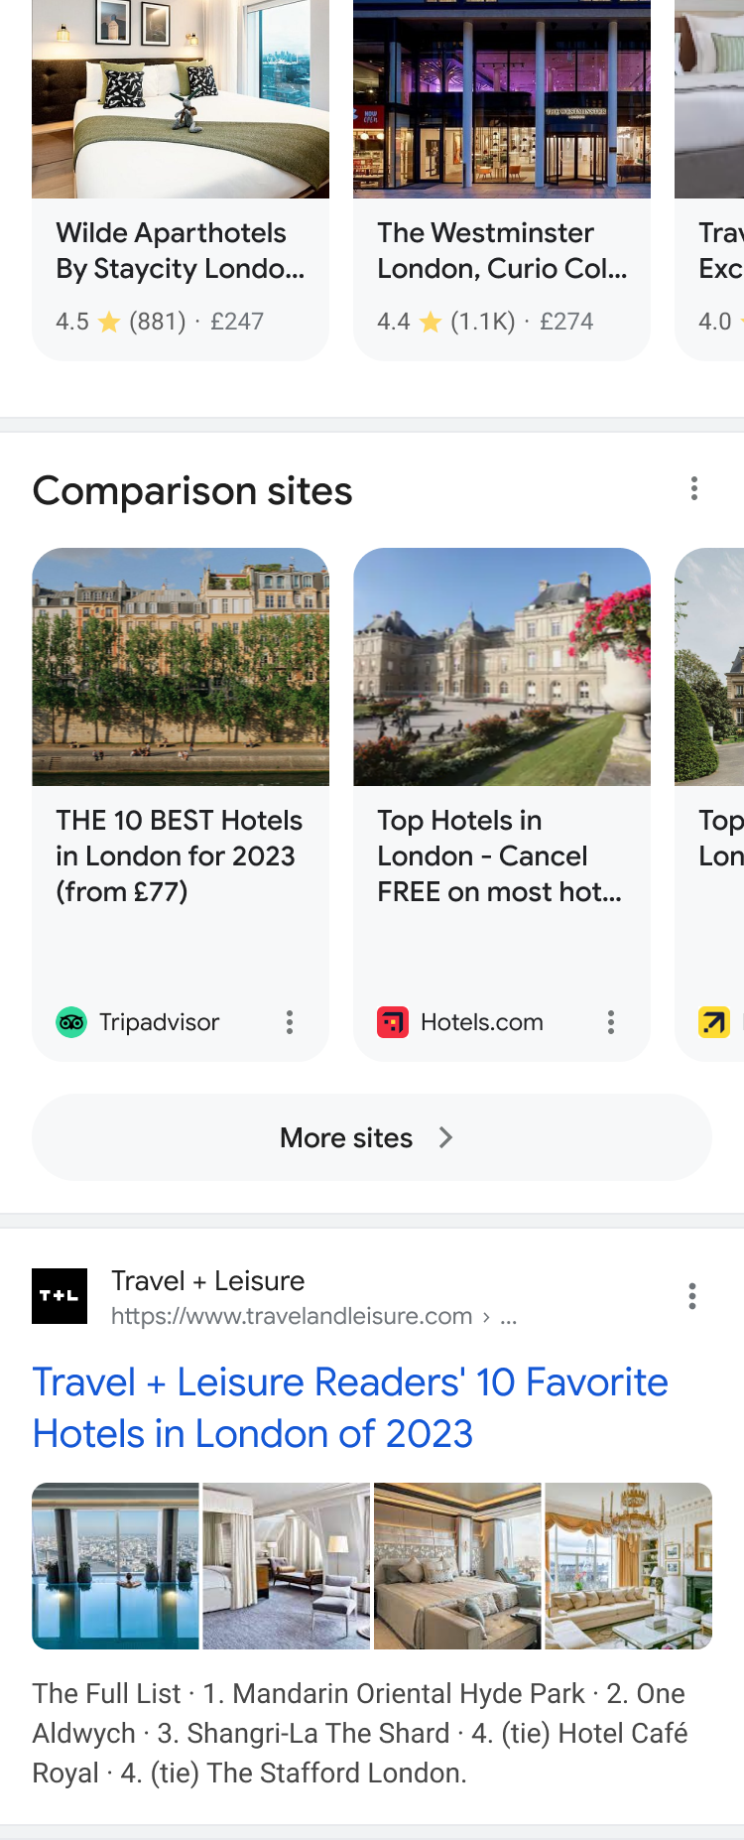
Dedicated unit for VSSs

Slide 59
Ability to focus results on VSSs

Slide 60
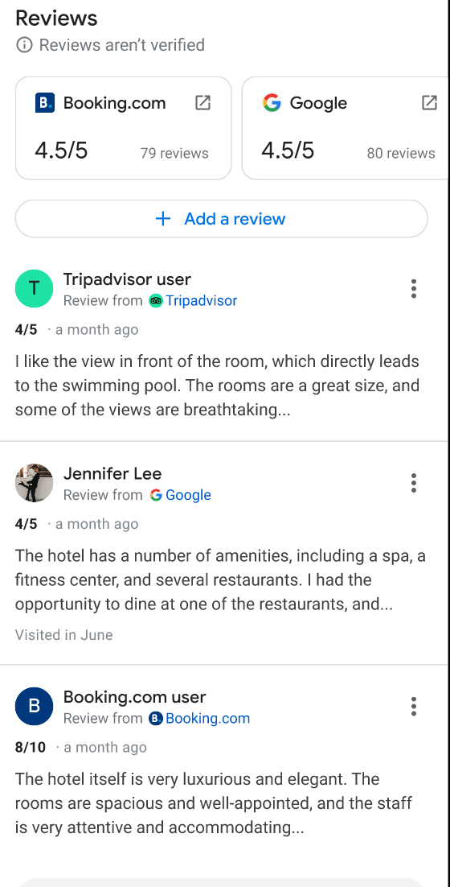
Free results to VSSs on entity result pages

Slide 61
New Opportunities for suppliers

Slide 62
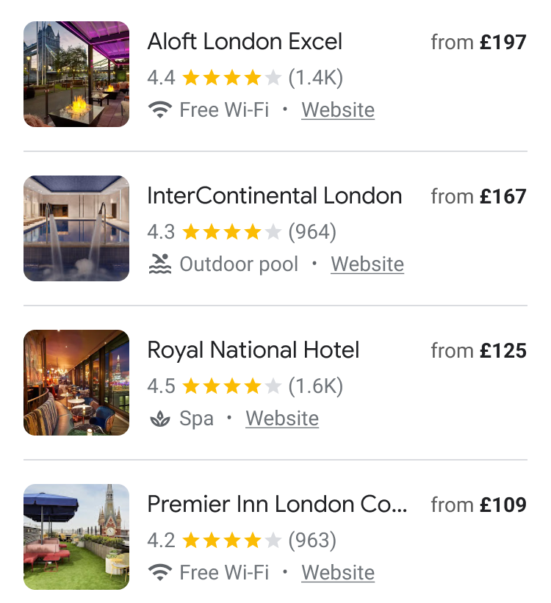
Direct links in entity tiles to suppliers

Slide 63
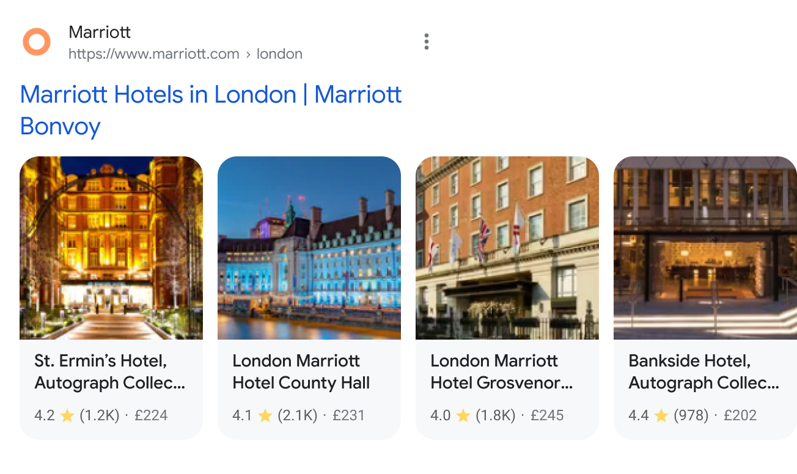
Richer individual results for suppliers

Slide 64
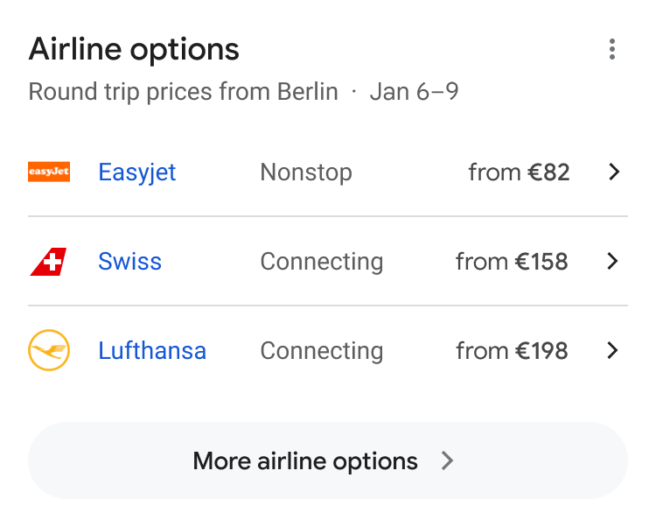
Airlines unit with direct links to airlines

Slide 65
Free results to suppliers on entity result pages

Slide 66
How to participate in the new opportunities

Slide 67
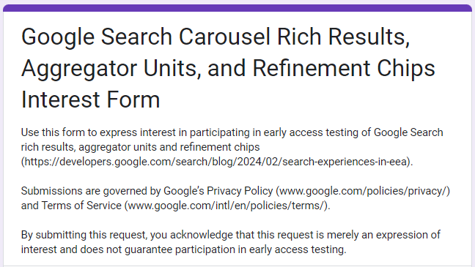
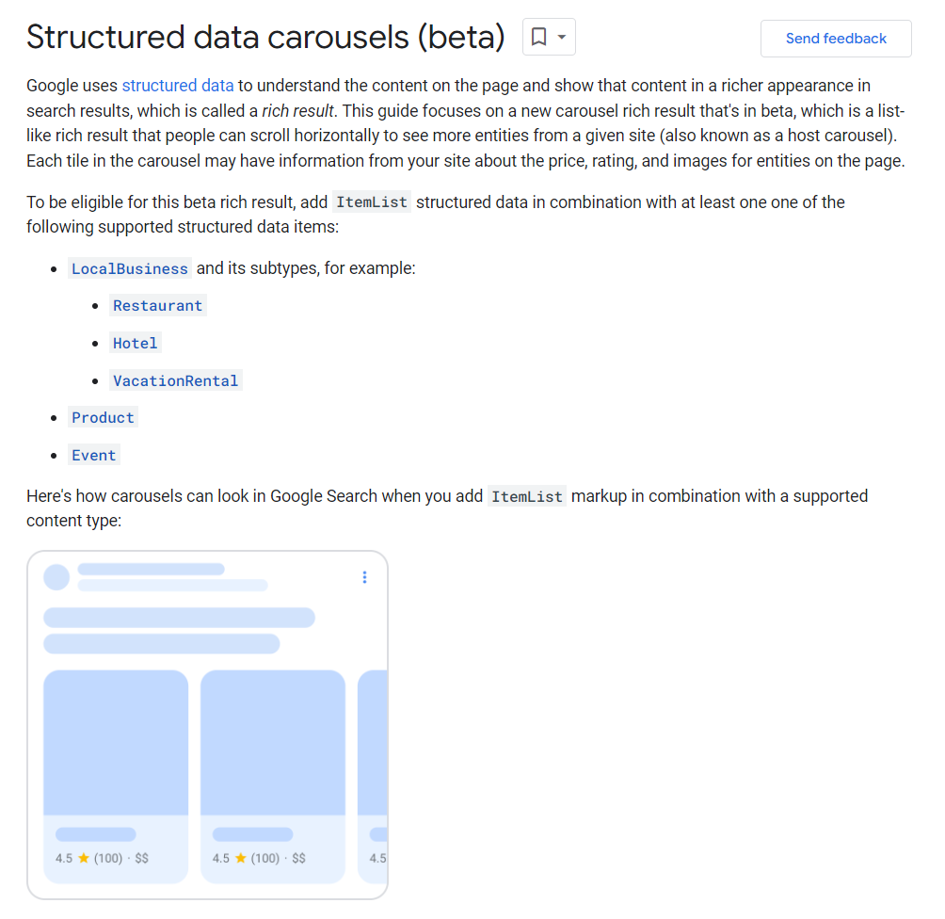
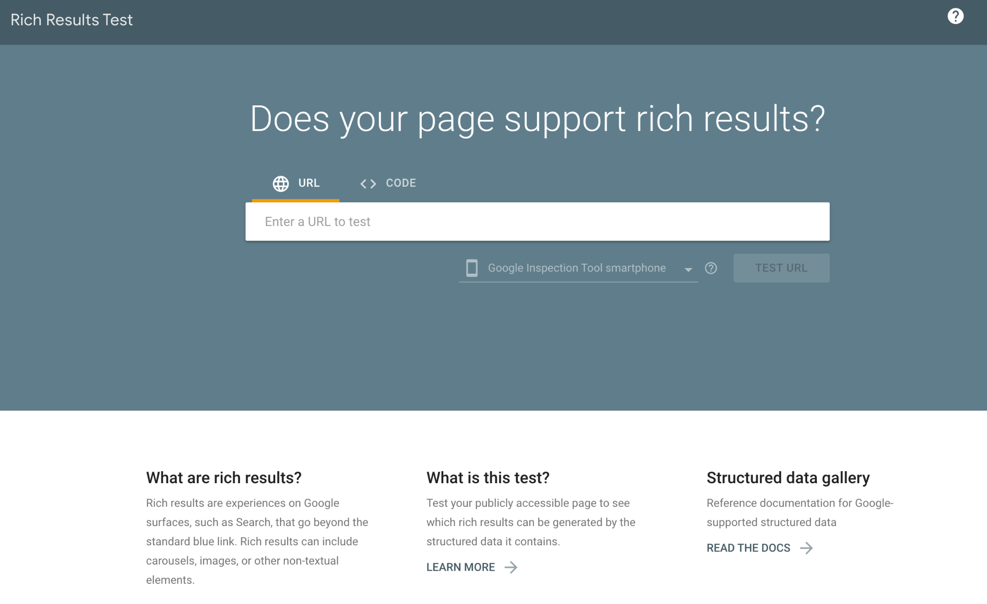
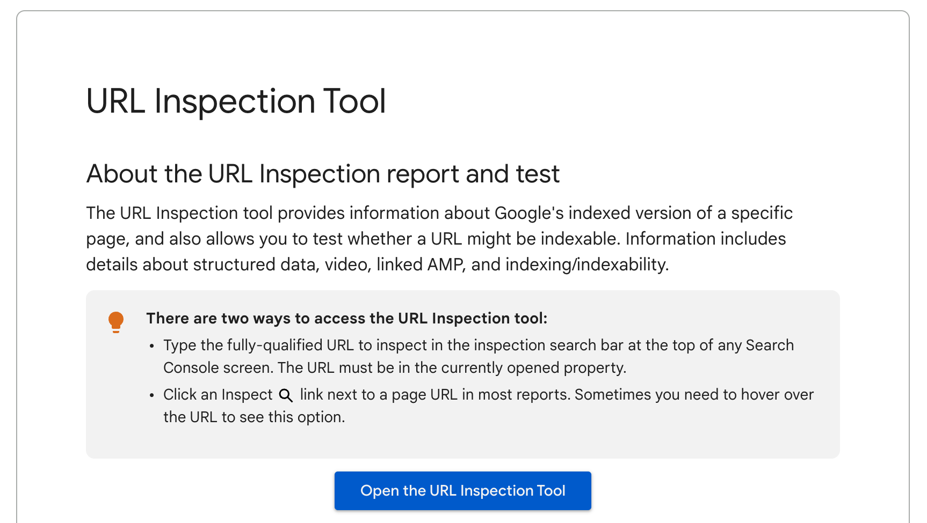
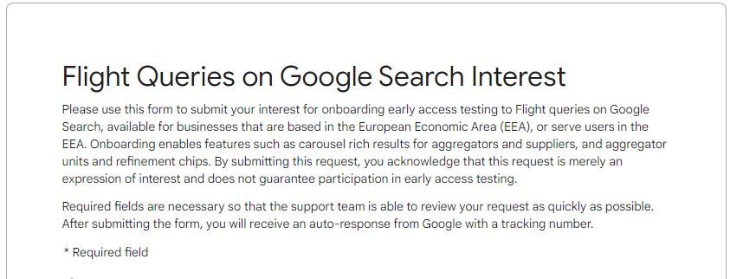
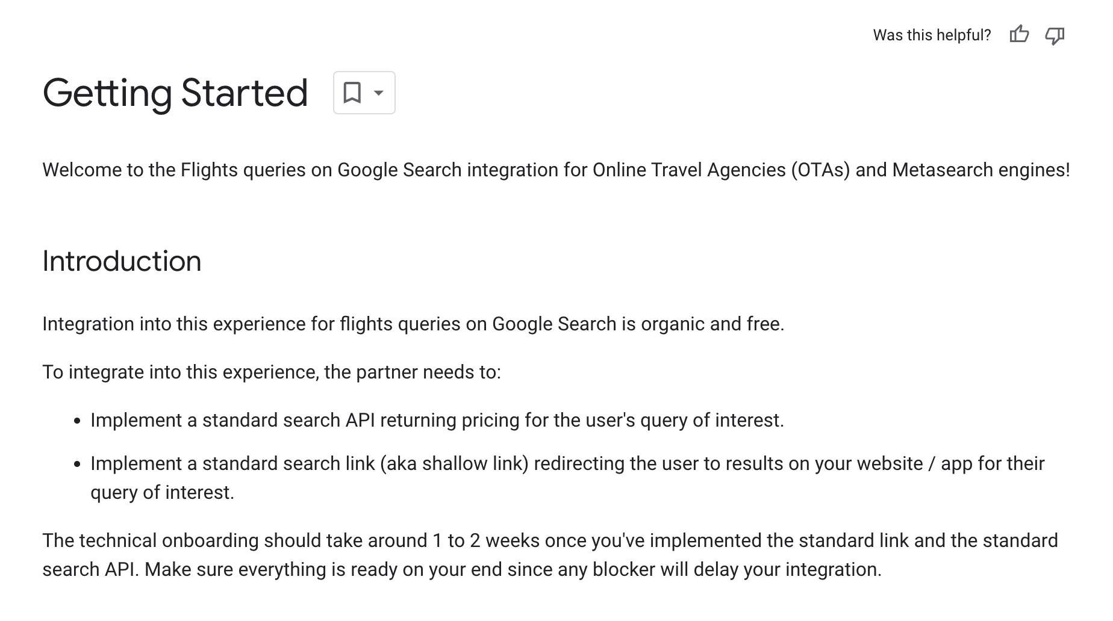
How can VSSs and direct supplier participate in rich web results
Apply via “Interest Form”
Implement structured mark-up / Flights API
Validate changes
Interest forms available at:
docs.google.com/forms/d/e/1FAIpQLSc2sGu__yRl3doNi9AxBY4OuW27rxTyYWlEuSeR2D1AEP1CcA/viewform
support.google.com/travel/contact/flight_queries_interest?sjid=5716008349617401925-EU
Guidance available at:
developers.google.com/search/docs/appearance/structured-data/carousels-beta
https://developers.google.com/travel/flights/search/getting-started
Guidance available at:
https://search.google.com/test/rich-results
https://support.google.com/webmasters/answer/9012289

Slide 68
What happens after VSSs or direct suppliers choose to participate in rich web results
Apply via “Interest Form”
+
Implement structured mark-up / API
+
Validate changes

Slide 69
How can VSSs participate in VSS units
Apply via “Interest Form”
Optional: Structured mark-up / API
No mark-up or API integrations required to participate in VSS units
Optionally mark-up and Flights API integration enables richer formats, like images and prices
Interest forms available at:
docs.google.com/forms/d/e/1FAIpQLSc2sGu__yRl3doNi9AxBY4OuW27rxTyYWlEuSeR2D1AEP1CcA/viewform
support.google.com/travel/contact/flight_queries_interest?sjid=5716008349617401925-EU
Guidance available at:
developers.google.com/search/docs/appearance/structured-data/carousels-beta
https://developers.google.com/travel/flights/search/getting-started

Slide 70
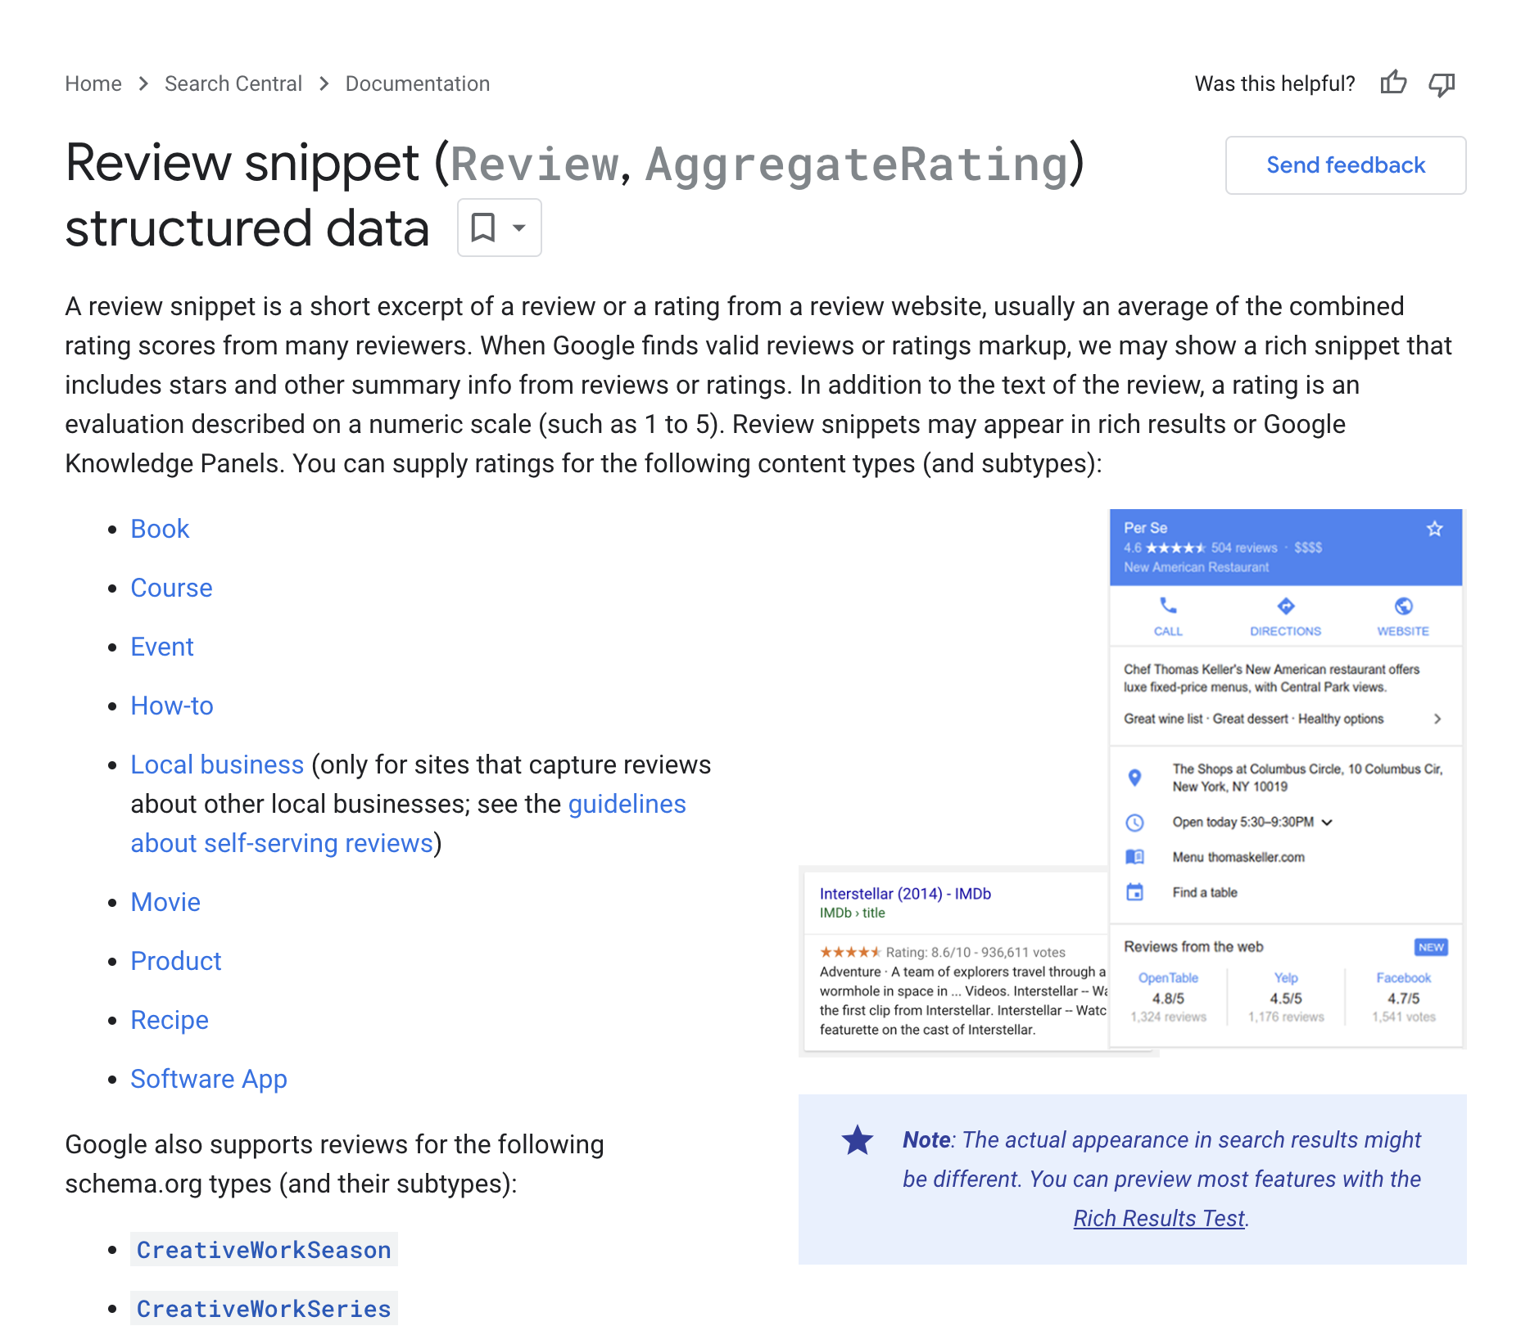
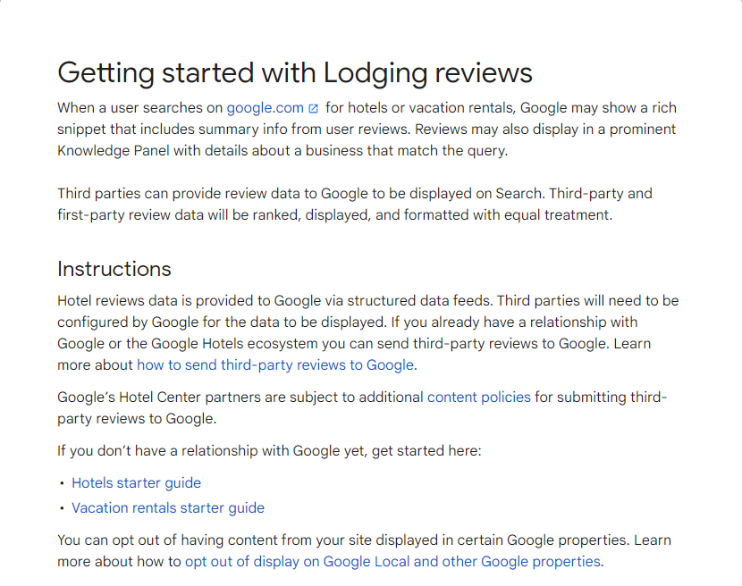
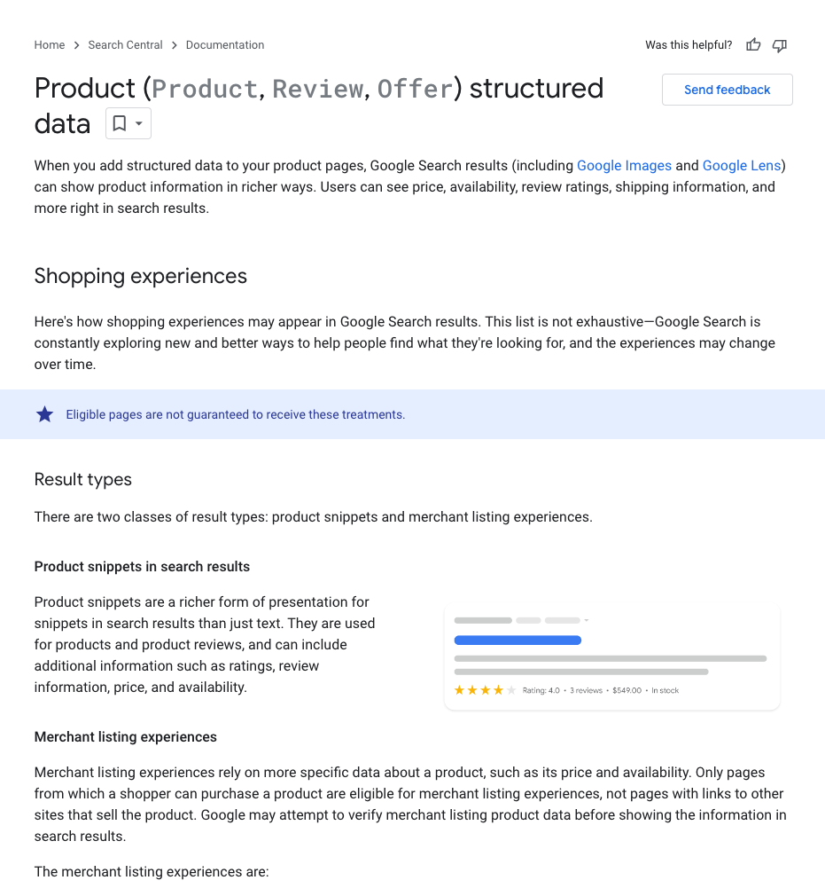
How to participate in results for reviews entity result pages
Provide structured markup
(Local businesses)
Provide structured data feeds (Lodging, Products)
Guidance available at:
developers.google.com/search/docs/appearance/structured-data/review-snippet
support.google.com/hotelprices/answer/14274025
support.google.com/business/answer/14561561
developers.google.com/hotels

Slide 71
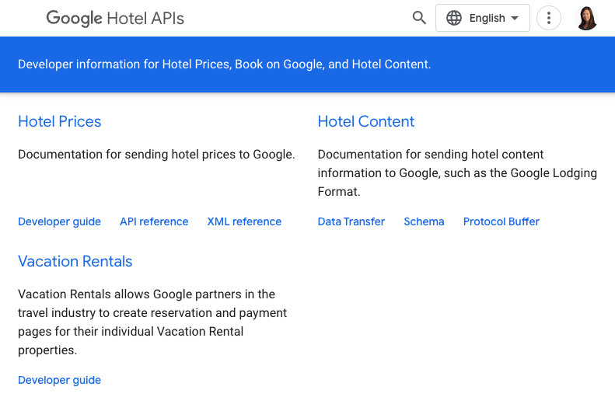
How to participate in results for offers on entity result pages
Provide structured data feeds
Guidance available at:
developers.google.com/hotels
developers.google.com/search/docs/appearance/structured-data/product

Slide 72
How can airlines participate in the airline unit
Apply via “Interest Form”
Guided onboarding with Support
Interest form available at:
support.google.com/travel/contact/flight_queries_interest?sjid=5716008349617401925-EU
Google Support:
The Google Support team will work directly with airlines to help them through the onboarding process.

Slide 73
What happens after providing structured mark-up / data feeds
Provide structured mark-up
for reviews
(Local businesses)
Provide structured data feeds for reviews (Lodging, Products) / offers
Provide structured data feeds for airline prices and schedules

Slide 74
Data feed choice and policies
Partner Choice for Data Feeds
Data Feed Policies
During onboarding and anytime thereafter, Partners can choose whether or not they want their prices, booking links, offers, itineraries or reviews feed data to appear on Google’s vertical search services.
More details are available on Google’s help pages for Lodging | Flights | Products.
All content shown on Google Search is subject to Google Search Spam policies (see Cloaking) which stipulates that content shown on Search must be publicly visible on the partner’s landing page
Additional policies and contractual terms are in place to ensure accuracy of information and prohibition of deceiving, confusing, unsafe, unlawful, or abusive behavior. Lodging | Flights | Products

Slide 75
Public Resources

Slide 76
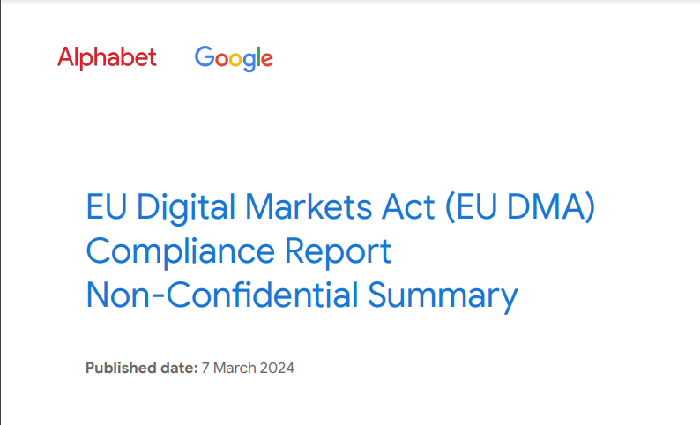
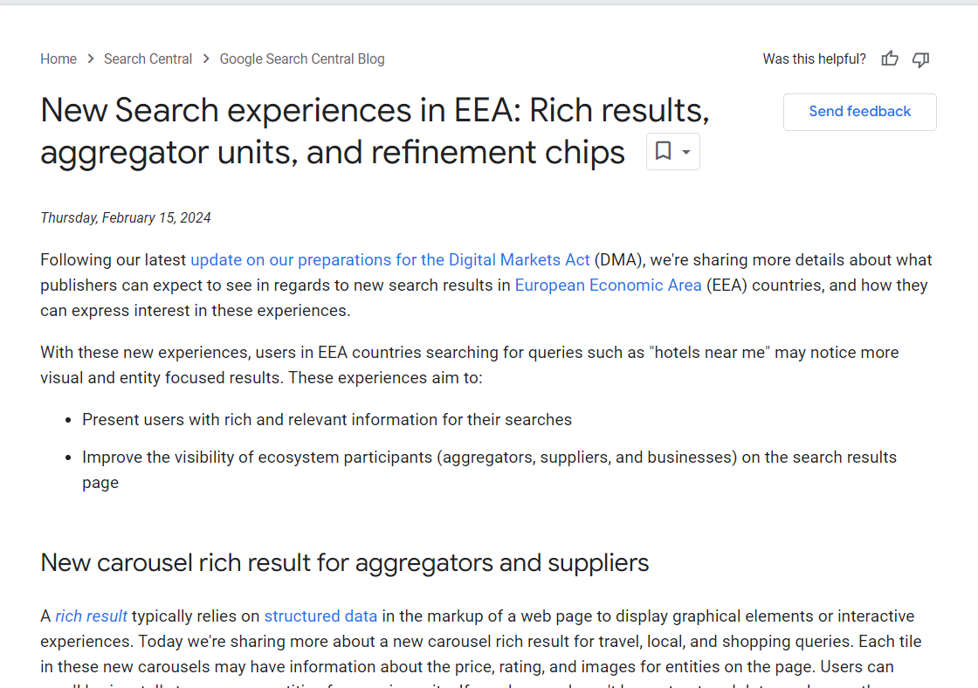
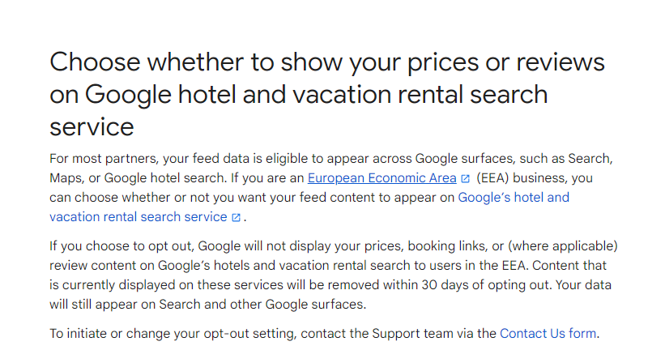
Public Resources
Compliance Report – Search Chapter
PDF Download Center – Google Transparency Report
Rich results, VSS units, and chips:
New Search experiences in EEA: Rich results, aggregator units, and refinement chips | Google Search Central Blog
Carousels (Beta) Structured Data | Google Search Central | Documentation
Reviews:
Getting started with Lodging reviews - Hotel Center Help
Getting started with local business reviews (EU only) - Google Business Profile Help
Data choice options:
Choose whether to show your prices or reviews on Google hotel and vacation rental search service
Choose whether to show your pricing and availability content on Google Flights
How to start showing products on behalf of your merchants

Slide 77
Thank you!

Slide 78
Regulatory landscape - Platforms
Rules of engagement
Always state your name and organisation (in room and via slido)
Questions and comments should be
clear and short = 2 min max,
relevant and on-topic of the specific DMA obligation,
constructive.
One question or comment per intervention
Online questions and comments via: https://app.sli.do/event/dC4mpnSDsJKepsfEQx91B6
slido.com - # 3029563

Slide 79
Coffee break

Slide 80
Session 4
Data-related provisions (Art. 5(2), 6(9) and 6(10) DMA

Slide 81
Art. 5(2) DMA
“The gatekeeper shall not do any of the following:
process, for the purpose of providing online advertising services, personal data of end users using services of third parties that make use of core platform services of the gatekeeper;
combine personal data from the relevant core platform service with personal data from any further core platform services or from any other services provided by the gatekeeper or with personal data from third-party services;
cross-use personal data from the relevant core platform service in other services provided separately by the gatekeeper, including other core platform services, and vice versa; and
sign in end users to other services of the gatekeeper in order to combine personal data,
unless the end user has been presented with the specific choice and has given consent within the meaning of Article 4, point (11), and Article 7 of Regulation (EU) 2016/679.
Where the consent given for the purposes of the first subparagraph has been refused or withdrawn by the end user, the gatekeeper shall not repeat its request for consent for the same purpose more than once within a period of one year.
This paragraph is without prejudice to the possibility for the gatekeeper to rely on Article 6(1), points (c), (d) and (e) of Regulation (EU) 2016/679, where applicable.”

Slide 82
Art. 6(9) and 6(10) DMA
Art. 6(9) DMA: “The gatekeeper shall provide end users and third parties authorised by an end user, at their request and free of charge, with effective portability of data provided by the end user or generated through the activity of the end user in the context of the use of the relevant core platform service, including by providing, free of charge, tools to facilitate the effective exercise of such data portability, and including by the provision of continuous and real-time access to such data.”
Art. 6(10) DMA: “The gatekeeper shall provide business users and third parties authorised by a business user, at their request, free of charge, with effective, high-quality, continuous and real-time access to, and use of, aggregated and non-aggregated data, including personal data, that is provided for or generated in the context of the use of the relevant core platform services or services provided together with, or in support of, the relevant core platform services by those business users and the end users engaging with the products or services provided by those business users. With regard to personal data, the gatekeeper shall provide for such access to, and use of, personal data only where the data are directly connected with the use effectuated by the end users in respect of the products or services offered by the relevant business user through the relevant core platform service, and when the end users opt in to such sharing by giving their consent.”

Slide 83
EC Alphabet Workshop
DMA Art. 5(2), 6(9) & 6(10)
March 21, 2024

Slide 84
Art. 5(2)
Consents

Slide 85
Complying with Art. 5(2) required work on two main pillars
New consent options for EEA users. Compliance requires dedicated designs for front-end consent options.
New consent options supplement existing consent options to ensure a coherent implementation of various legislations and allow users to freely combine the new Art. 5(2) consent options with Google’s existing consent options (e.g., for Ads personalisation, service personalisation, etc).
New infrastructure data controls. We created new types of technical data controls within our data infrastructure, designed specifically for Art. 5(2), to regulate the flow of data from and to relevant services consistent with user consents.

Slide 86
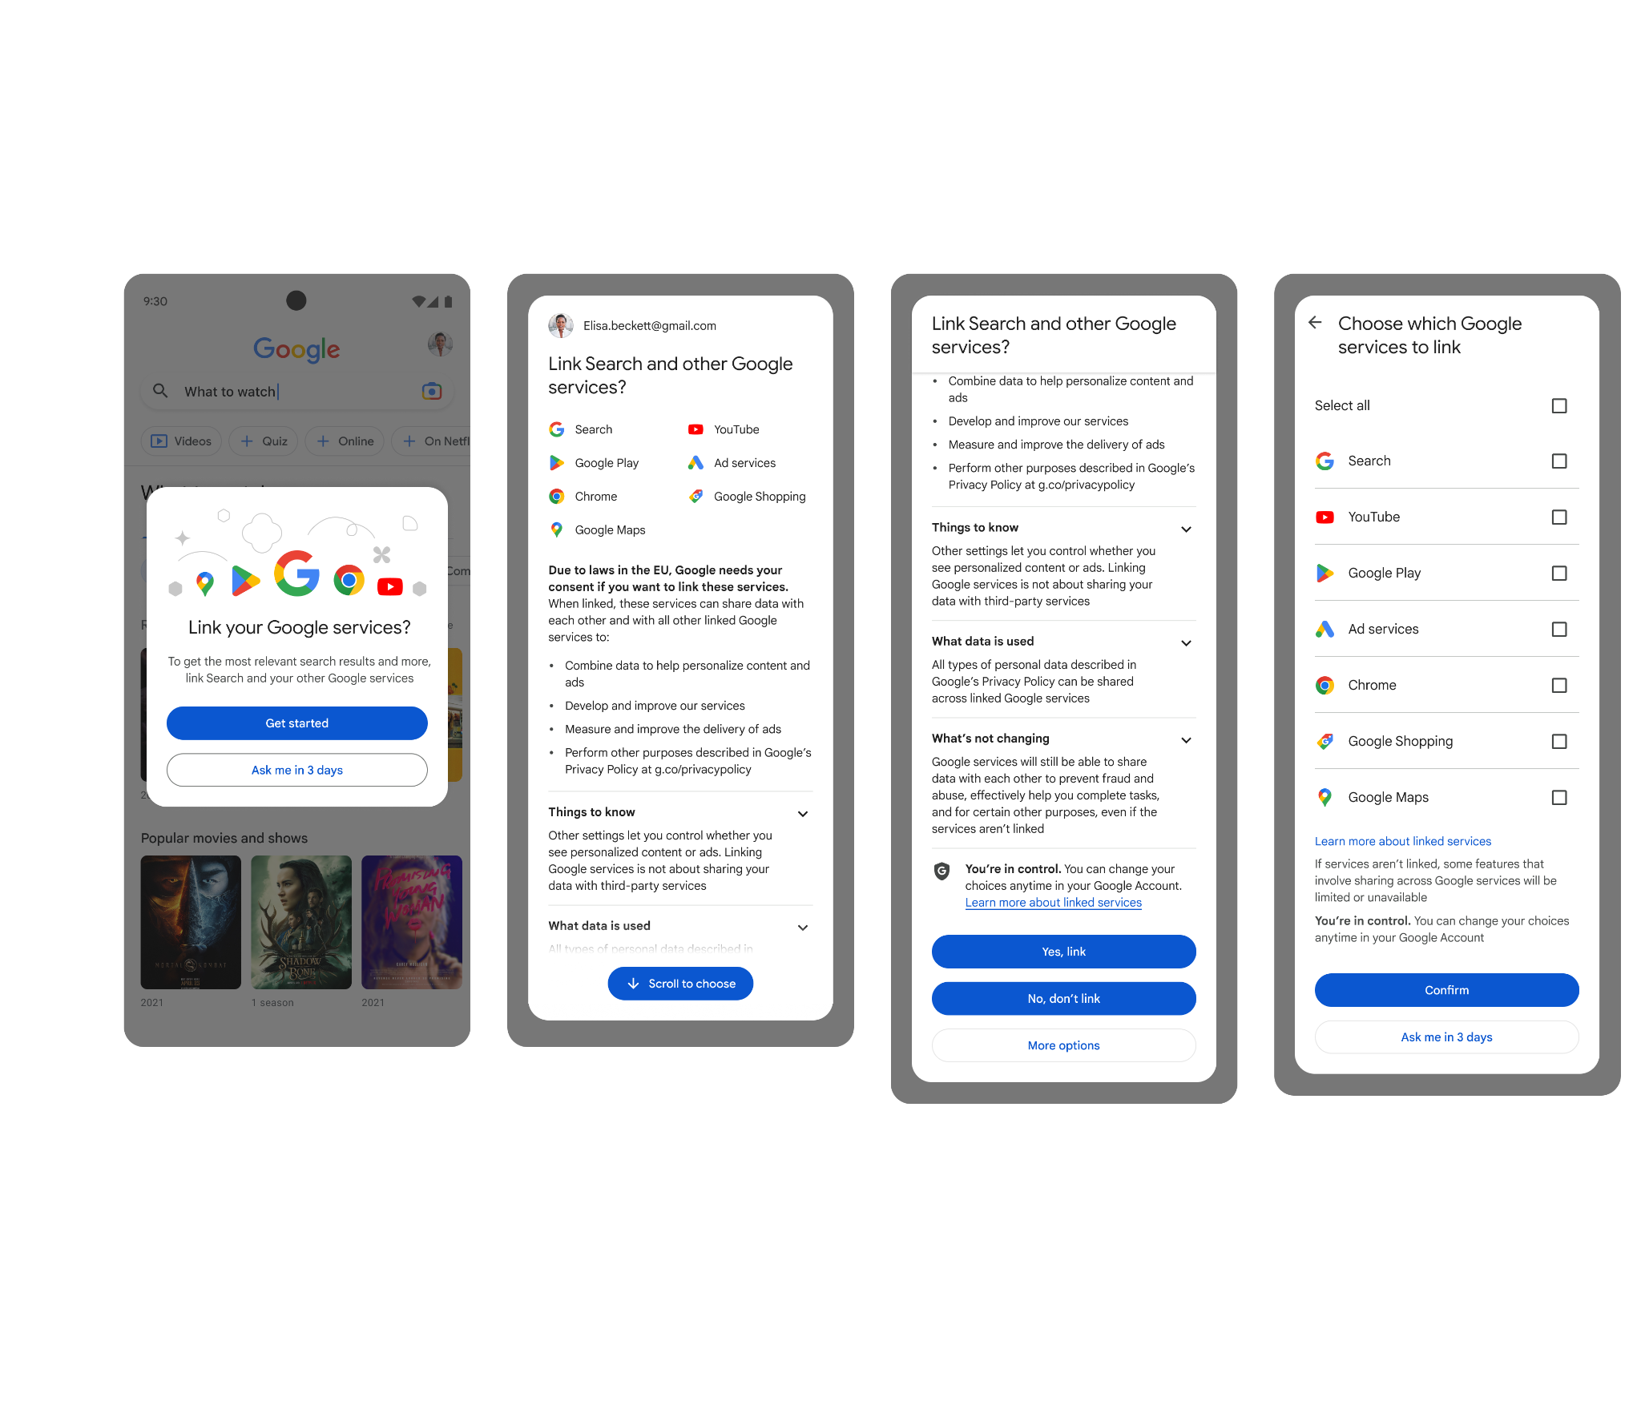
Article 5(2) consent screens
Key principles
Consent is provided on a per-CPS basis, with each CPS operating as a separate data entity by default
New consent options complement existing consent options to ensure a coherent implementation of various legislations
Consent options are transparent, simple, and clear– providing users symmetrical, equally weighted options to reject all, accept all, or customize their choices
Consent is requested before cross-service data processing occurs, and can be revised and revoked at any time via account settings

Slide 87
By default, CPS data is inaccessible to other services
Key principles
Each piece of data collected or otherwise produced by Google products and services is labeled with the service that originated it. Services are defined in line with Commission’s designation decisions
By default, CPSs cannot share data with nor read data from any other Google product or service
Only where an end-user consents, can CPSs share data with and read data from other available Google products and services. In order for data to be exchanged between two CPSs, the user must have consented to cross-service processing for both CPSs involved
Personal data available for cross-service use
(in principle and subject to other controls)
Core Platform Services
Non-CPSs

Slide 88
What this means in practice: imagine the user is planning a trip to Barcelona…
Activities
Searched for barcelona itinerary
Data | Type | Owning service | User id
barcelona itinerary | Query | Search | 0x123
picasso museum | Query | Search | 0x123
Picasso Museum HD | Watch video | YouTube | 0x123
When data is written to storage, the owning service must be specified
Searched for picasso museum
Watched Picasso Museum HD
A storage system
These interactions create data that is associated with the user’s id

Slide 89
Imagine that the user visits YouTube in a fully Art. 5(2) consented state…
Data | Type | Owning service | User id
barcelona itinerary | Query | Search | 0x123
picasso museum | Query | Search | 0x123
Picasso Museum HD | Watch video | YouTube | 0x123
Art
Pablo Picasso
Barcelona
Museu Picasso
Museums
Travel
Inferred from interactions on YouTube
Inferred from interactions on Search

Slide 90
Imagine that the user visits YouTube in a fully Art. 5(2) unconsented state…
Data | Type | Owning service | User id
barcelona itinerary | Query | Search | 0x123
picasso museum | Query | Search | 0x123
Picasso Museum HD | Watch video | YouTube | 0x123
Art
Pablo Picasso
Barcelona
Pablo Picasso
Museu Picasso
Museu Picasso
Museums
Museums
Travel
Inferred from interactions on YouTube
YouTube cannot access the user’s interactions on Search

Slide 91
Benefits of our approach
Over the past 2 years, we’ve been hard at work building a state of the art solution that pairs a new and user friendly consent experience with robust technical controls
The implementation of those controls at low levels of the technical stack drives consistency and, when coupled with compliant defaults, mitigates the risk of missed enforcement points across Alphabet products & services
Our 5(2) controls aren’t limited to personalisation; instead covering all data flows in principle (e.g. product improvement)
We do not charge users that do not wish to provide consent for the use of their data across services. Users can freely decline or grant consent
We do not require users to set up different accounts. Our controls apply at the data point level and keep data of different services separate regardless of whether a user uses the same or different accounts

Slide 92
Art. 6(9)
Data Portability

Slide 93
Google’s long-standing commitment to data portability
Google is a pioneer in data portability.
For over 15 years, Google has been providing free tools that allow for easy user data portability.
59 products in Takeout
Data Liberation Front started
Support for
Exporting to cloud
Takeout launches with 5 products
Data Transfer Project
EAP
DLF publicly announced
Data Portability
API
13 products in Takeout
>80 products in Takeout
2007 | 2008 | 2009 | 2010 | 2011 | 2012 | 2013 | 2014 | 2015 | 2016 | 2017 | 2018 | 2019 | 2020 | 2021 | 2022 | 2023 | 2024

Slide 94
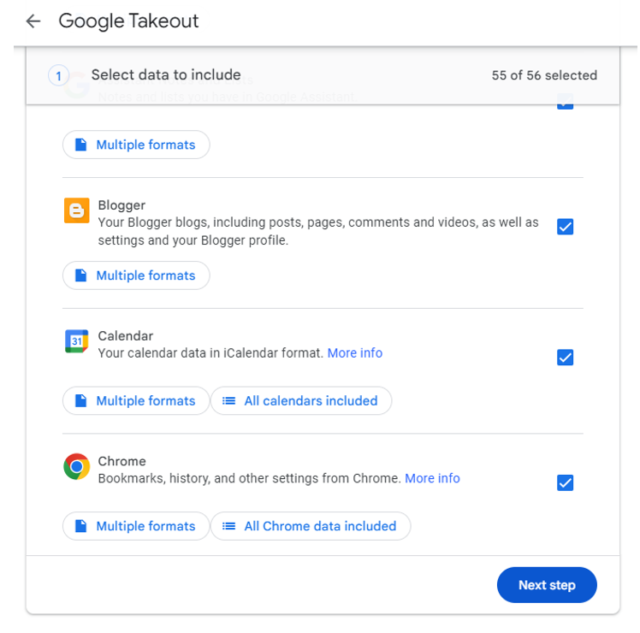
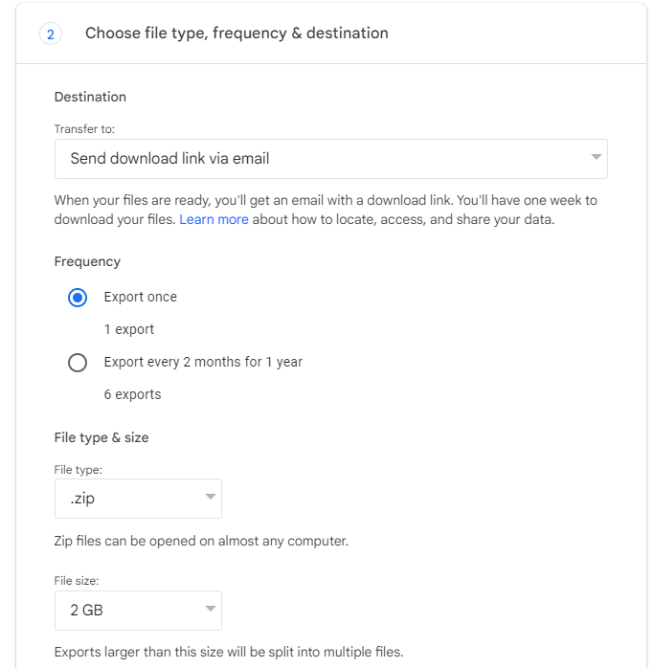
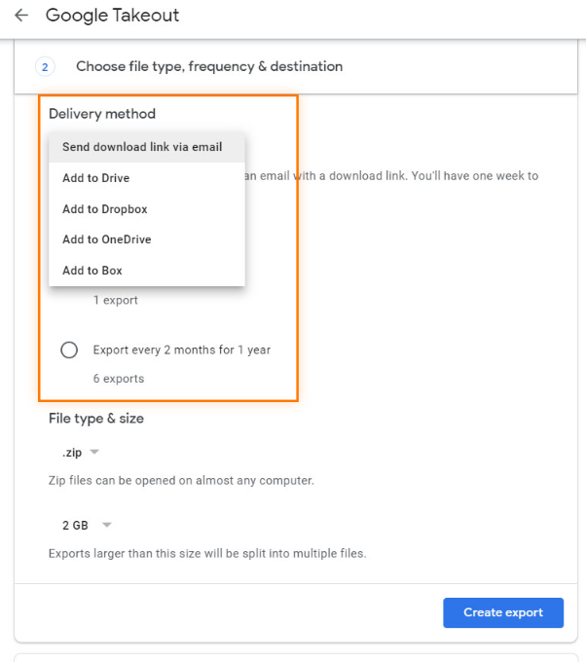
How Takeout works
Google offers a centralised portability tool, Takeout, that:
Allows users to export a copy of their data from over 80 Google products for free
Provides users with several portability options (variety of formats and recurring automatic exports)
Allows users to download their data to their device, save it to their Google Drive or send a copy to third-party storage services

Slide 95
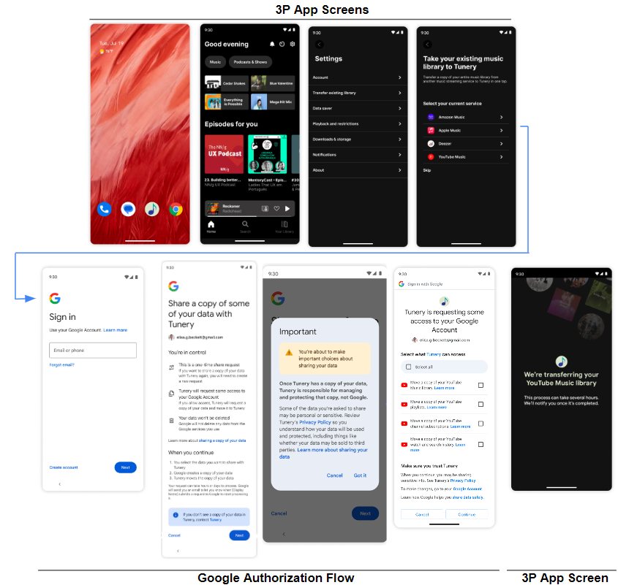
The Data Portability API
We have launched an even easier way for users to share a copy of their data:
The Data Portability API enables direct sharing of user data with authorised third parties.
Third-party developers are subject to Google’s developer verification process. This helps limit the risk the API will be abused.
The API provides a rich developer experience, supported by detailed documentation and easily accessible ways to provide feedback.
The Data Portability API provides end users with a new, powerful way of porting their data in a format developers can readily use.

Slide 96
User & market feedback on the new Data Portability API
We solicited market feedback through various initiatives (EAP, Hackathon, and Beta program) and deep-dive interviews.
Feedback has been markedly positive with comments on the API’s utility and accessibility. We have also heard participants that echo our view of the importance of being thoughtful about security and privacy.
We continue to welcome feedback from users and the market and now also look forward to seeing feedback from the real-world usage of the API.
EAP
Beta
“Sounds like a great feature [with] better exports”
“The documentation has also been really helpful and clear”
General positive reactions from participants & emphasis on the importance of security and privacy
2023 Sep
Dec
2024
Jan
Feb
Deep-dive interviews
The new API works well and there are “a lot of good use cases.” Importance of security again underlined.
Hackathon
Participants built new working app in under 2 hours

Slide 97
Third-party verification process
Abuse Screening
App Verification
App Security
Access Process
Does the developer requesting access to end users’ personal data have a history of abuse?
Is the app requesting data in a clear and transparent way that is in line with its privacy policies?
Is the app technologically secure?
Monitoring Access to the Data Portability API: once a developer gains access to the Data Portability API, Google takes reasonable and proportionate measures to monitor third-party use of the API. In the event of violation or meaningful security concerns, Google may revoke access.
Ongoing monitoring

Slide 98
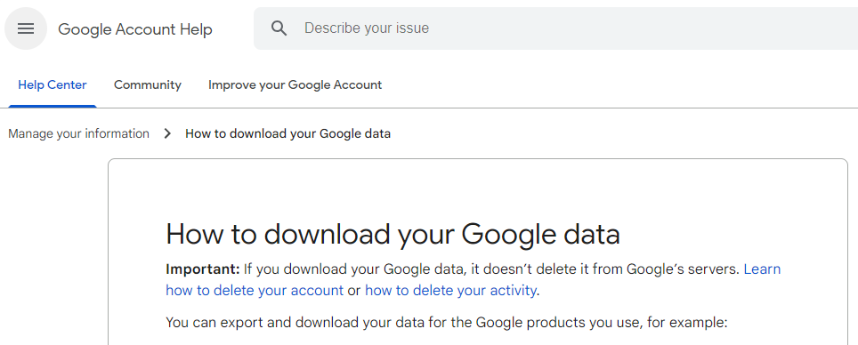
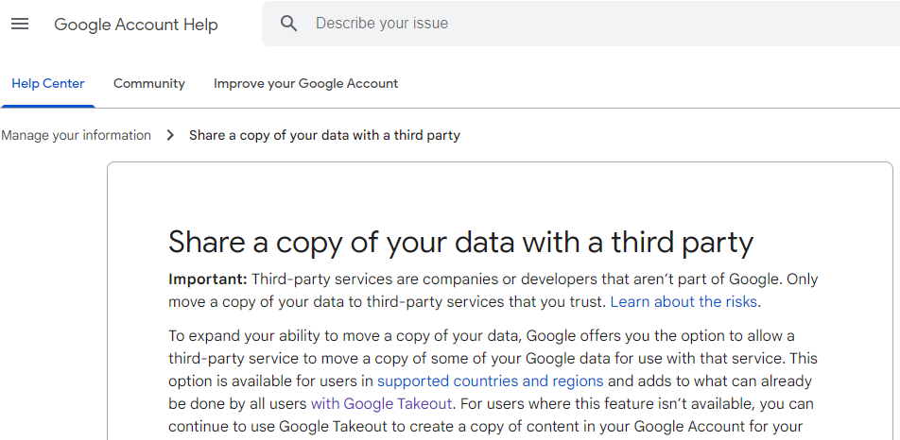
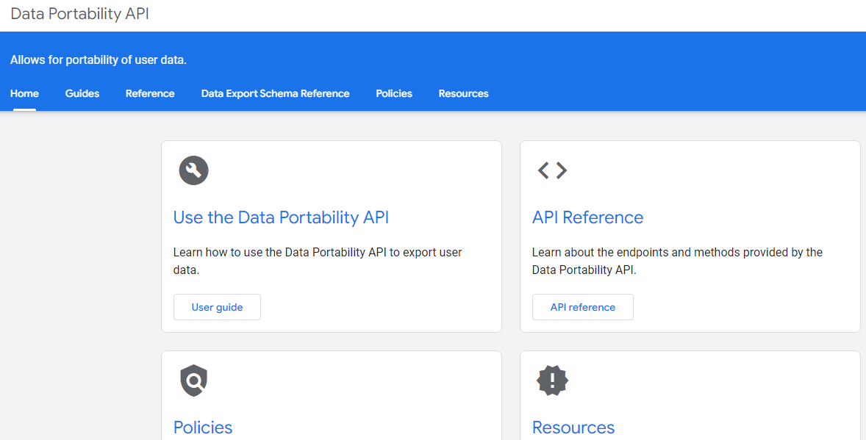
How can end users and authorised third parties get access to end user data?
End users can access their data at:
Google Takeout
More information about accessing user data is available at:
How to download your Google data
Share a copy of your data with a third party
Developer documentation for the Data Portability API

Slide 99
Art. 6(10)
Data Sharing

Slide 100
Our long-held approach to data sharing with business users
Art. 6(10) is about providing business users with data about their activity on our platforms.
We have long believed that there is a mutual interest in our providing useful, actionable data to our business users as well as powerful analytical tools to make the most of that data. This benefits our business users, our end users, and the platforms that host them.
This is why – well before the DMA was even envisaged – we developed frontends and tools that provide business users not just with the data about their activity on our platforms, as required on 6(10); but also with data – beyond the scope of the DMA’s obligation – about how users interact with the platforms themselves.
Art. 6(10) is therefore not a paradigm shift for Google: it is a continuation and a formalization of a long-held philosophy – that where Google’s business users succeed, Google also succeeds.

Slide 101
Google provides access to extensive data across all CPSs, even beyond the requirements of the DMA
Business users can access extensive data including:
Performance metrics, e.g., clicks, impressions, click-through rates, watch times, growth metrics, etc.
Quality data, e.g., ratings and reviews, mobile website useability, app crash data, etc.
Data on user base, e.g., privacy-safe demographics and traffic sources
To enable business users to make the most of this data, Google invests significantly in:
Sophisticated analytics tools
Benchmarking information
Detailed supporting documentation
Comprehensive tutorials and courses.

Slide 102
Google shares data via a range of sophisticated tools that are tailored to the service
Play tools include the Google Play Console and Play APIs like the Reporting API and the In-App Purchases API.
Search tools include the Search Console, additional analytics centres like the Travel Analytics Center, and related APIs, such as the Search Console API.
Shopping tools include the Merchant Center, Business Profile, Manufacturer Center, and related APIs like the Business Profile API and the Content API.
Ads tools include Google Ads, Display Video 360, Google Ad Manager, and Adsense, and related APIs.
Maps tools include the Merchant Center, Business Profile, and Business Profile APIs.
YouTube tools include Creator Studio, YouTube Analytics and Artist Analytics, as well as related APIs like the YouTube Analytics API.

Slide 103
Google has published a huge library of supporting resources
To help business users identify, access, and utilize the data available across all tools and CPSs, Google has:
built dedicated Help Centers like Play Console Help and YouTube Help,
published webinars and tutorial videos on YouTube, and
designed courses on the Google Play Academy to teach business users how to access and use the data.

Slide 104
Ongoing enhancements to the data we share
Google Ads
Google enhanced access to data for Google Ads publisher partners by enabling access to new reports called “Regional Data Access”
Google enhanced advertisers’ access to non-aggregated data by including it in DV360 Data Transfer Files
Google Shopping
Google Merchant tools now provide additional API access to product listing data
We are always iterating and working to improve the data we share with business users: we release new data cuts, analytics, tools all the time.
Business users’ feedback and actual usage of the tools we provide is a key guide in developing further releases.
And to prepare for the DMA’s implementation, Google reviewed its data sharing practices and identified additional features that we have rolled-out to comply with the legislation.

Slide 105
Further information can be found on Google’s Help Centers
Play. Play Console Help
Search. Search Console Help
Shopping. Google Merchant Center Help
Maps. Google Maps Help
YouTube. YouTube Help
Ads. Ads Help

Slide 106
Thank you!

Slide 107
Regulatory landscape - Platforms
Rules of engagement
Always state your name and organisation (in room and via slido)
Questions and comments should be
clear and short = 2 min max,
relevant and on-topic of the specific DMA obligation,
constructive.
One question or comment per intervention
Online questions and comments via: https://app.sli.do/event/dC4mpnSDsJKepsfEQx91B6
slido.com - # 3029563

Slide 108
Thank you

