Slide 1
DMA Enforcement Workshops
Amazon
20 March 2024

Slide 2
Regulatory landscape - Platforms
Agenda
13:00-13:20 | Introductory remarks
13:20-14:10 | Session 1 – Data processing (Article 5.2)
14:10-15:10 | Session 2 – Data portability and access obligations (Article 6.9 and 6.10)
15:10-15:30 | Break
15:30-16:30 | Session 3 - Advertising transparency obligations (Articles 5.9, 5.10, 6.8)
16:30-16:50 | Session 4 - Use of Seller data and self-preferencing (Articles 6.2 and 6.5)
16:50-17:50 | Q&A and Open Table Discussion
17:50-18:00 | Closing Remarks by the European Commission

Slide 3
Regulatory landscape - Platforms
Rules of engagement
Always state your name and organisation (in room and via slido)
Questions and comments should be
clear and short = 2min max,
relevant and on-topic,
constructive.
One question or comment per intervention
Online questions and comments via:
slido.com - # 6858411

Slide 4
Regulatory landscape - Platforms
Rules of engagement
No reference to ongoing or past proceedings
No attacks; questions should be civilized / constructive
The Commission will moderate the discussions. Its role will be to steer the discussion
The Commission will not provide legal interpretations / take any positions
No sharing of business sensitive information
Goal is to hear stakeholders’ feedback on the concrete compliance solutions
We may not be able to take all comments and questions. Any observations can be sent to EC-DMA@ec.europa.eu

Slide 5
Digital Markets Act - Amazon Workshop
20 March 2024

Slide 6
Agenda
Article 5(2) – Data Sharing
Articles 6(9) and 6(10) – Data Portability and Data Access
Article 5(9), 5(10), 6(8) – Ads Transparency
Articles 6(2) and 6(5) – Use of Seller Data and Favouring

Slide 7
Session 1
Data processing
(Article 5.2)

Slide 8
Article 5.2
“The gatekeeper shall not do any of the following:
process, for the purpose of providing online advertising services, personal data of end users using services of third parties that make use of core platform services of the gatekeeper;
combine personal data from the relevant core platform service with personal data from any further core platform services or from any other services provided by the gatekeeper or with personal data from third-party services;
cross-use personal data from the relevant core platform service in other services provided separately by the gatekeeper, including other core platform services, and vice versa; and
sign in end users to other services of the gatekeeper in order to combine personal data,
unless the end user has been presented with the specific choice and has given consent within the meaning of Article 4, point (11), and Article 7 of Regulation (EU) 2016/679.
Where the consent given for the purposes of the first subparagraph has been refused or withdrawn by the end user, the gatekeeper shall not repeat its request for consent for the same purpose more than once within a period of one year.
This paragraph is without prejudice to the possibility for the gatekeeper to rely on Article 6(1), points (c), (d) and (e) of Regulation (EU) 2016/679, where applicable.”

Slide 9
Article 5(2) – Data Sharing

Slide 10
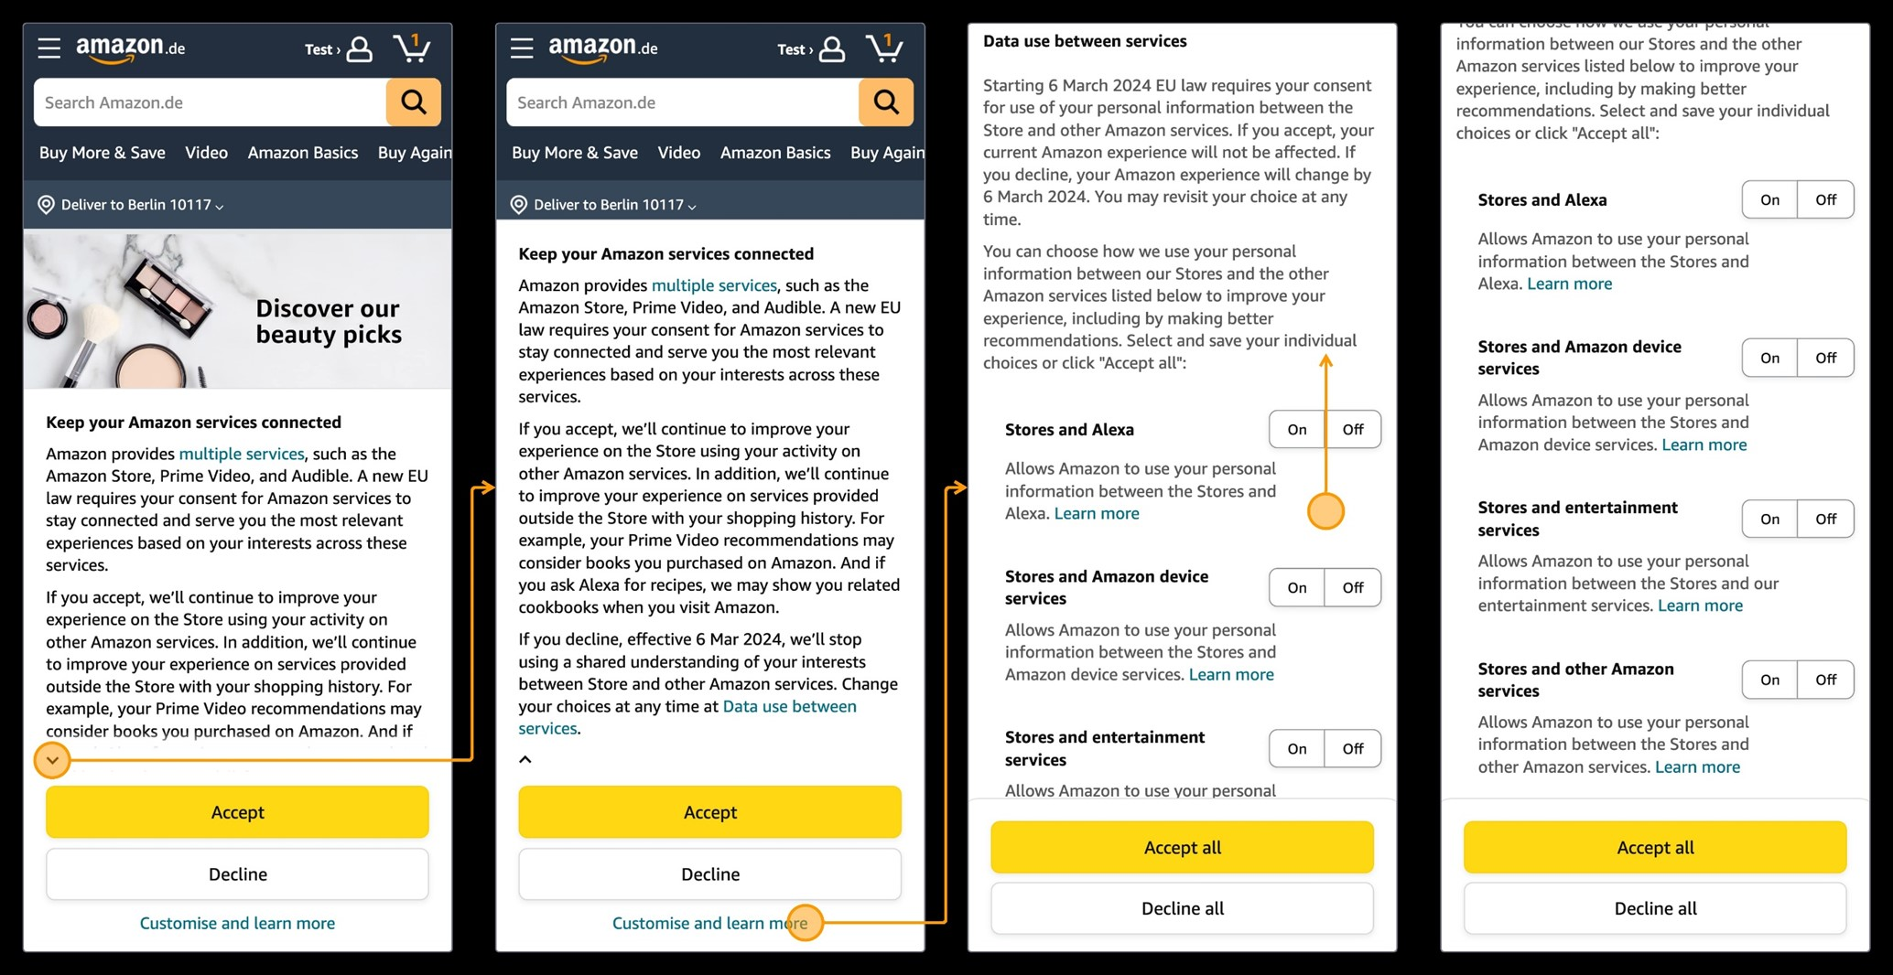
Store Prompt (Article 5(2))

Slide 11
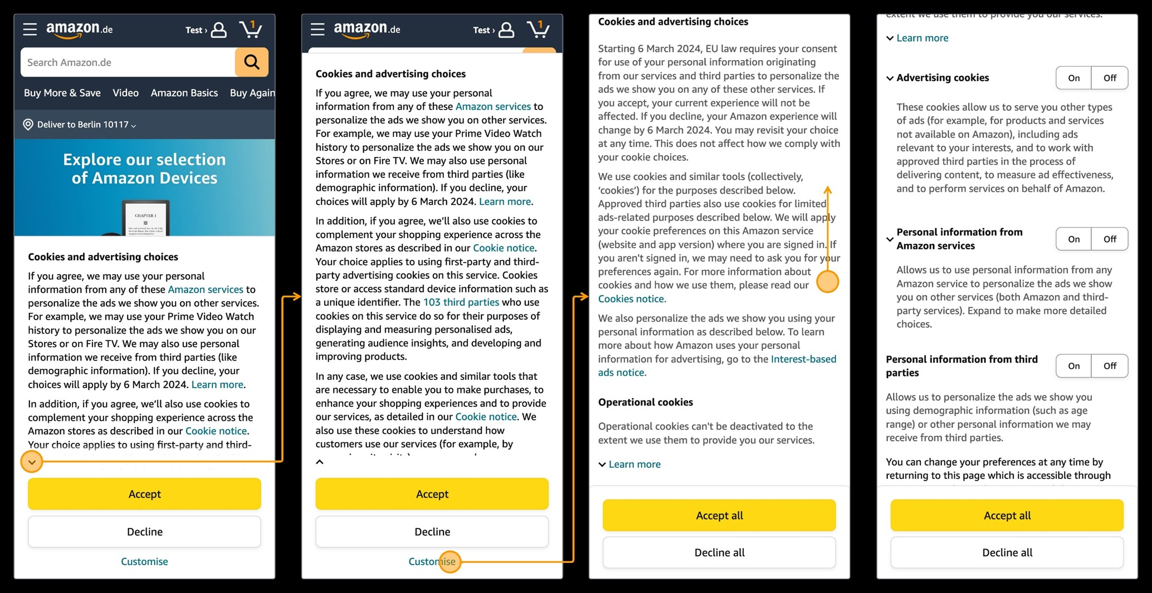
Ads Prompt (Article 5(2))

Slide 12
Data processing (Article 5.2)
Q&A On The Presentation And
Open Table Discussion
Online questions and comments via:
slido.com - # 6858411

Slide 13
Session 2
Data portability and
access obligations
(Articles 6.9 and 6.10)

Slide 14
Article 6.9
“The gatekeeper shall provide end users and third parties authorised by an end user, at their request and free of charge, with effective portability of data provided by the end user or generated through the activity of the end user in the context of the use of the relevant core platform service, including by providing, free of charge, tools to facilitate the effective exercise of such data portability, and including by the provision of continuous and real-time access to such data.”

Slide 15
Article 6.10
“The gatekeeper shall provide business users and third parties authorised by a business user, at their request, free of charge, with effective, high-quality, continuous and real-time access to, and use of, aggregated and non-aggregated data, including personal data, that is provided for or generated in the context of the use of the relevant core platform services or services provided together with, or in support of, the relevant core platform services by those business users and the end users engaging with the products or services provided by those business users. With regard to personal data, the gatekeeper shall provide for such access to, and use of, personal data only where the data are directly connected with the use effectuated by the end users in respect of the products or services offered by the relevant business user through the relevant core platform service, and when the end users opt in to such sharing by giving their consent.”

Slide 16
Articles 6(9) and 6(10) Data Portability and Data Access

Slide 17
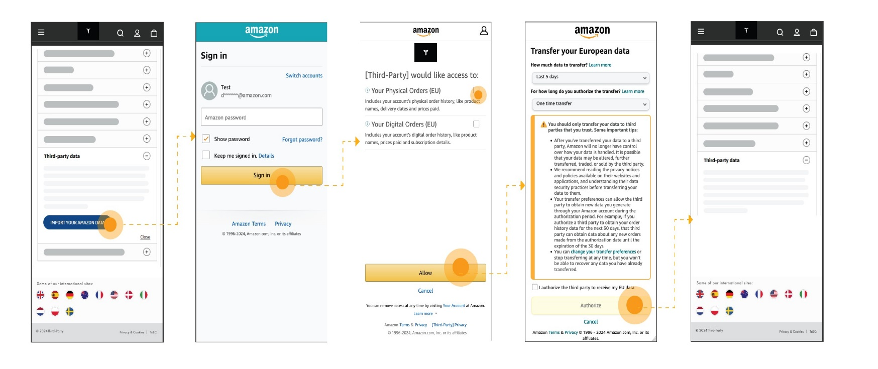
Direct End-user Portability Experience (Article 6(9))

Slide 18
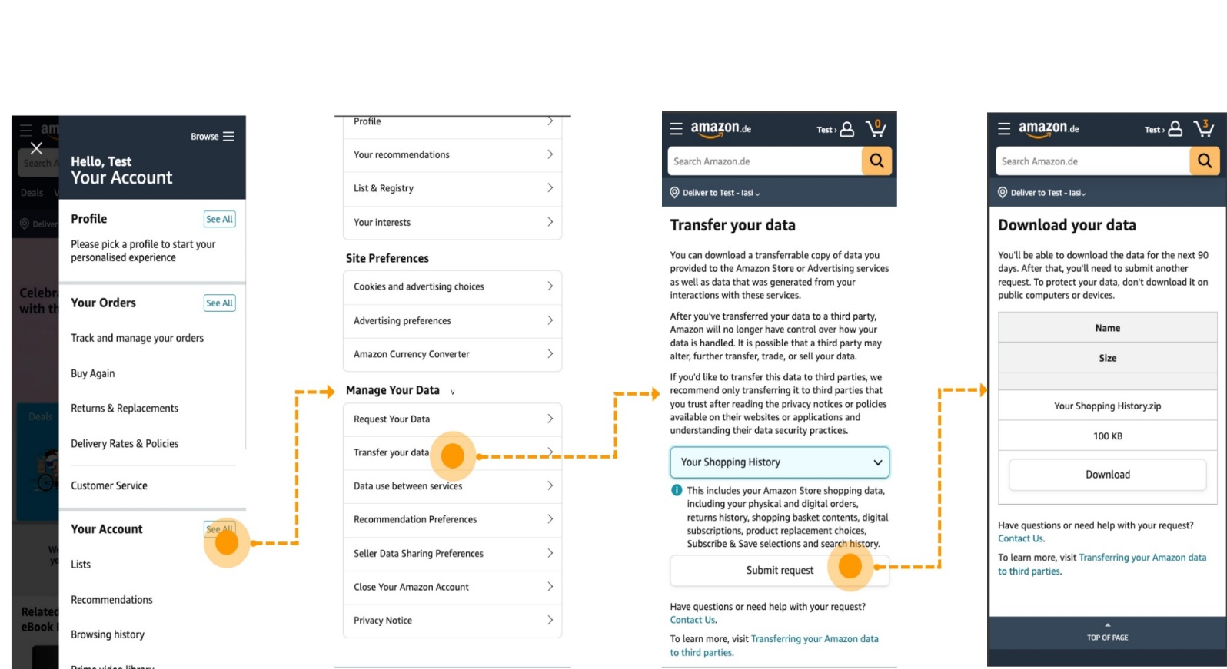
Customer Portability Experience via the Portal (Article 6(9))

Slide 19
Access to Business User Data – End-user Authorisation Experience (Article 6(10))

Slide 20
Data portability and access obligations (Articles 6.9 and 6.10)
Q&A On The Presentation And
Open Table Discussion
Online questions and comments via:
slido.com - # 6858411

Slide 21
Coffee Break

Slide 22
Session 3
Advertising transparency obligations
(Articles 5.9, 5.10 and 6.8)

Slide 23
Article 5.9
“The gatekeeper shall provide each advertiser to which it supplies online advertising services, or third parties authorised by advertisers, upon the advertiser’s request, with information on a daily basis free of charge, concerning each advertisement placed by the advertiser, regarding:
the price and fees paid by that advertiser, including any deductions and surcharges, for each of the relevant online advertising services provided by the gatekeeper,
the remuneration received by the publisher, including any deductions and surcharges, subject to the publisher’s consent; and
the metrics on which each of the prices, fees and remunerations are calculated.
In the event that a publisher does not consent to the sharing of information regarding the remuneration received, as referred to in point (b) of the first subparagraph, the gatekeeper shall provide each advertiser free of charge with information concerning the daily average remuneration received by that publisher, including any deductions and surcharges, for the relevant advertisements.”

Slide 24
Article 5.10
“The gatekeeper shall provide each publisher to which it supplies online advertising services, or third parties authorised by publishers, upon the publisher’s request, with free of charge information on a daily basis, concerning each advertisement displayed on the publisher’s inventory, regarding:
the remuneration received and the fees paid by that publisher, including any deductions and surcharges, for each of the relevant online advertising services provided by the gatekeeper;
the price paid by the advertiser, including any deductions and surcharges, subject to the advertiser’s consent; and
the metrics on which each of the prices and remunerations are calculated.
In the event an advertiser does not consent to the sharing of information, the gatekeeper shall provide each publisher free of charge with information concerning the daily average price paid by that advertiser, including any deductions and surcharges, for the relevant advertisements.”

Slide 25
Article 6.8
“The gatekeeper shall provide advertisers and publishers, as well as third parties authorised by advertisers and publishers, upon their request and free of charge, with access to the performance measuring tools of the gatekeeper and the data necessary for advertisers and publishers to carry out their own independent verification of the advertisements inventory, including aggregated and non-aggregated data. Such data shall be provided in a manner that enables advertisers and publishers to run their own verification and measurement tools to assess the performance of the core platform services provided for by the gatekeepers.”

Slide 26
Article 5(9), 5(10), 6(8) Advertising Transparency

Slide 27
Advertising transparency obligations (Articles 5.9, 5.10 and 6.8)
Q&A On The Presentation And
Open Table Discussion
Online questions and comments via:
slido.com - # 6858411

Slide 28
Session 4
Use of Seller data and
self-preferencing
(Articles 6.2 and 6.5)

Slide 29
Article 6(2)
“The gatekeeper shall not use, in competition with business users, any data that is not publicly available that is generated or provided by those business users in the context of their use of the relevant core platform services or of the services provided together with, or in support of, the relevant core platform services, including data generated or provided by the customers of those business users.
For the purposes of the first subparagraph, the data that is not publicly available shall include any aggregated and non-aggregated data generated by business users that can be inferred from, or collected through, the commercial activities of business users or their customers, including click, search, view and voice data, on the relevant core platform services or on services provided together with, or in support of, the relevant core platform services of the gatekeeper.”

Slide 30
Article 6(5)
“The gatekeeper shall not treat more favourably, in ranking and related indexing and crawling, services and products offered by the gatekeeper itself than similar services or products of a third party. The gatekeeper shall apply transparent, fair and non-discriminatory conditions to such ranking.”

Slide 31
Articles 6(2) and 6(5) Use of Seller Data and Favouring

Slide 32
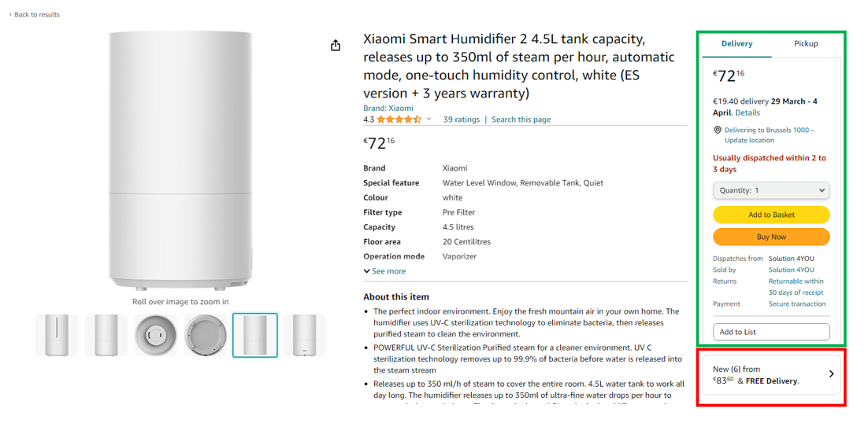
Product Detail Page Example

Slide 33
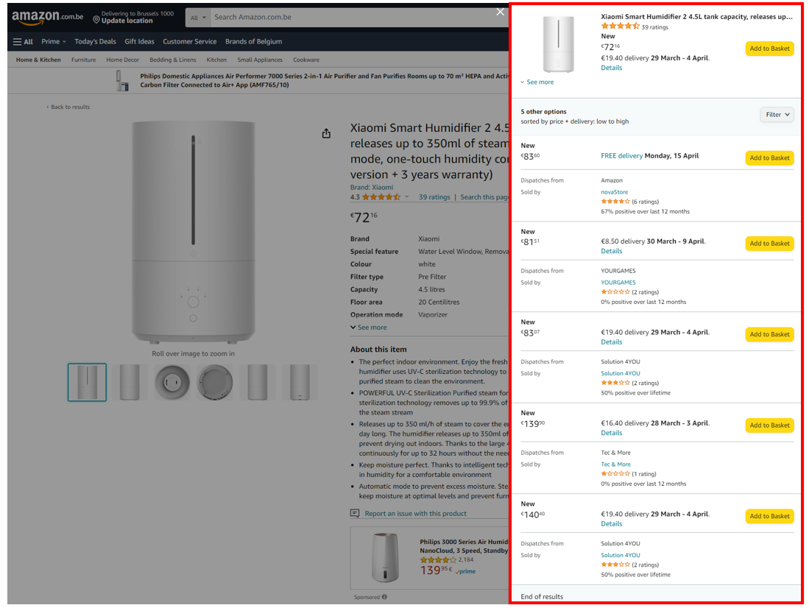
Product Detail Page Example

Slide 34
Use of Seller data and self-preferencing (Articles 6.2 and 6.5)
Q&A On The Presentation And
Open Table Discussion
Online questions and comments via:
slido.com - # 6858411

Slide 35
Thank you

