Slide 1
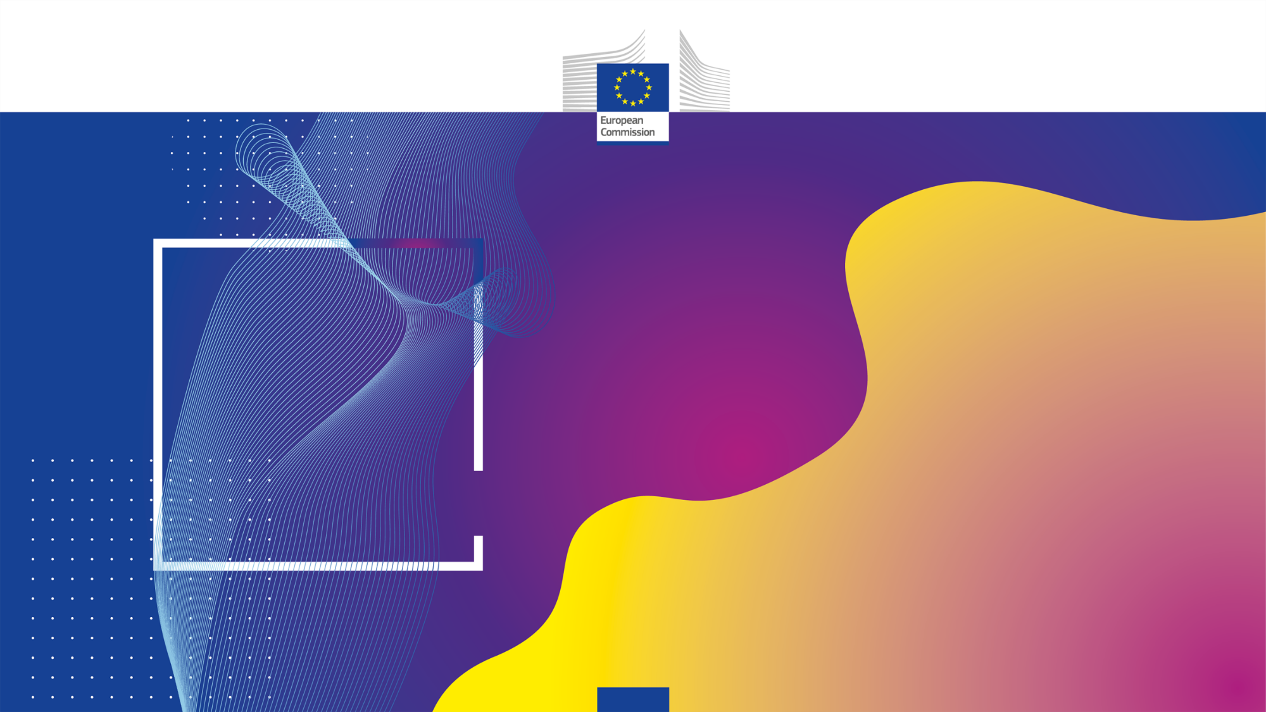
DMA Enforcement Workshops
ByteDance
Brussels, 2 July 2025

Slide 2
Regulatory landscape - Platforms
Agenda (part 1)
9:00-9:30 | Registration/coffee
9:30-9:40 | Introductory remarks by the Commission
Update on first year of DMA compliance
9:40-9:55 | Presentation by the Commission on the regulatory dialogue with ByteDance
9:55-10:30 | Presentation by ByteDance on the main evolution and effects of the compliance measures Main topics: Data combination Data portability and data access FRAND access and alternative dispute resolution
10:30-11:10 | Q&A on the presentation and open discussion
11:10-11:30 | Coffee break

Slide 3
Regulatory landscape - Platforms
Agenda (part 2)
ByteDance’s new services and their compliance with the DMA
11:30-12:00 | Presentation by ByteDance on the main developments TikTok Shop TikTok Studio TikTok business facing features
12:00-12:30 | Q&A on the presentation and open discussion
Other topics and conclusions
12:30-13:00 | Q&A on any other topics related to DMA compliance
13:00-13:10 | Concluding remarks by the Commission

Slide 4
Regulatory landscape - Platforms
Rules of engagement l
No reference to ongoing or past proceedings
No attacks; questions should remain polite and constructive.
The Commission will moderate the discussions. Its role will be to steer the discussion
The Commission will not provide legal interpretations / take any positions
No sharing of business sensitive information
Goal is to hear stakeholders’ feedback on the concrete compliance solutions
We may not be able to take all comments and questions. Any observations can be sent to EC-DMA@ec.europa.eu

Slide 5

Regulatory landscape - Platforms
Rules of engagement ll
Always state your name and organisation (in room and via slido)
Questions and comments should be
clear and short = 2 min max,
relevant and on-topic of the specific DMA obligation,
constructive.
One question or comment per intervention
Online questions and comments via:
www.slido.com, code: 4267451

Slide 6
Presentation by the Commission on the ongoing regulatory dialogue

Slide 7
Timeline
14 Sept 2022
DMA is published
7 March 2024
ByteDance must comply /
First Compliance Report
6 March 2025
Second compliance report
.………… …………… …………………. ……………… …………..…… .…… Ongoing Dialogue
5 Sept 2023
ByteDance designated as gatekeeper
22 March 2024
First ByteDance compliance workshop
2 July 2025
Second Compliance workshop

Slide 8
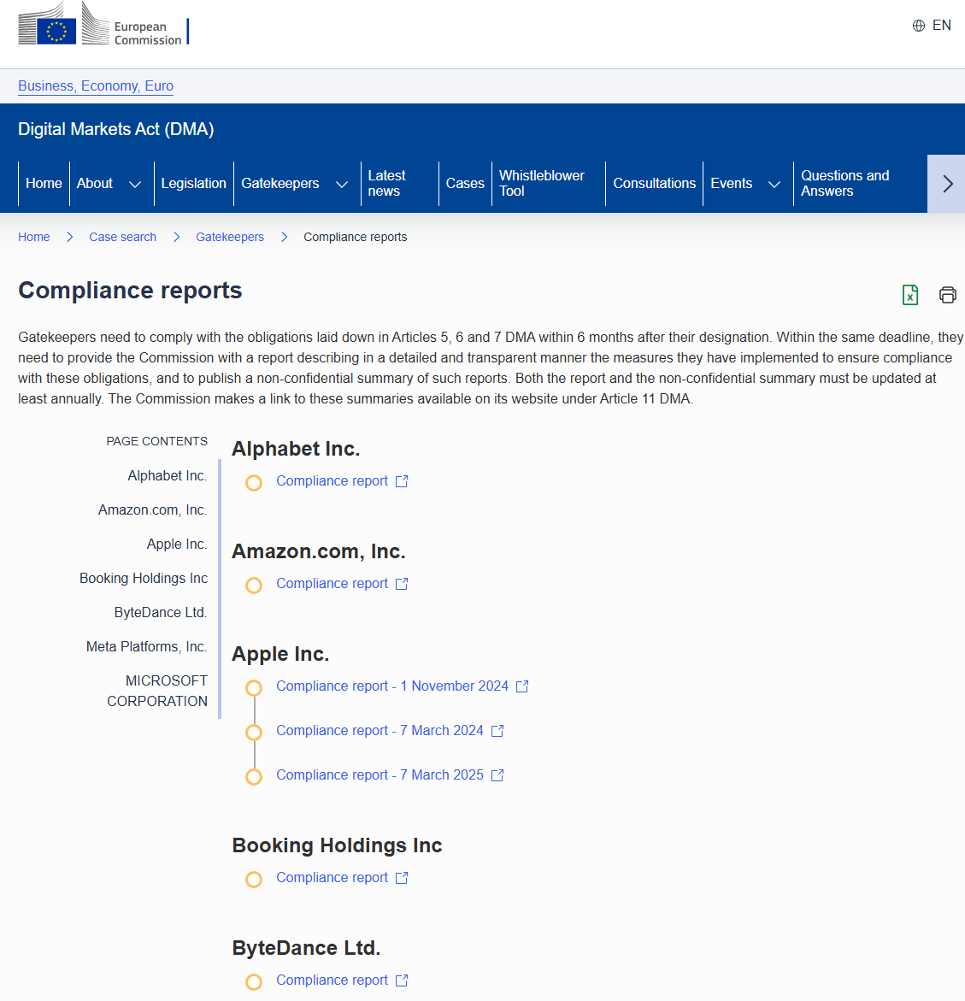

Slide 9
DMA obligations applicable to ByteDance
Art. 5(2)
Art. 5(6)
Art. 6(13)
Arts. 5
(7) (8)
Art. 6(2)
Art. 6(9) and (10)
Art. 6(12)

Slide 10
Regulatory dialogue
Commission
Third parties
ByteDance

Slide 11
Data combination and cross-use
Main objectives – explicit consent to data processing - Article 5(2) DMA
Article 5(2) DMA mandates that gatekeepers must obtain explicit and valid user consent before combining or cross-using personal data from their core platform services and other third-party services.
This emphasizes the importance of free, informed, and specific consent from users regarding how their personal data are processed and used.
Article 5(2) DMA frames these requirements within the broader objectives of enhancing contestability and fairness of digital markets, prevent gatekeepers’ advantages stemming from the accumulation of data and ensuring that users control over how their personal data are processed and used.

Slide 12
Data combination and cross-use
Main areas of regulatory dialogue - Article 5(2) DMA
Improving the design and granularity of the consent screen prompt;
Identifying potential data combination scenarios subject to the DMA consent mechanism for TikTok’s recently launched services (TikTok Shop and TikTok Studio);
Understanding the impact of AI-powered tools developed by ByteDance on Article 5(2) DMA compliance.

Slide 13
Articles 6(9) and 6(10): Data portability and data access
Gatekeeper CPS
End users’ data portability
Article 6(9)
Business users’ data access
Article 6(10)
Authorised third parties

Slide 14
Focus of the regulatory dialogue – end user data portability (Art. 6(9))
Clarity of compliance solution
Granularity of data
Ease of use of and timeframe of compliance solution

Slide 15
Focus of the regulatory dialogue – end user data portability (Art. 6(10))
Clarity of compliance solution
Breadth and granularity of data

Slide 16
Article 6(12): FRAND access and alternative dispute resolution
Gatekeeper obligation under Article 6(12) DMA:
App stores, search engines and social networks
Grant business users of the platform Fair, Reasonable and Non-Discriminatory (=FRAND) access
Publish and apply general conditions of access for business users, including alternative dispute settlement mechanism (ADSM)

Slide 17
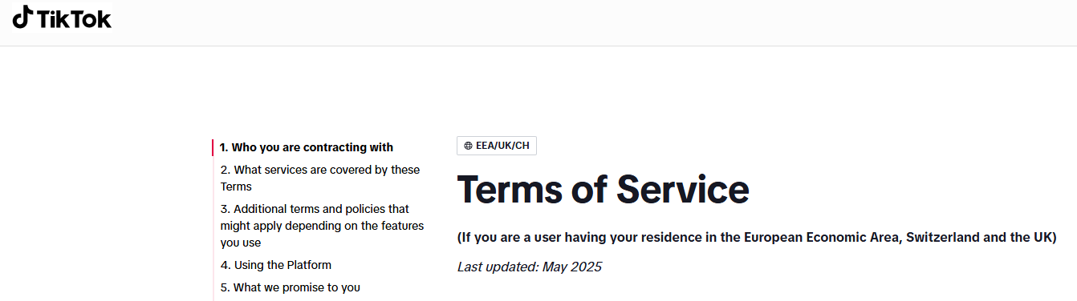




Result of dialogue with ByteDance:
Currently being updated to reflect discussions with EC DMA team!

Slide 18
Thank you!
… and keep in touch:
EC-DMA@ec.europa.eu

Slide 19
Presentation by ByteDance on the main evolution and effects of the compliance measures

Slide 20
TikTok - DMA Workshop
Session 1 - Effective compliance
2 July 2025

Slide 21






Steve Reeder
Global Head of Antitrust
Darryl Jones
DMA Compliance Lead
Alex Abrahams
Lead Monetisation Privacy Counsel, Europe
David Bass
Senior Legal Counsel, Litigation
Liam Price
Senior Legal Counsel, Product Legal
Ane Alonso
Senior Legal Counsel, E-Commerce

Slide 22
Developments since last year’s DMA Workshop
TikTok's online social networking service remains its only designated CPS
  The EC did not designate TikTok Ads
This year, TikTok:
  Continued to build on DMA compliance solutions, and
  Launched new products and features (e.g., TikTok Shop)

Slide 23
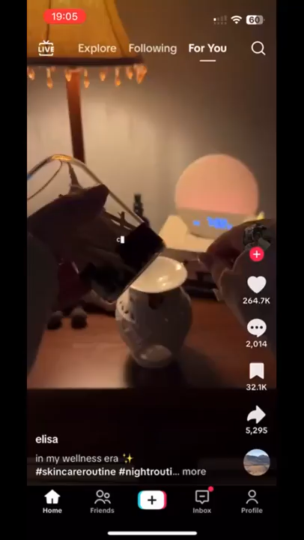
TikTok CPS: Recap
For You Feed
TikTok is an entertainment platform
For You Feed: Where it all happens
Built around a ‘content graph’ rather than a ‘social graph’
Users include personal and business accounts (self-identified and registered)

Slide 24
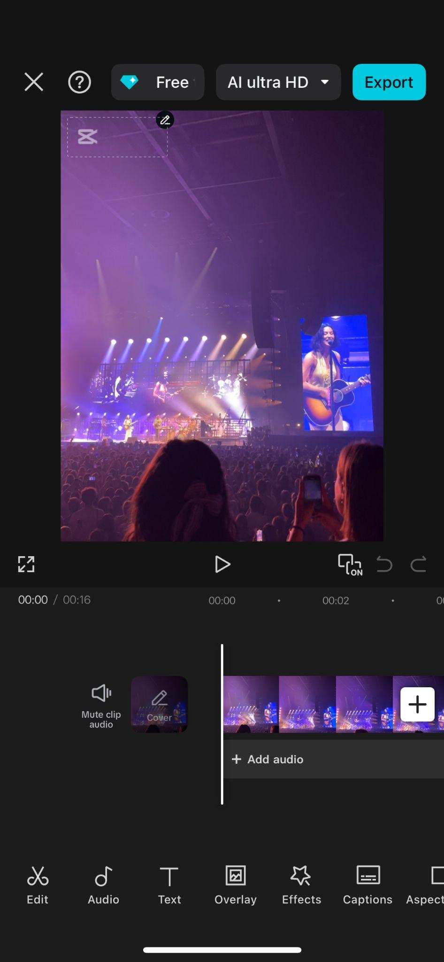
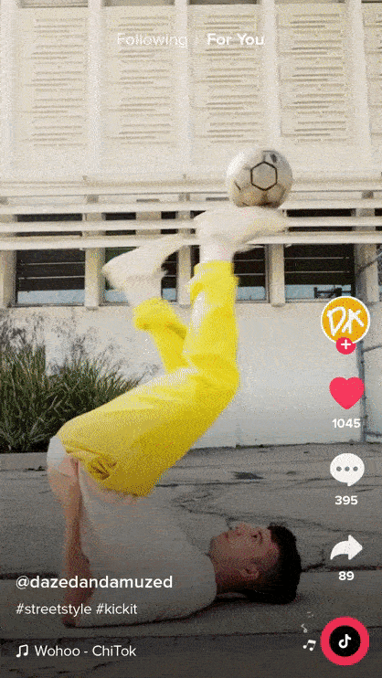
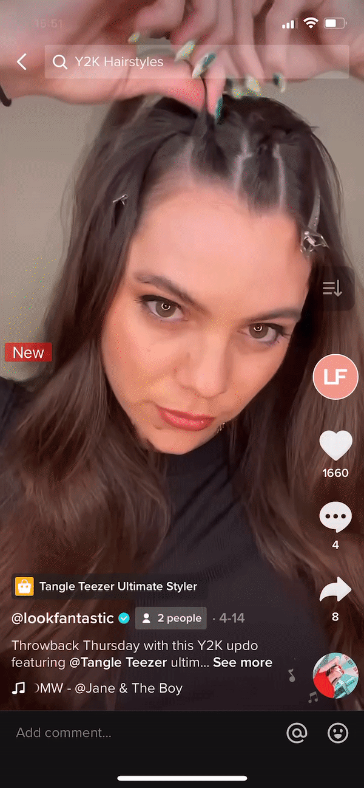
TikTok Ads
TikTok Shop
CapCut

Slide 25
Key DMA Obligations
Consent for data processing Article 5.2
Business analytics
Article 6.10
Data portability solutions
Article 6.9
Fair terms of access
Article 6.12

Slide 26
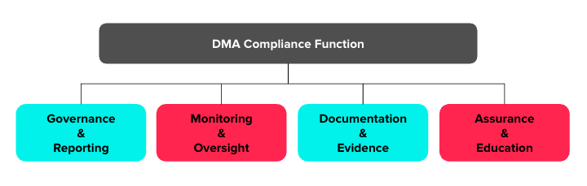
DMA Compliance Function - DMAO
Provides the Independent Compliance Function required by Article 28

Slide 27
Ensuring effective compliance

Slide 28
Choice is at the core of TikTok's data practices
Article 5.2

Slide 29
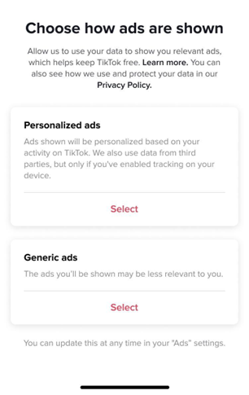
TikTok Ads consent screen

Slide 30
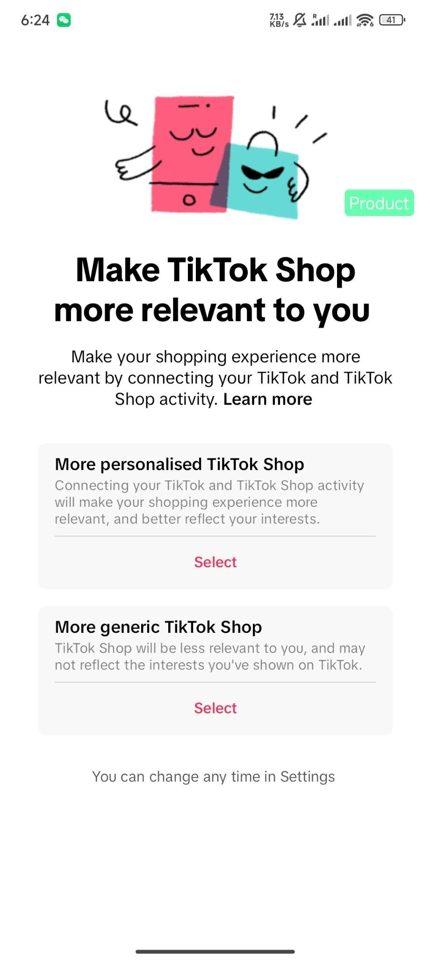
TikTok Shop consent screen

Slide 31
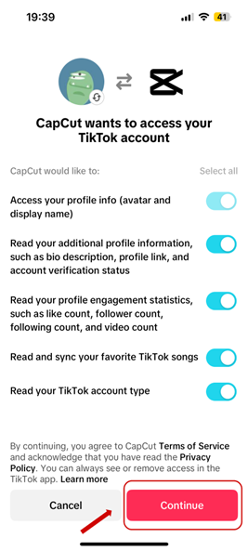
CapCut consent screen

Slide 32
TikTok seeks effective consent
Our consent screens:
In line with GDPR and other best practices
We monitor consent rates
Open to stakeholder feedback

Slide 33
TikTok empowers users through data portability
Article 6.9

Slide 34
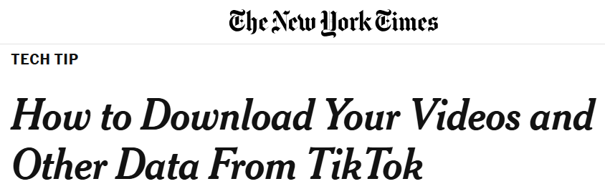
Download Your Data
1 million monthly unique users in the EU
13 million worldwide

Slide 35
Data portability API
TikTok has approved all complete Data Portability API applications
Also extended to UK
Use cases
cross-posting to multiple platforms
message interoperability
personal data management
data broker services
user insights

Slide 36
Data transparency that supports our Business Users
Article 6.10

Slide 37
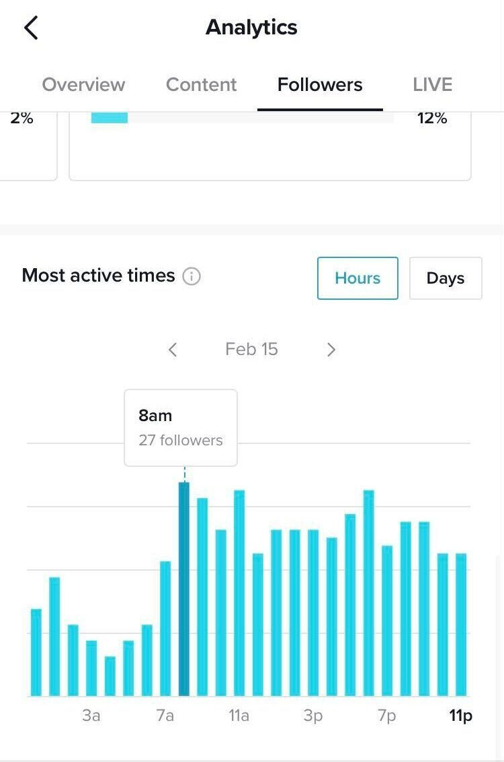
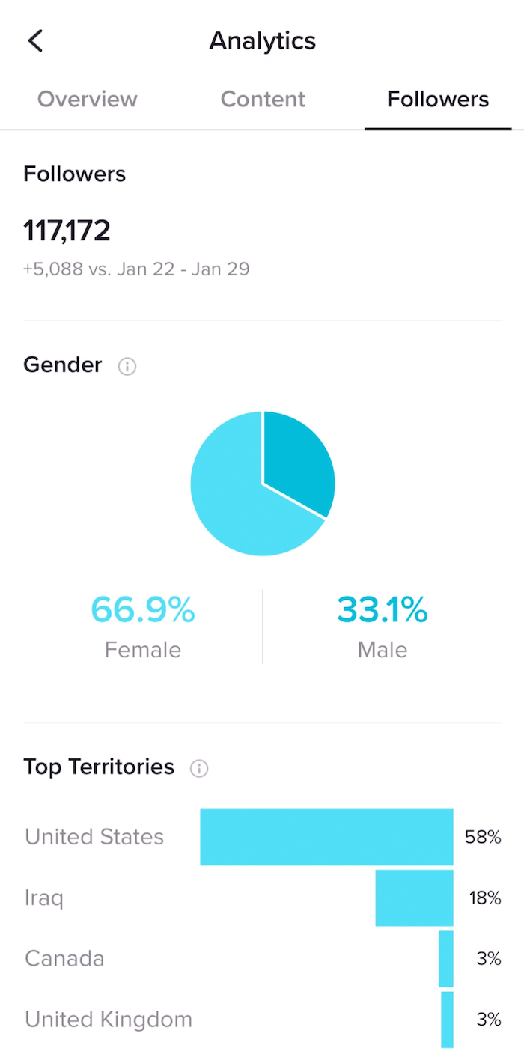
Supporting growth through transparency
Business Analytics
Rich audience insights and performance metrics for Business Users
Used by tens of thousands of weekly EU Business Users
TikTok approved over 1,500 new registrations in the 12 months prior to 7 March 2025

Slide 38
Stakeholder feedback & compliance updates

Slide 39
Expanding Lead Generation worldwide

Slide 40
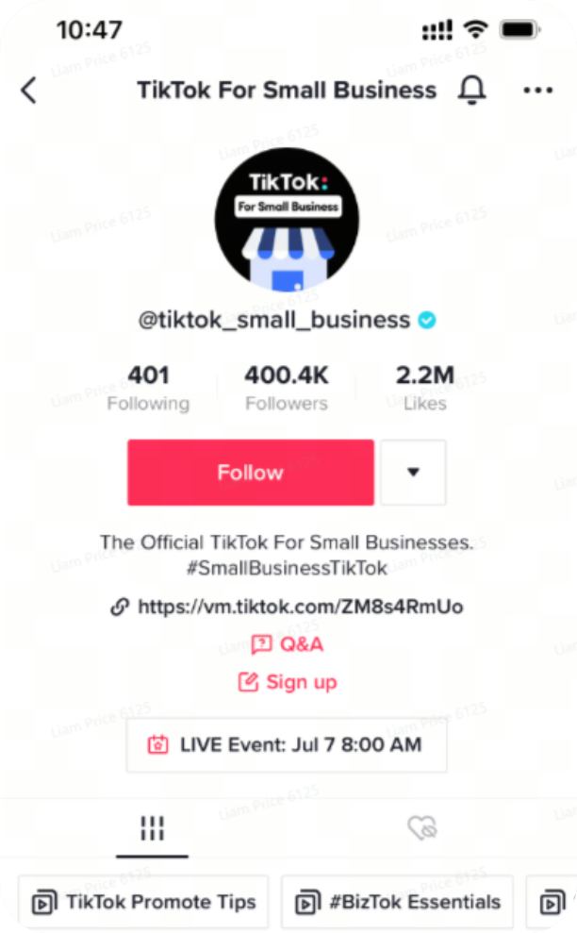
Business Account - Lead Generation
Lead generation is the process of identifying and cultivating potential customers (‘leads’)
TikTok offers Business Users the Business Account - Lead Generation tool to help empower businesses to get leads organically

Slide 41
Lead Generation expansion
Existing TikTok feature extended to the rest of the EU (and globally!)
Enables TikTok users and businesses to connect directly
Available to Registered Business Accounts and Business Accounts with > 1000 followers
Used by 50,000 EU businesses (in the two months prior to March 2025)
Used by 5,000 EU users per week (in the two months to March 2025)

Slide 42
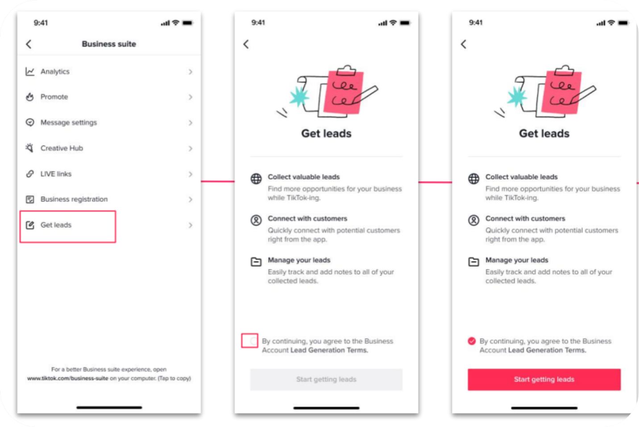
Business Account - Lead Generation

Slide 43
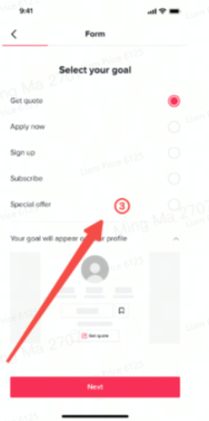
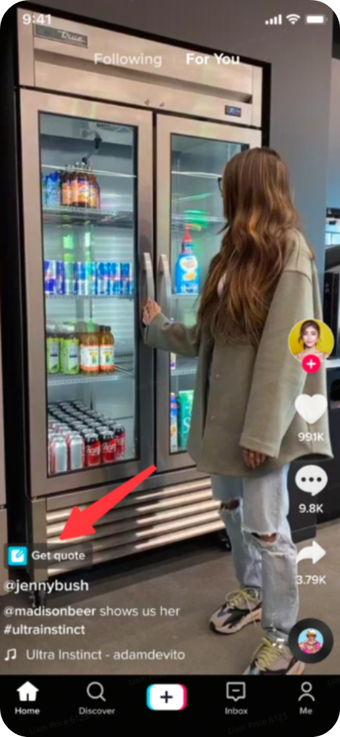
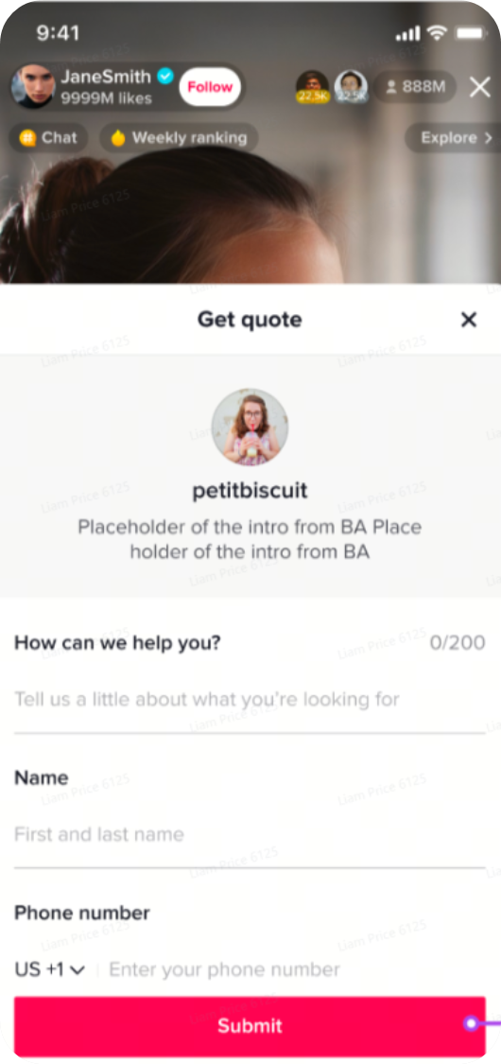
Business Account - Lead Generation
Calls to Action (CTAs): Apply Now, Sign Up, Get Quote, Special Offer
CTA button can be on profile or video
After clicking on the CTA, users can use a form to start the conversation

Slide 44
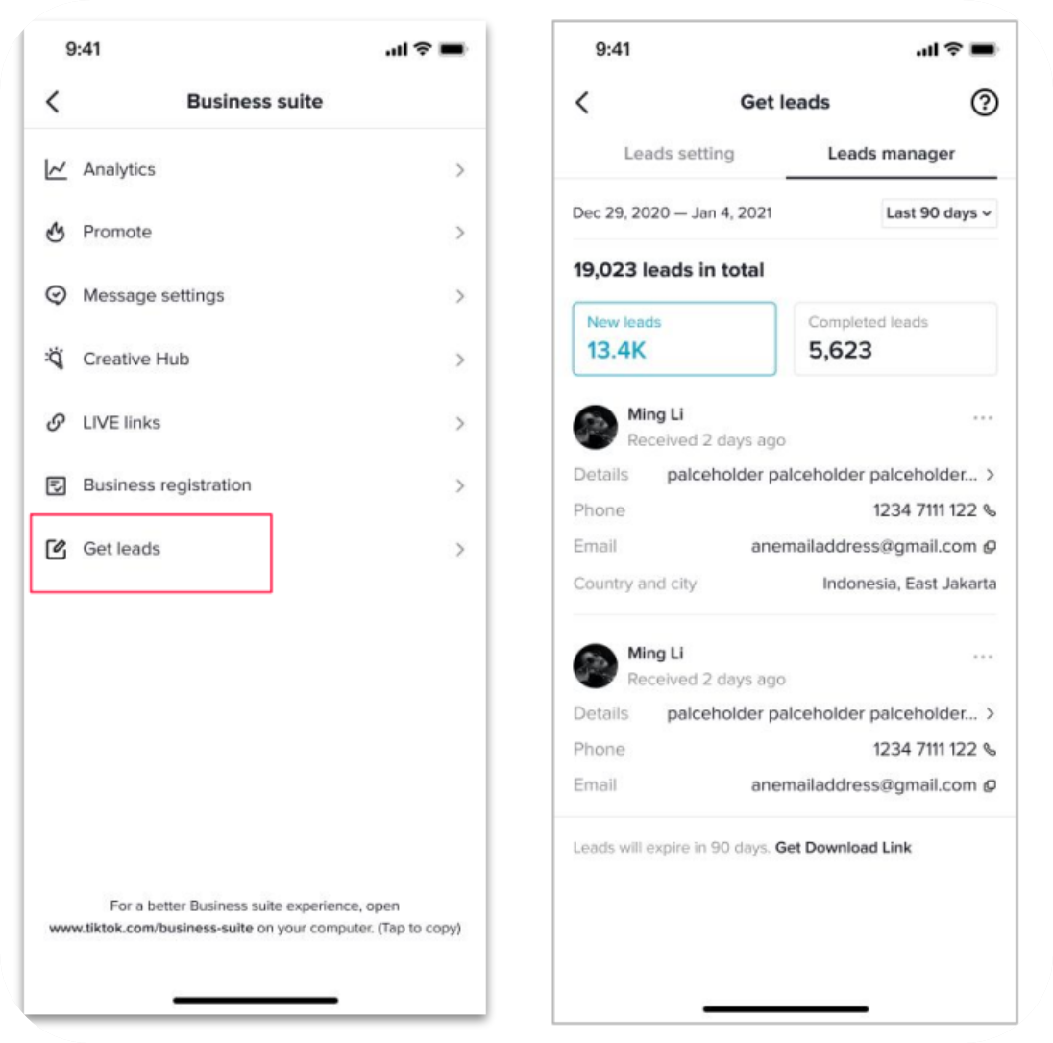
Business Account - Lead Generation
The business receives the lead forms and can review and manage those requests
The business can respond and take the leads forward

Slide 45
Balanced terms for better business partnerships
Article 6.12

Slide 46
Fair terms of access
Under Article 6.12, terms of access must:
Be published
Be consistent with FRAND principles
Provide for a Union-based alternative dispute resolution mechanism
Our Business Terms of Service already met these requirements, but we have enhanced further

Slide 47
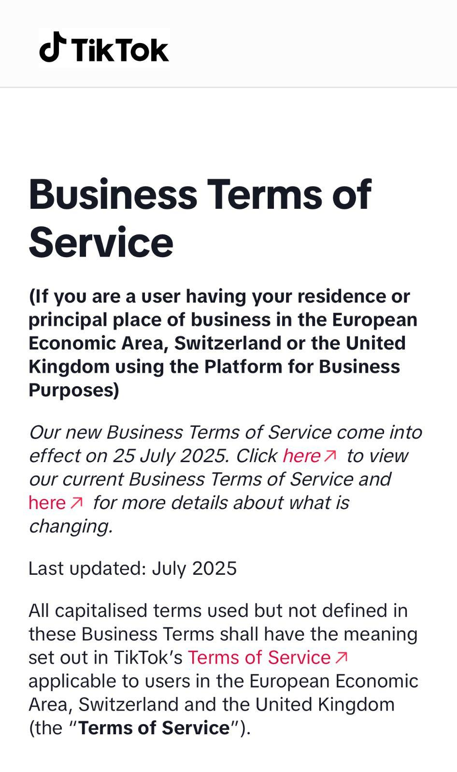
Business Terms of Service updates
Alternative dispute resolution mechanism:
  CEDR will handle DMA Business User mediations (formal agreement)
  TikTok will cover CEDR fees
Updated terms effective from 25 July 2025
  Users notified on main Terms of Service landing page

Slide 48
Other stakeholder feedback
Compliance is an ongoing process, and we appreciate feedback from the engaged TikTok community
We’re committed to taking their views into account as we continue to develop our products
TikTok’s success depends on creating a welcoming destination for users, creators, and brands
We respond promptly to stakeholders and keep the European Commission up-to-date

Slide 49
Thank you & questions?

Slide 50
Coffee break

Slide 51
Session 2 - Presentation by ByteDance on new services and their compliance with the DMA

Slide 52
TikTok - DMA Workshop
Session 2 - Main Developments
2 July 2025

Slide 53
TikTok Product Launches

Slide 54
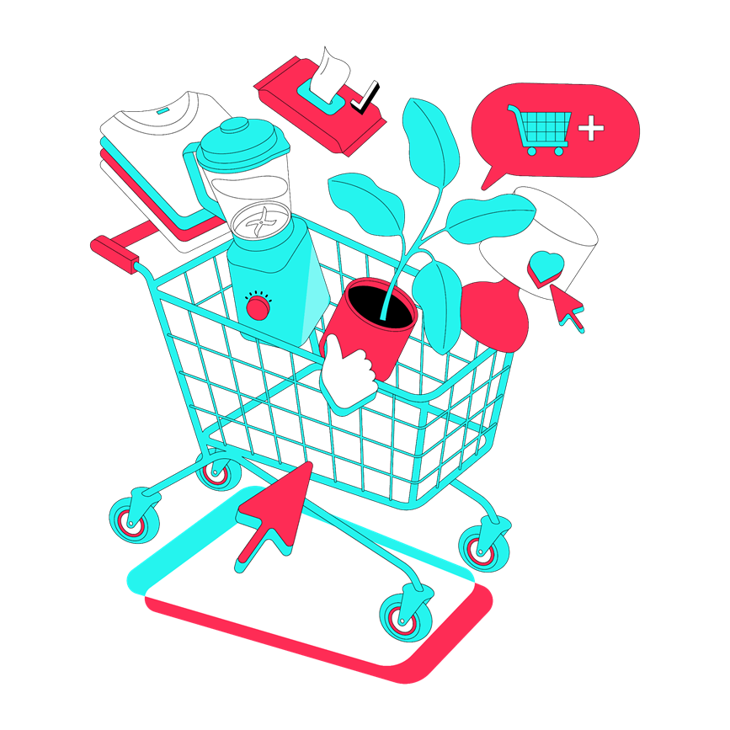
What is
TikTok Shop?

Slide 55

TikTok Shop is an e-commerce feature fully integrated within TikTok
We bring together consumers, businesses, and creators for a safe and trustworthy shopping experience
TikTok Shop’s innovative experience provides new choice and competition in European e-commerce

Slide 56
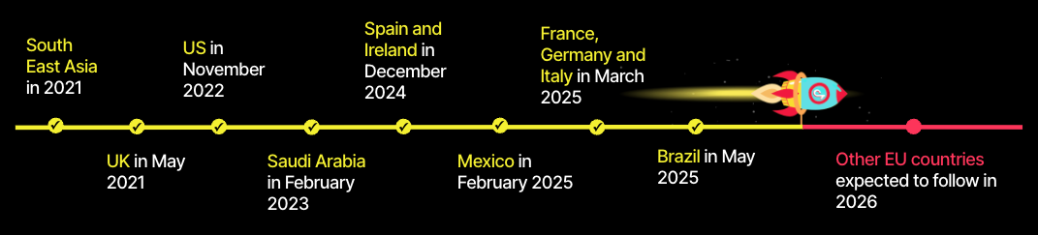
TikTok Shop: a short history

Slide 57

The benefits of TikTok Shop in the EU
For consumers seeking new products
For small businesses looking to grow
For established brands wanting to reach new audiences
For creators wishing to develop commercial opportunities

Slide 58
Understanding TikTok Shop

Slide 59
Understanding the TikTok Shop experience
Seller
Buyer
Shoppable videos
Livestreams
Product showcase
Shoppable videos
Livestreams
Product showcase
Search
TikTok Shop
Creator
Content links to seller's products

Slide 60
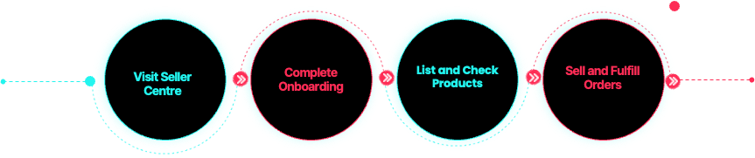
Seller Experience: Becoming a Seller on Shop

Slide 61
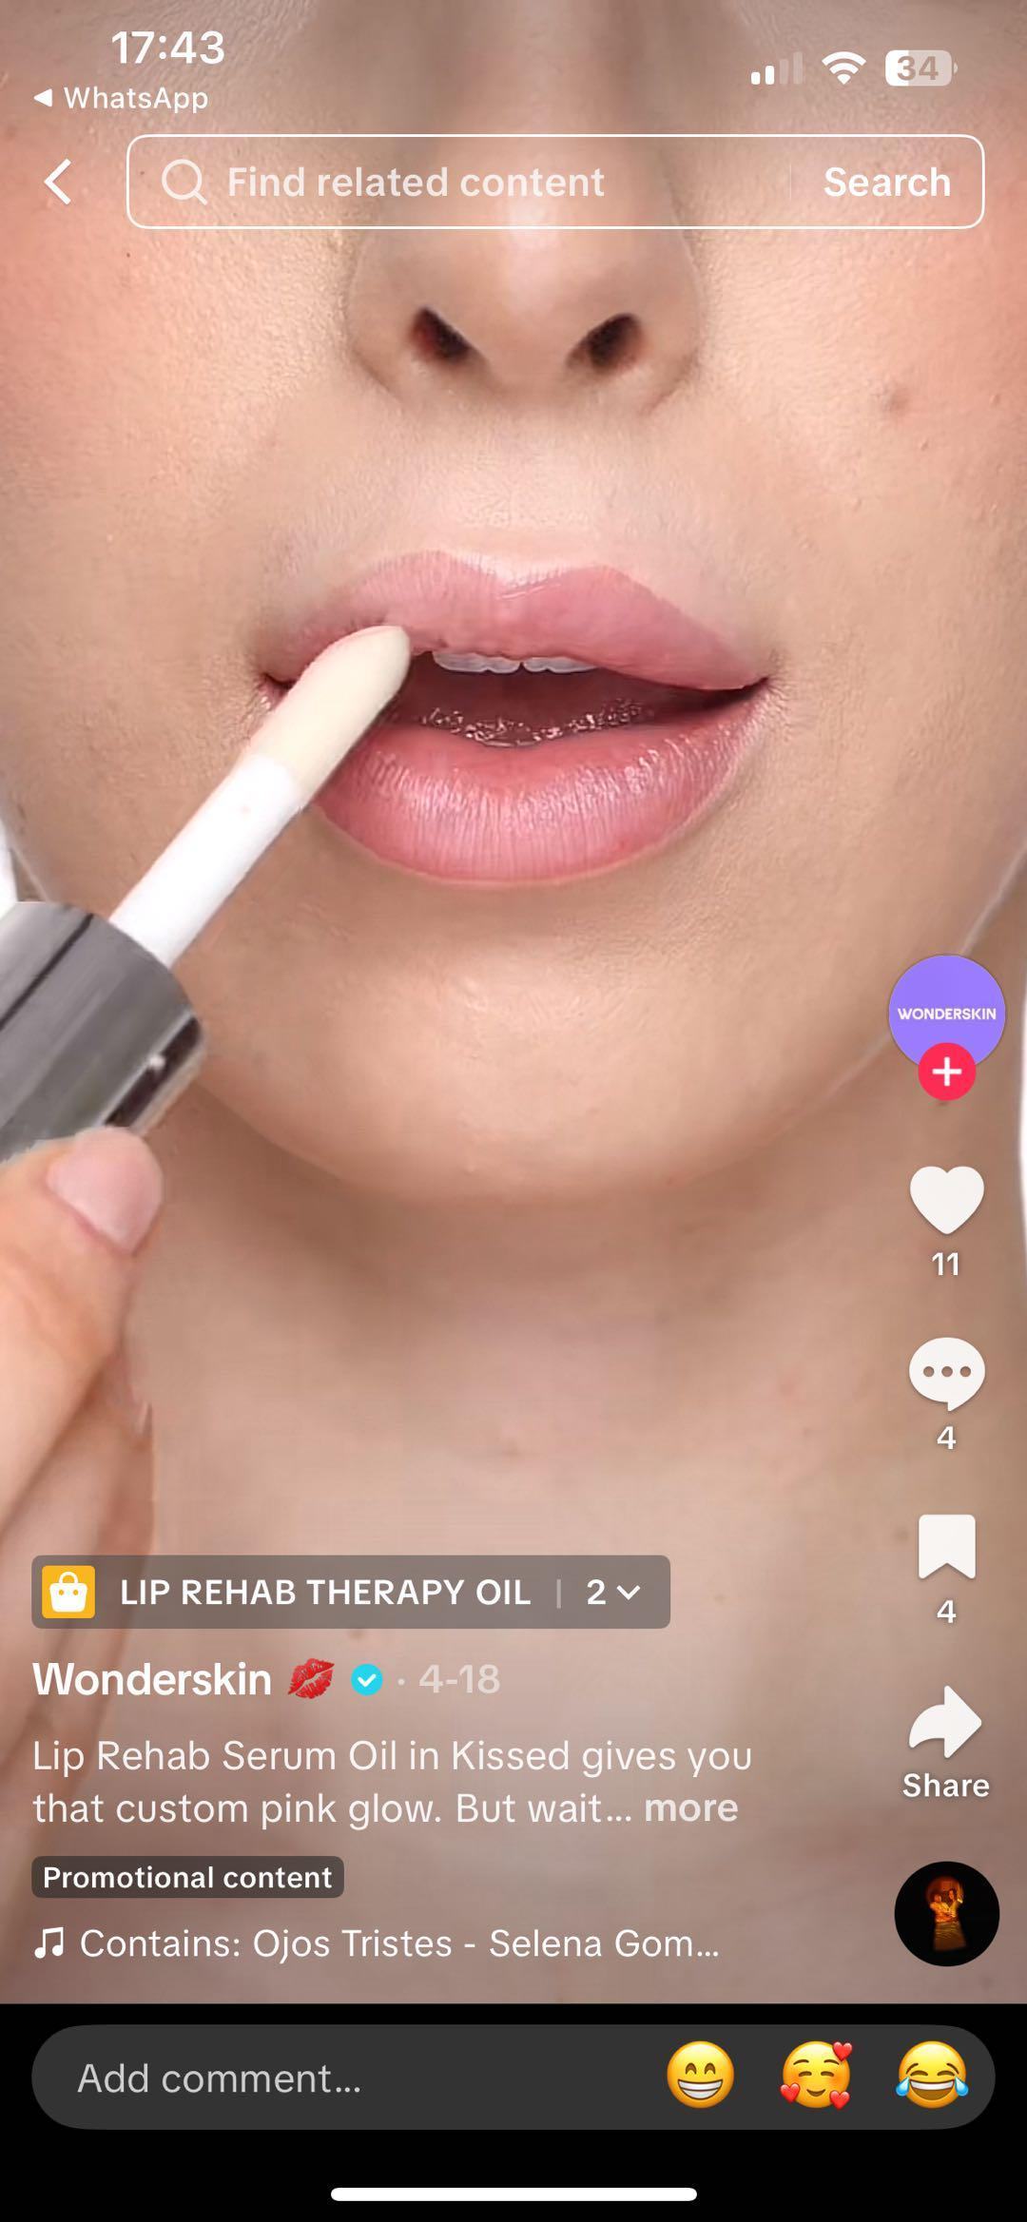
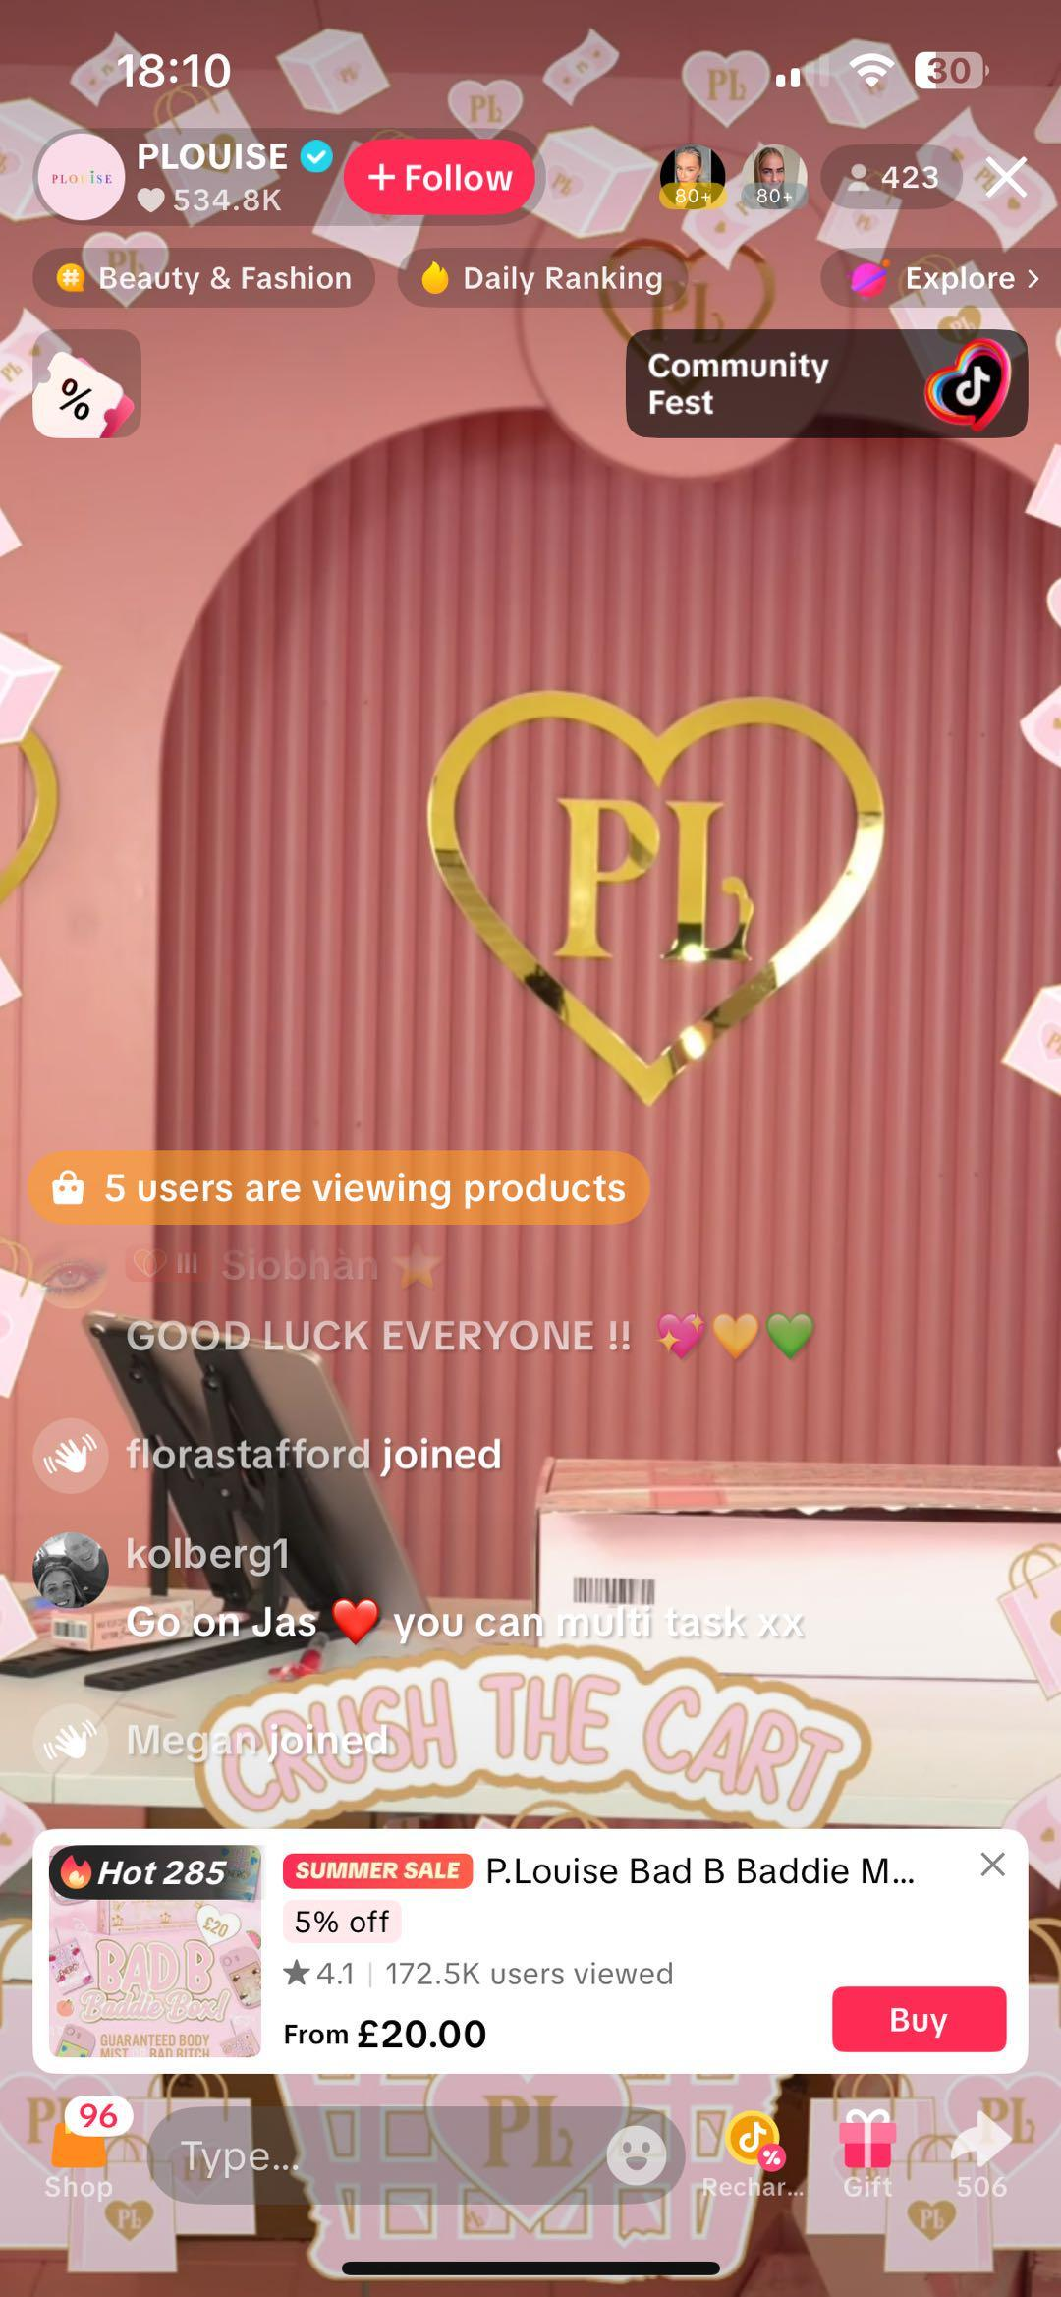
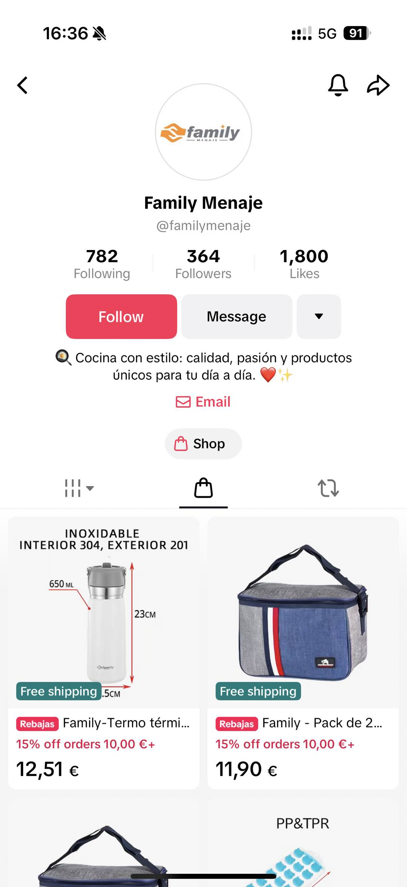
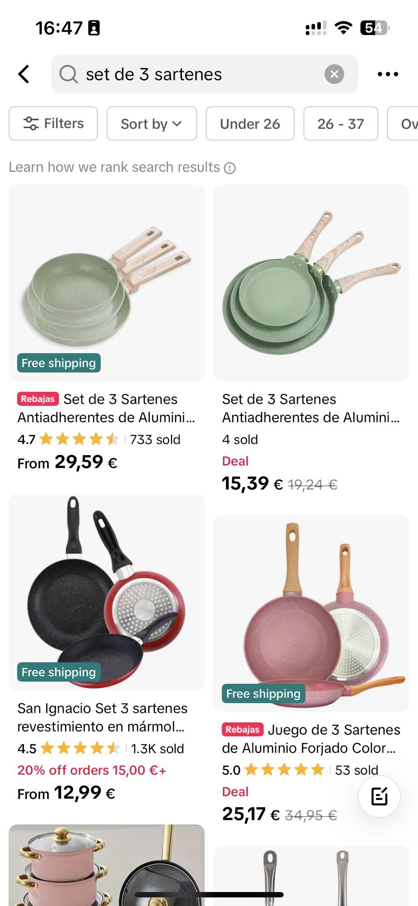
Seller Experience
Shoppable Videos
Livestreams
Product Showcase
Search Bar

Slide 62
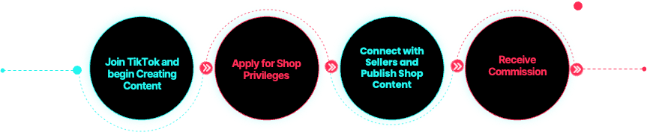
Creator Experience: Becoming a Creator on Shop

Slide 63
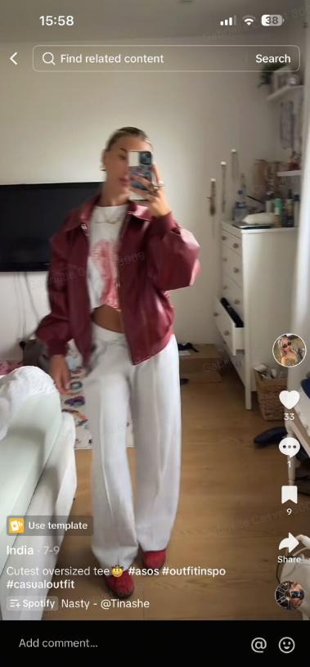
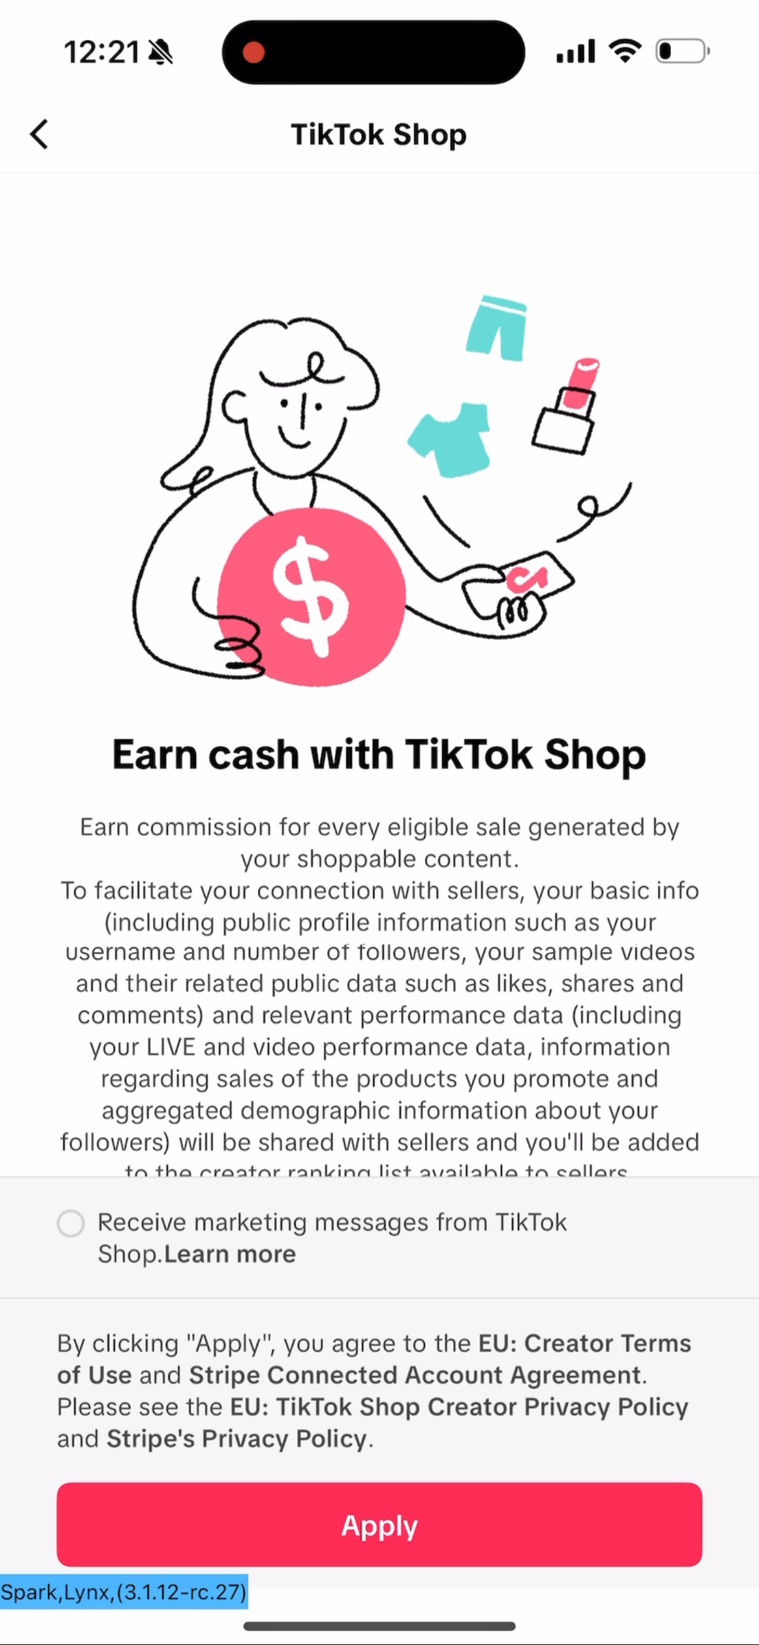
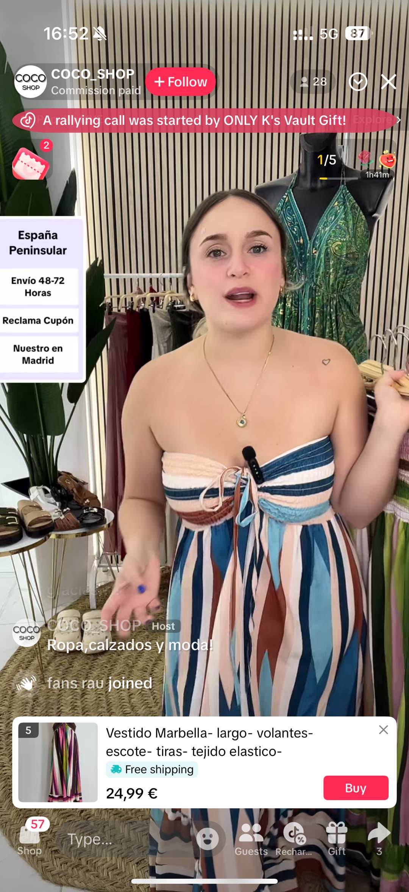
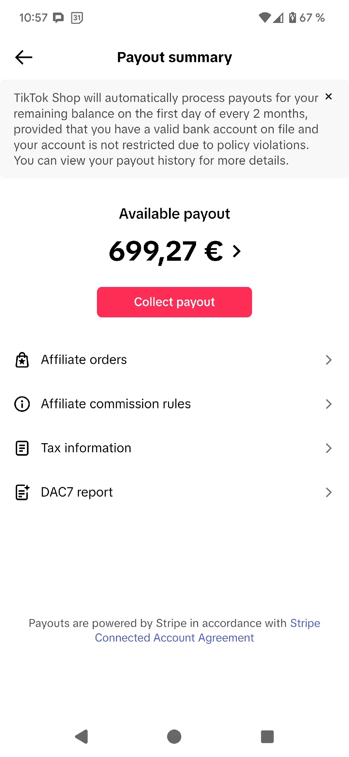
Creator Experience
Create with TikTok
Apply for Shop
Publish Shop content
Earn commission

Slide 64
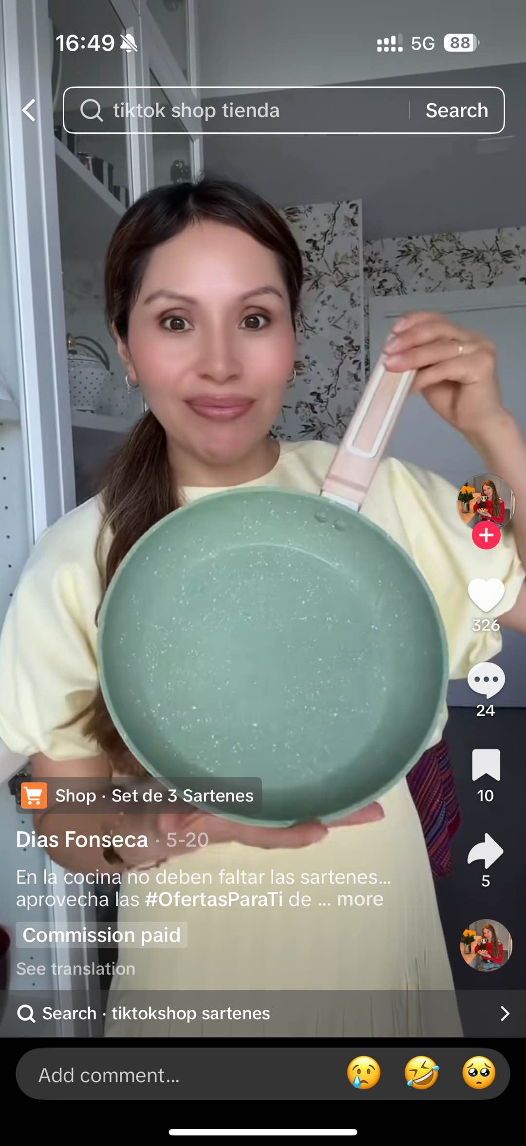
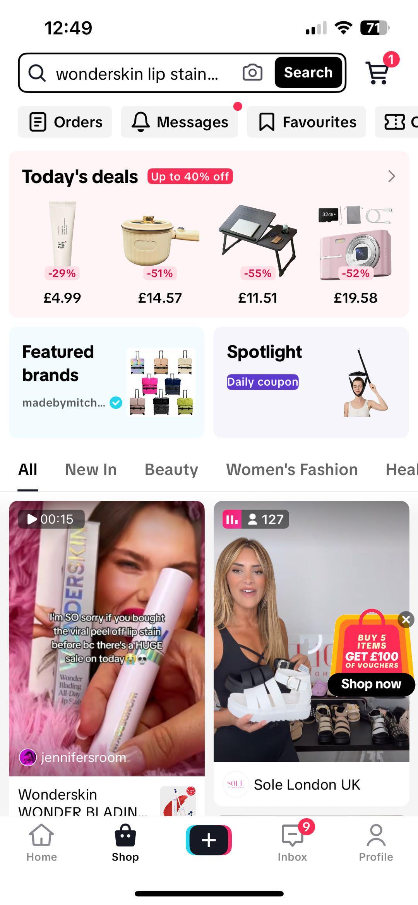
Customer Experience
Shoppable Videos
Livestreams
Product Showcase
Shop Tab
Search Bar

Slide 65
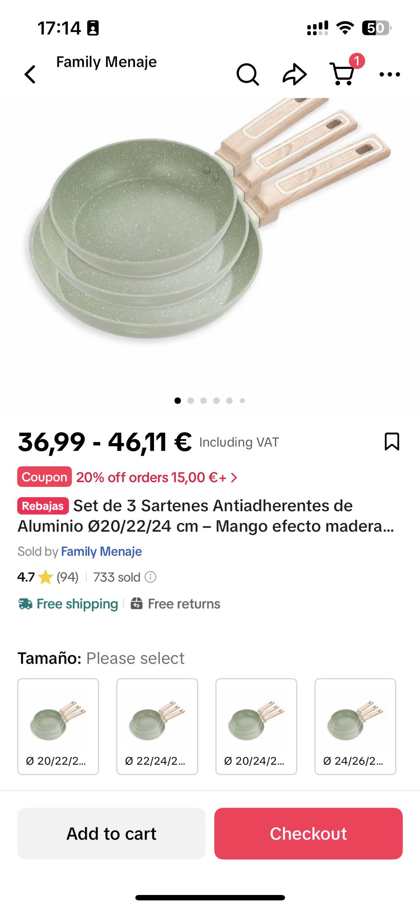
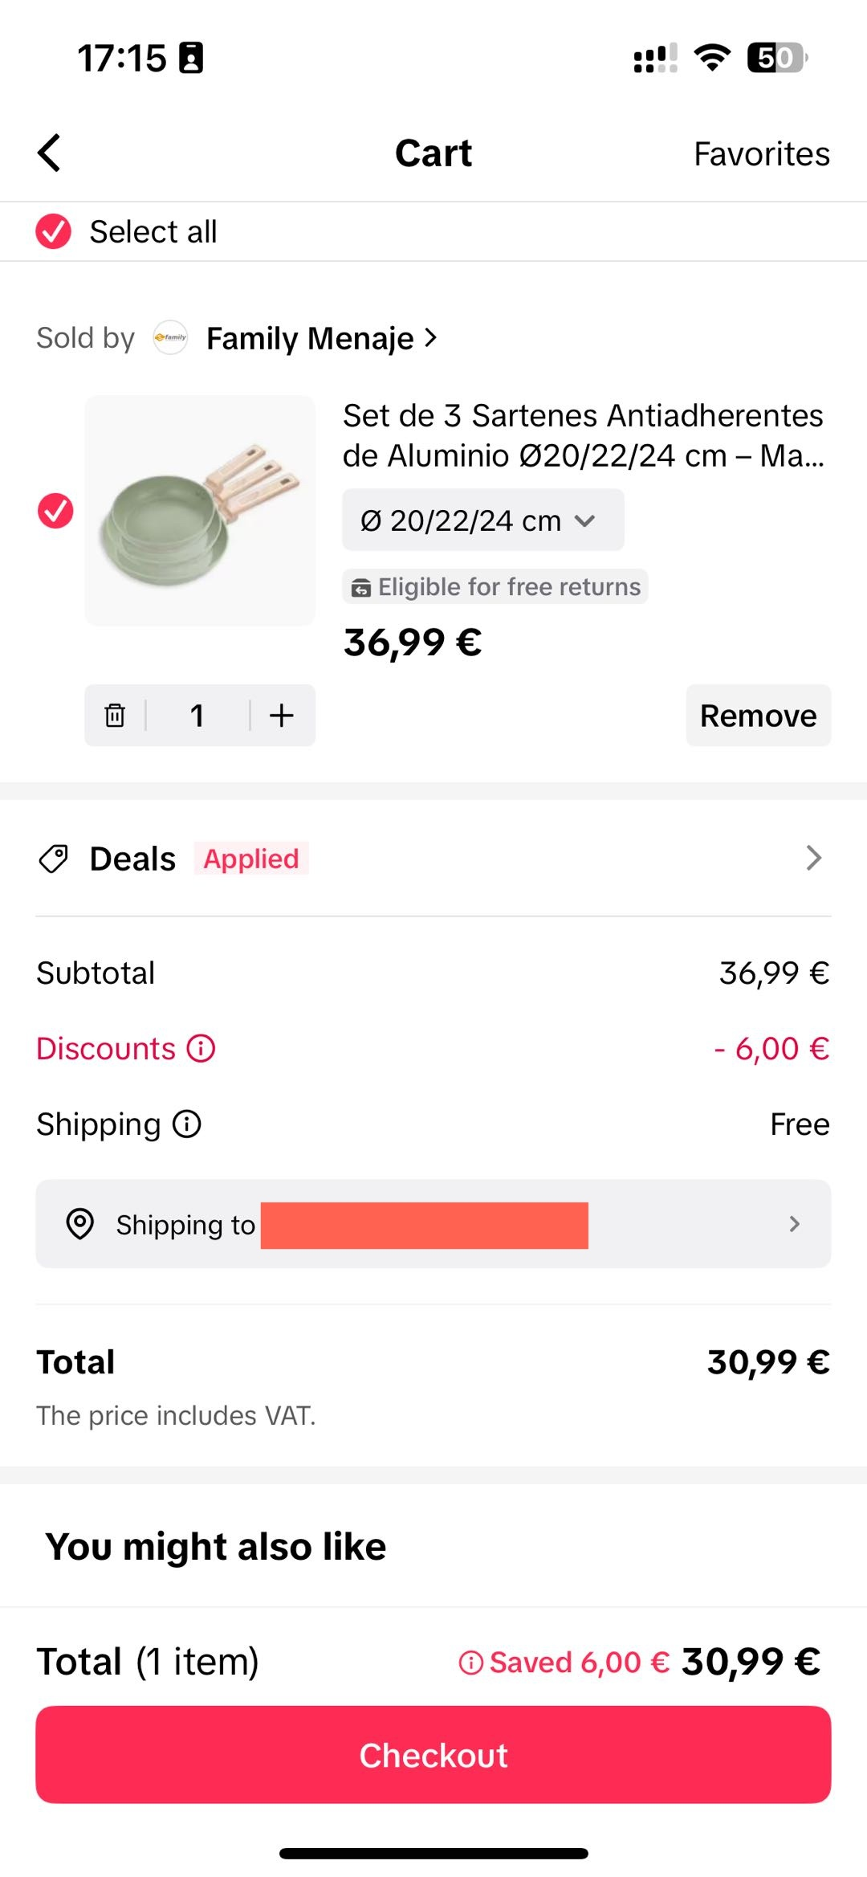
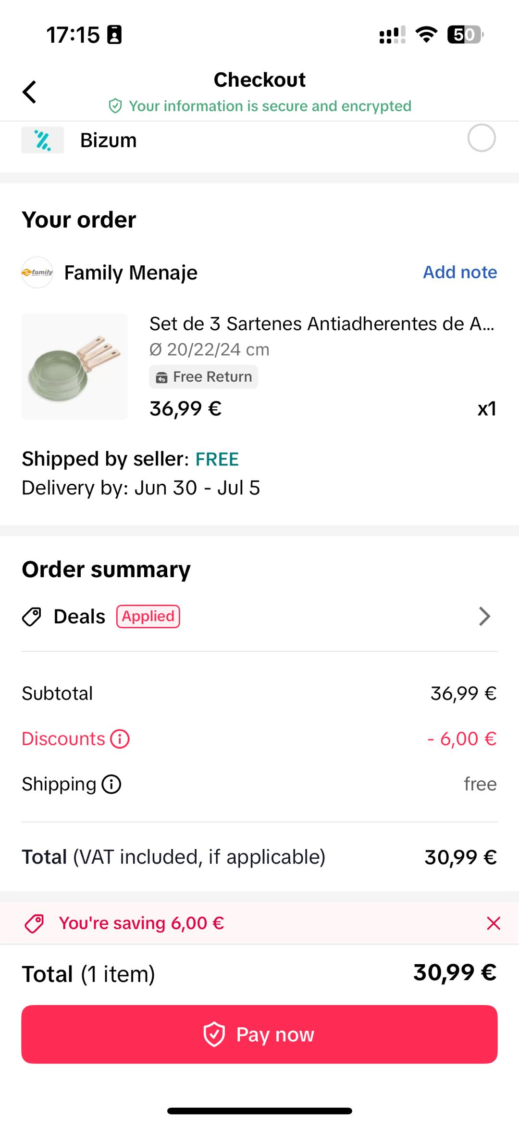
Customer Experience
Shop Content
Product Listing Page
Shopping Basket
Checkout

Slide 66
Compliance by Design
TikTok builds new products, like TikTok Shop, with compliance in mind, including:
  DSA,
  GDPR,
  Consumer Rights,
  Product Liability,
  Intellectual Property Rights, and
  DMA

Slide 67
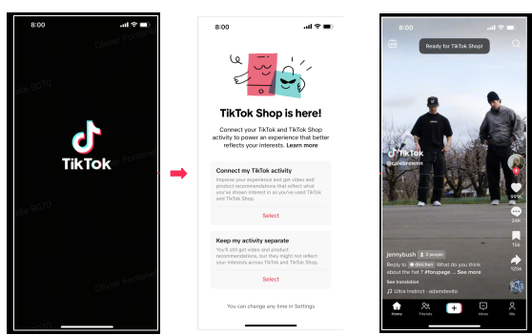

TikTok Shop Article 5.2 consent
Users see a TikTok Shop DMA consent prompt when launching the app
Access to detailed help article before selection

Slide 68
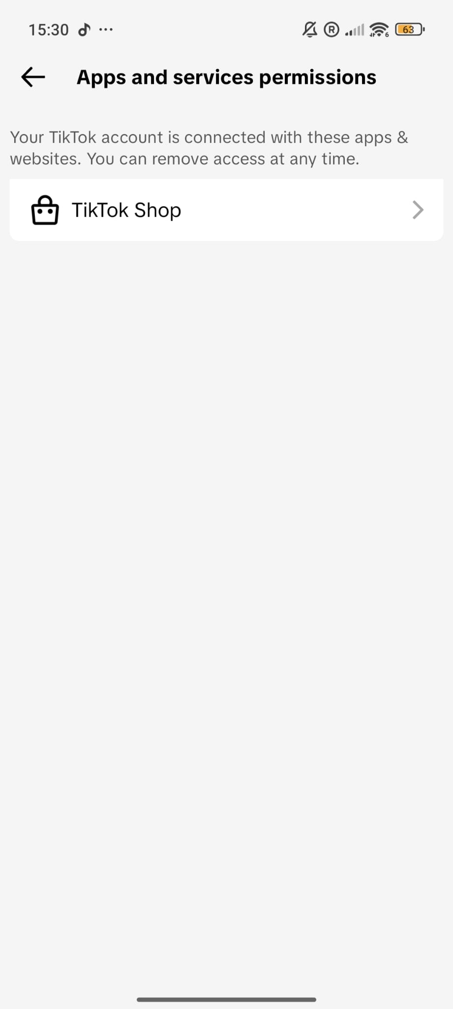
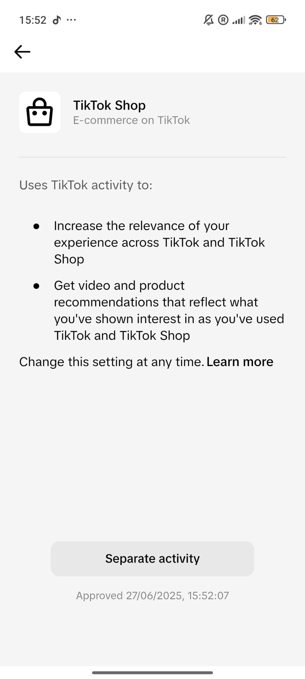
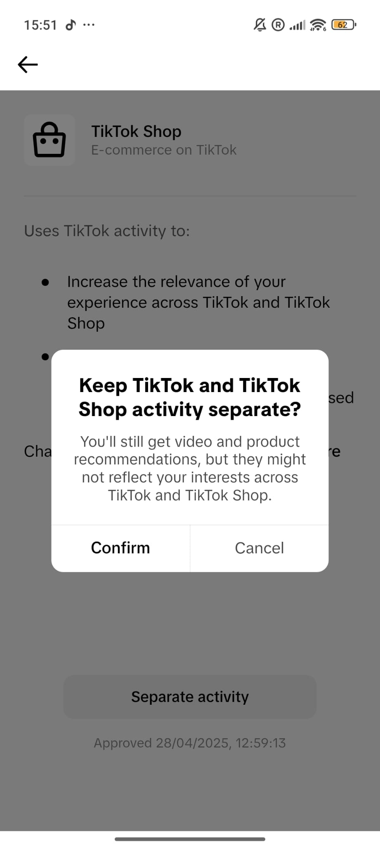
TikTok Shop Article 5.2 consent
Users can revoke their consent at any time in their app settings
Users will only see the consent prompt once every 365 days if they choose to keep their TikTok and TikTok Shop activity separate

Slide 69
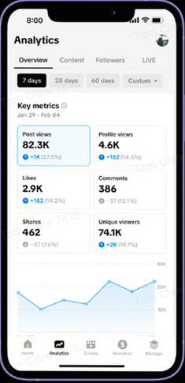
Introducing TikTok Studio
TikTok Studio is a new app that consolidates TikTok’s existing creator tools in one easily accessible location - similar to “studio” functions on other platforms
TikTok Studio provides one dedicated, integrated and easy to access place for users to better understand the value of the platform and track performance
Enables businesses to
  Manage their content,
  Engage their audience, and
  Analyse their performance

Slide 70
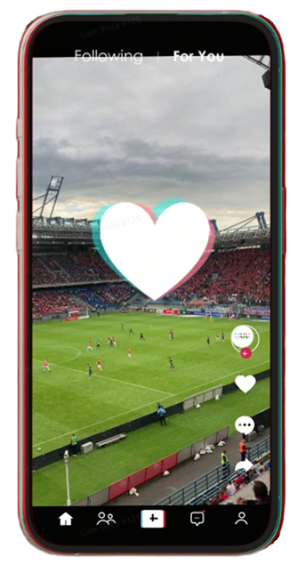
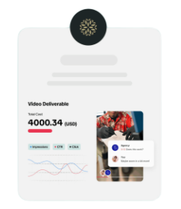
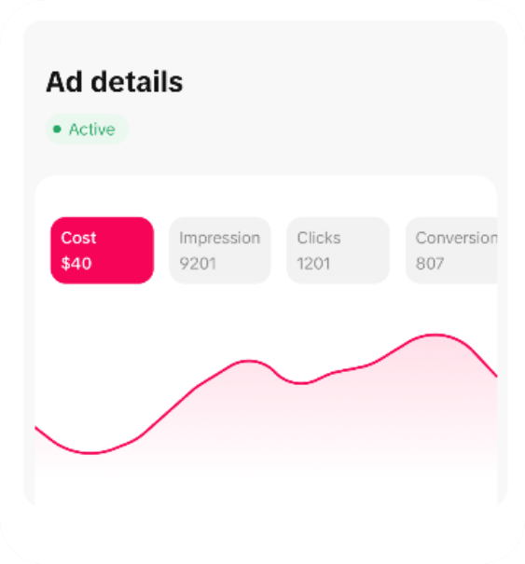

Overview of TikTok Business Features
Advertise through TikTok for Business
Connect
organically
Sell with TikTok Shop
Get creative with TikTok One

Slide 71

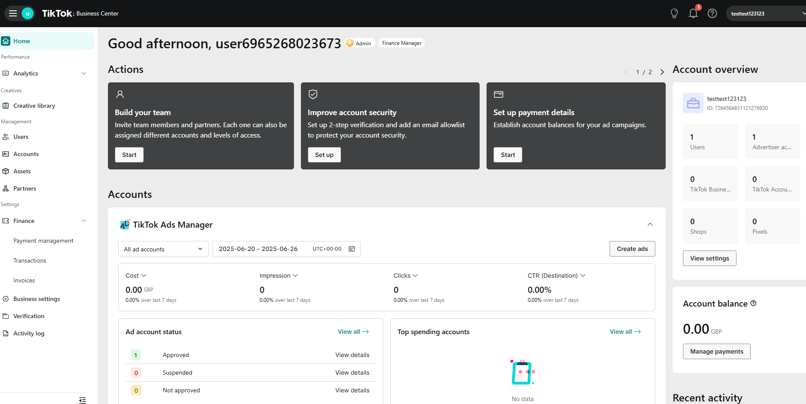

Slide 72
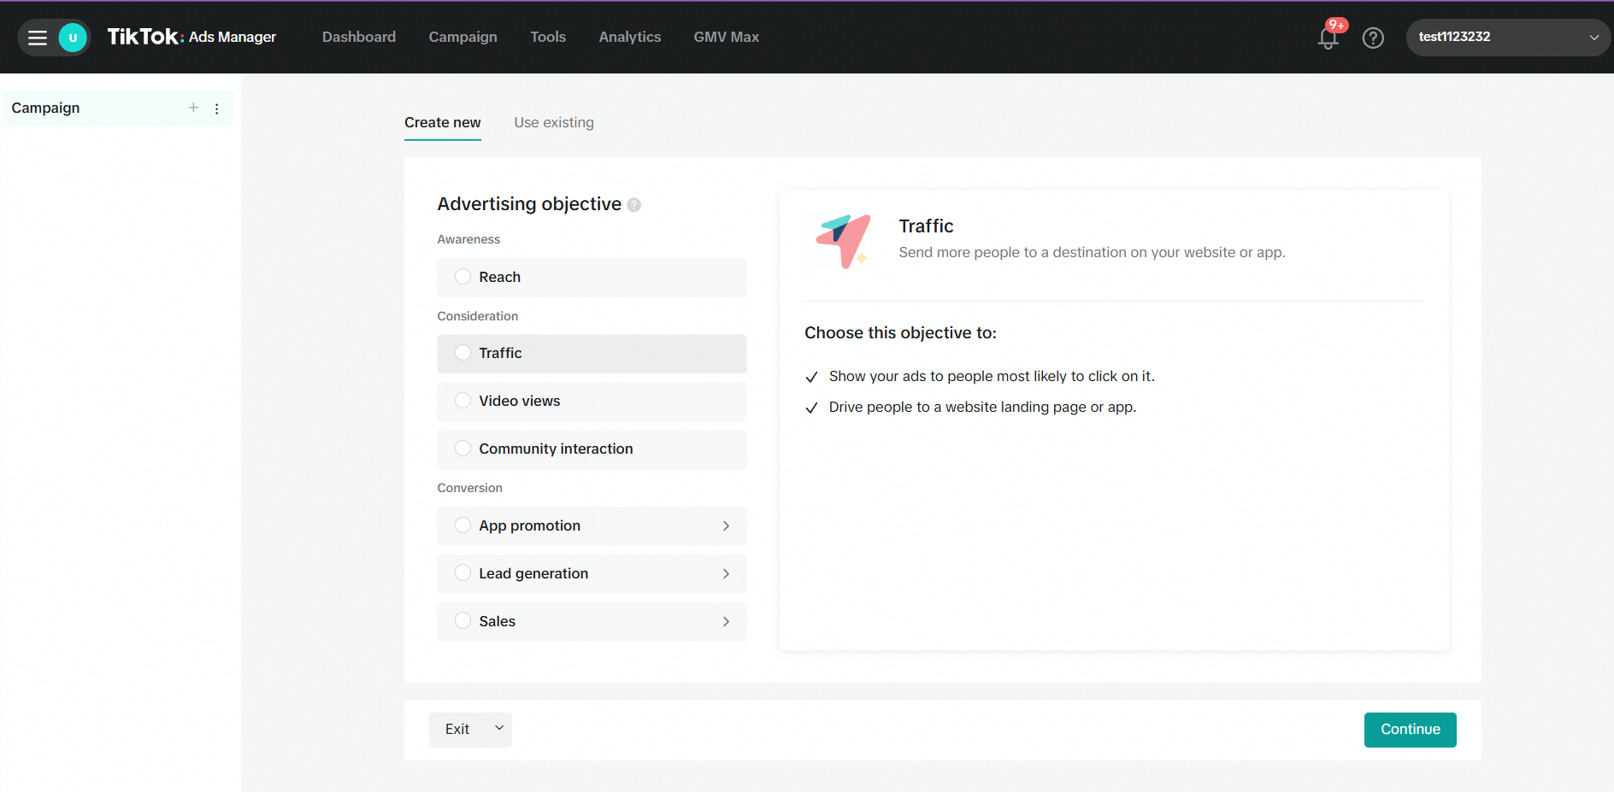


Slide 73
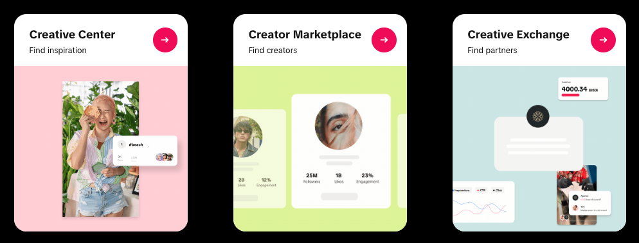
TikTok One
Get insights &
inspiration
Access creators
Discover partners

Slide 74
Thank you & questions?

Slide 75
Q&A on presentation or any other topic related to DMA compliance

Slide 76
Concluding remarks by the Commission

Slide 77
Thank you

