Slide 1

DMA Enforcement Workshops
Microsoft
Brussels, 26 March 2024

Slide 2
Regulatory landscape - Platforms
Agenda
13:00 – 13:15 | Introductory remarks by the Commission
13:15 – 15:00 | Session 1 – Windows PC OS (Articles 5.2, 6.2, 6.3, 6.4, 6.7, 6.9 and 6.10)
15:00 – 15:30 | Coffee break
15:30 – 17:15 | Session 2 – LinkedIn (Articles 5.2, 6.2, 6.5, 6.9 and 6.10)
17:15 – 17:30 | Closing remarks
17:30 | End of workshop

Slide 3
Regulatory landscape - Platforms
Rules of engagement
No reference to ongoing or past proceedings
No attacks; questions should be civilized / constructive
The Commission will moderate the discussions. Its role will be to steer the discussion
The Commission will not provide legal interpretations / take any positions
No sharing of business sensitive information
Goal is to hear stakeholders’ feedback on the concrete compliance solutions
We may not be able to take all comments and questions. Any observations can be sent to EC-DMA@ec.europa.eu

Slide 4

Regulatory landscape - Platforms
Rules of engagement
Always state your name and organisation (in room and via slido)
Questions and comments should be
clear and short = 2 min max,
relevant and on-topic of the specific DMA obligation,
constructive.
One question or comment per intervention
Online questions and comments via: https://app.sli.do/event/prjNqZjsdXHP73Nep8otN8
slido.com - # 3596369

Slide 5
Session 1
Windows PC OS
(Articles 5.2, 6.2, 6.3, 6.4, 6.7, 6.9 and 6.10)

Slide 6
Article 5(2)
“The gatekeeper shall not do any of the following:
process, for the purpose of providing online advertising services, personal data of end users using services of third parties that make use of core platform services of the gatekeeper;
combine personal data from the relevant core platform service with personal data from any further core platform services or from any other services provided by the gatekeeper or with personal data from third-party services;
cross-use personal data from the relevant core platform service in other services provided separately by the gatekeeper, including other core platform services, and vice versa; and
sign in end users to other services of the gatekeeper in order to combine personal data,
unless the end user has been presented with the specific choice and has given consent within the meaning of Article 4, point (11), and Article 7 of Regulation (EU) 2016/679.
Where the consent given for the purposes of the first subparagraph has been refused or withdrawn by the end user, the gatekeeper shall not repeat its request for consent for the same purpose more than once within a period of one year.
This paragraph is without prejudice to the possibility for the gatekeeper to rely on Article 6(1), points (c), (d) and (e) of Regulation (EU) 2016/679, where applicable.”

Slide 7
Article 6(2)
“The gatekeeper shall not use, in competition with business users, any data that is not publicly available that is generated or provided by those business users in the context of their use of the relevant core platform services or of the services provided together with, or in support of, the relevant core platform services, including data generated or provided by the customers of those business users.
For the purposes of the first subparagraph, the data that is not publicly available shall include any aggregated and non-aggregated data generated by business users that can be inferred from, or collected through, the commercial activities of business users or their customers, including click, search, view and voice data, on the relevant core platform services or on services provided together with, or in support of, the relevant core platform services of the gatekeeper.”

Slide 8
Article 6(3)
“The gatekeeper shall allow and technically enable end users to easily un-install any software applications on the operating system of the gatekeeper, without prejudice to the possibility for that gatekeeper to restrict such un-installation in relation to software applications that are essential for the functioning of the operating system or of the device and which cannot technically be offered on a standalone basis by third parties.
The gatekeeper shall allow and technically enable end users to easily change default settings on the operating system, virtual assistant and web browser of the gatekeeper that direct or steer end users to products or services provided by the gatekeeper. That includes prompting end users, at the moment of the end users’ first use of an online search engine, virtual assistant or web browser of the gatekeeper listed in the designation decision pursuant to Article 3(9), to choose, from a list of the main available service providers, the online search engine, virtual assistant or web browser to which the operating system of the gatekeeper directs or steers users by default, and the online search engine to which the virtual assistant and the web browser of the gatekeeper directs or steers users by default.”

Slide 9
Article 6(4)
“The gatekeeper shall allow and technically enable the installation and effective use of third-party software applications or software application stores using, or interoperating with, its operating system and allow those software applications or software application stores to be accessed by means other than the relevant core platform services of that gatekeeper. The gatekeeper shall, where applicable, not prevent the downloaded third-party software applications or software application stores from prompting end users to decide whether they want to set that downloaded software application or software application store as their default. The gatekeeper shall technically enable end users who decide to set that downloaded software application or software application store as their default to carry out that change easily.
The gatekeeper shall not be prevented from taking, to the extent that they are strictly necessary and proportionate, measures to ensure that third-party software applications or software application stores do not endanger the integrity of the hardware or operating system provided by the gatekeeper, provided that such measures are duly justified by the gatekeeper.
Furthermore, the gatekeeper shall not be prevented from applying, to the extent that they are strictly necessary and proportionate, measures and settings other than default settings, enabling end users to effectively protect security in relation to third-party software applications or software application stores, provided that such measures and settings other than default settings are duly justified by the gatekeeper.”

Slide 10
Article 6(7)
“The gatekeeper shall allow providers of services and providers of hardware, free of charge, effective interoperability with, and access for the purposes of interoperability to, the same hardware and software features accessed or controlled via the operating system or virtual assistant listed in the designation decision pursuant to Article 3(9) as are available to services or hardware provided by the gatekeeper. Furthermore, the gatekeeper shall allow business users and alternative providers of services provided together with, or in support of, core platform services, free of charge, effective interoperability with, and access for the purposes of interoperability to, the same operating system, hardware or software features, regardless of whether those features are part of the operating system, as are available to, or used by, that gatekeeper when providing such services.
The gatekeeper shall not be prevented from taking strictly necessary and proportionate measures to ensure that interoperability does not compromise the integrity of the operating system, virtual assistant, hardware or software features provided by the gatekeeper, provided that such measures are duly justified by the gatekeeper.”

Slide 11
Articles 6(9) and (10)
“9. The gatekeeper shall provide end users and third parties authorised by an end user, at their request and free of charge, with effective portability of data provided by the end user or generated through the activity of the end user in the context of the use of the relevant core platform service, including by providing, free of charge, tools to facilitate the effective exercise of such data portability, and including by the provision of continuous and real-time access to such data.
10. The gatekeeper shall provide business users and third parties authorised by a business user, at their request, free of charge, with effective, high-quality, continuous and real-time access to, and use of, aggregated and non-aggregated data, including personal data, that is provided for or generated in the context of the use of the relevant core platform services or services provided together with, or in support of, the relevant core platform services by those business users and the end users engaging with the products or services provided by those business users. With regard to personal data, the gatekeeper shall provide for such access to, and use of, personal data only where the data are directly connected with the use effectuated by the end users in respect of the products or services offered by the relevant business user through the relevant core platform service, and when the end users opt in to such sharing by giving their consent.”

Slide 12

Windows

Slide 13
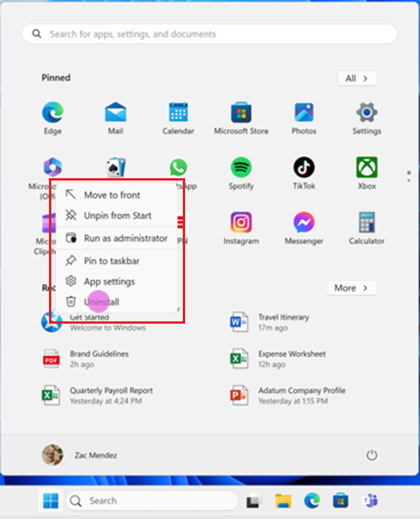
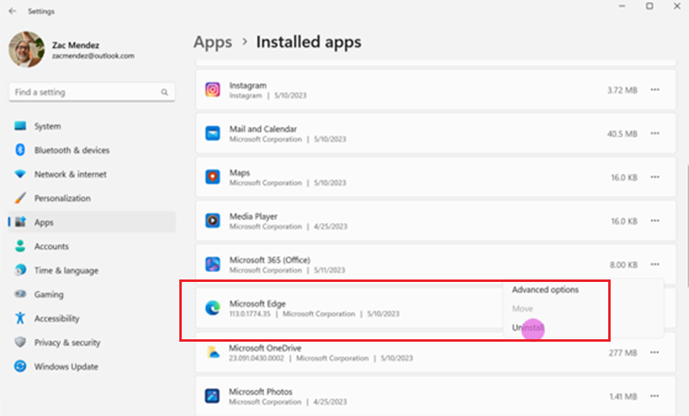
Article 6(3)
Users Can Uninstall Applications on Windows
Uninstalling An Application From Start
Uninstalling An Application From The Installed Apps List In Settings

Slide 14
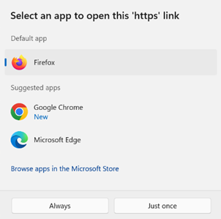
Article 6(3) and 6(4)
Defaults Are Easily Configurable on Windows
Windows Asks Users Whether They Want to Set a Newly Installed Application as the Default
Windows automatically prompts the user with an “Open With” dialog to select a default app for a file or link type the first time that type is opened after a newly installed app registers support for that type.
Applications May Prompt Users To Be Set As The Default
Windows API enables apps to prompt the user and take them to settings to set the app as the default.

Slide 15
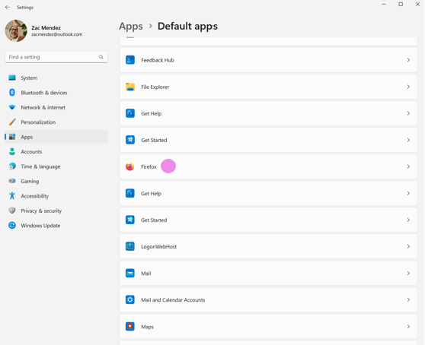
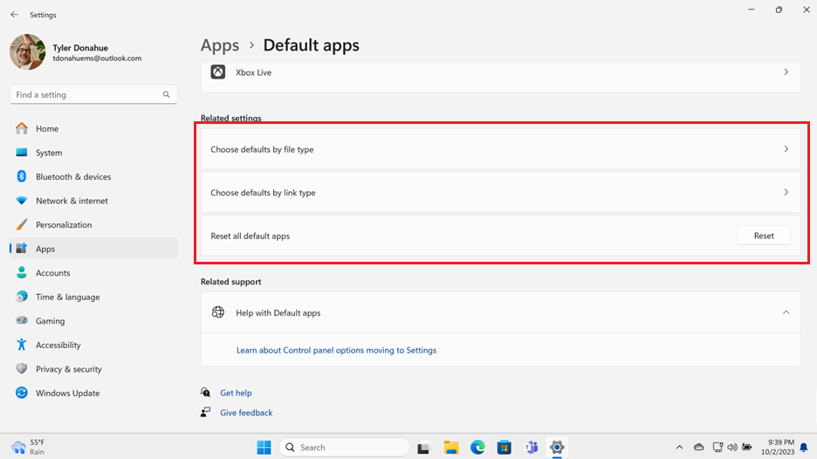
Article 6(3) and 6(4)
Defaults Are Easily Configurable on Windows
Users Can Set Defaults By Application in Settings
Users Can Set Defaults By Link or File Type in Settings

Slide 16
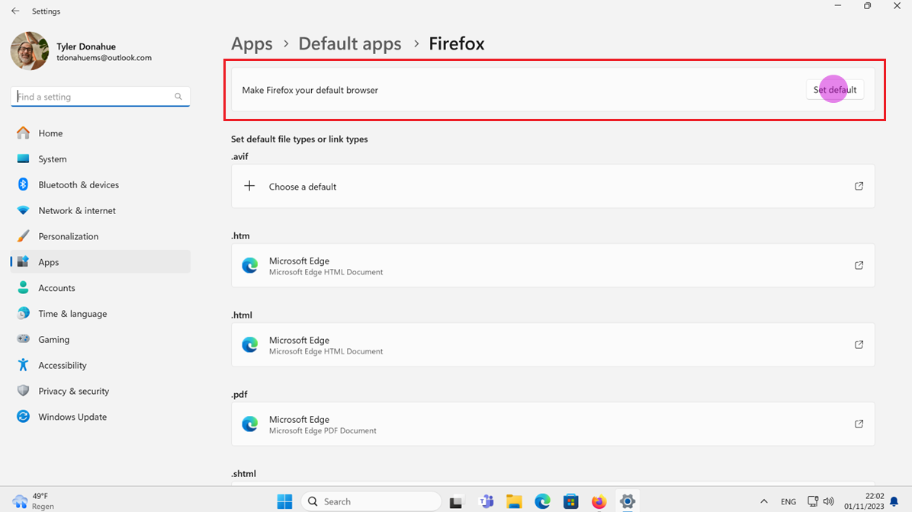
Article 6(3) and 6(4)
Defaults Are Easily Configurable on Windows
Browser Apps Can Be Set As The Default With A Single Button For File and Link Types
http, https, .htm and .html

Slide 17
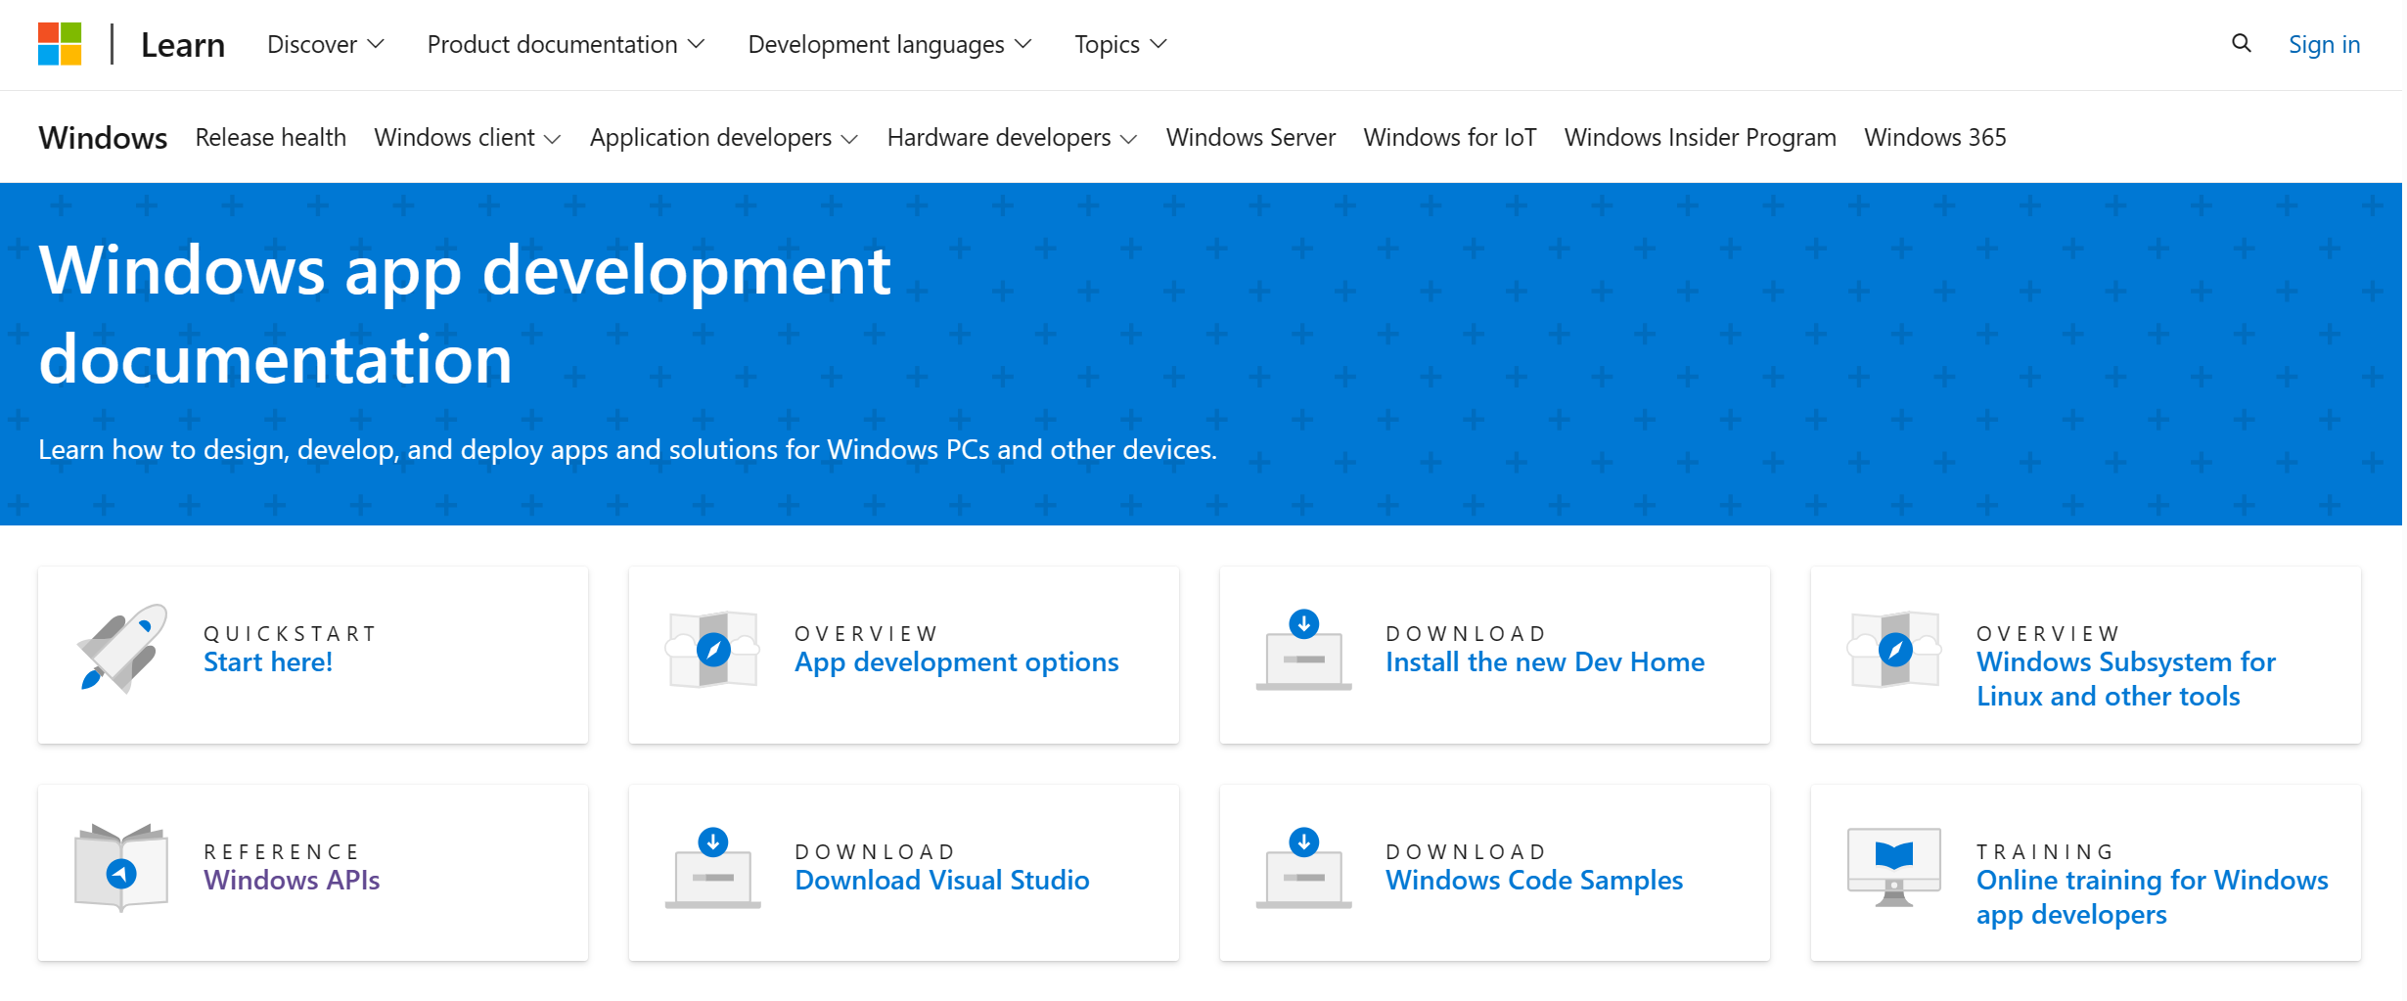
Article 6(7) – Interoperability
Windows has documented APIs and provides developer tools to enable third-party applications to access all hardware and software features that Microsoft apps and services can access.
Microsoft created two new extensibility opportunities because of the DMA:
Windows Search Box
Windows 11 Widgets Board – Feed extensibility

Slide 18
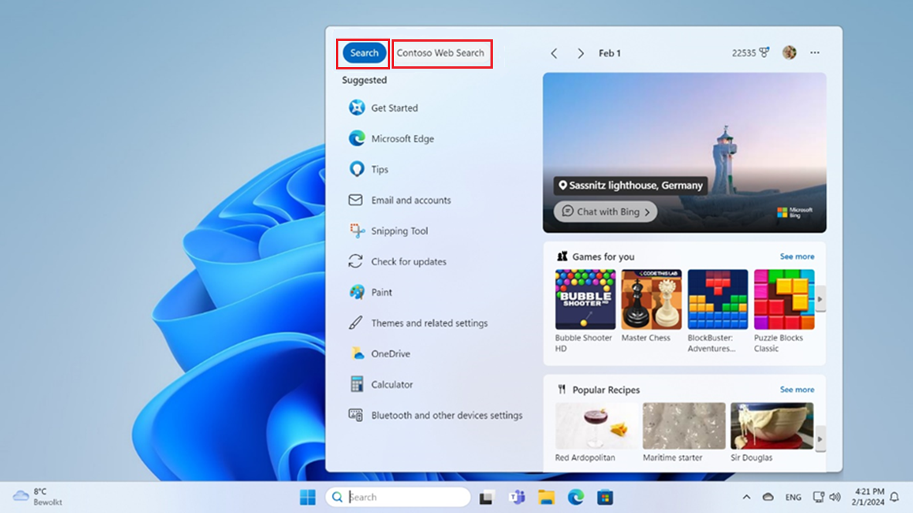
Article 6(7) – Windows Search Box Extensibility
Experience with Web Search From Microsoft Bing and a Third-Party Web Search Provider Enabled

Slide 19
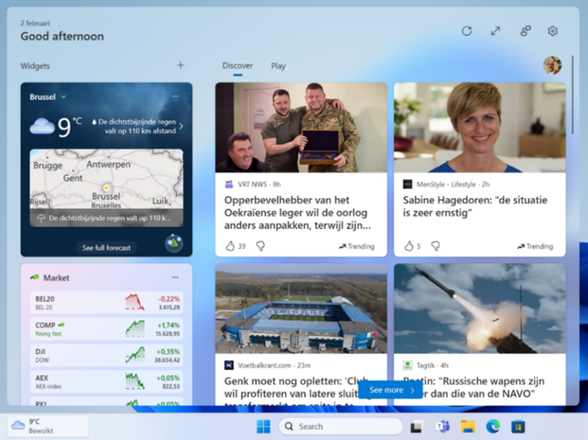
Article 6(7) – Windows 11 Widgets Board –
Feed Extensibility
The Windows Widgets Board hosts widget and feed providers. Widget extensibility existed prior to the DMA, but feed extensibility was added for the DMA.
Applications can use public APIs to implement a widget and feed provider.

Slide 20
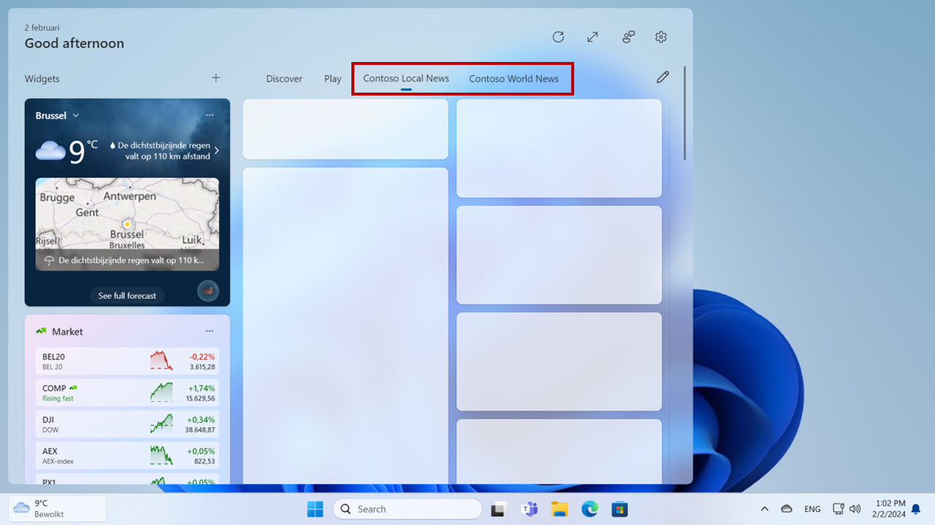
Article 6(7) – Windows 11 Widgets Board –
Feed Extensibility
Mockup of What a Third-Party Feed Provider Could Do in the Widgets Board

Slide 21
Windows Data

Slide 22
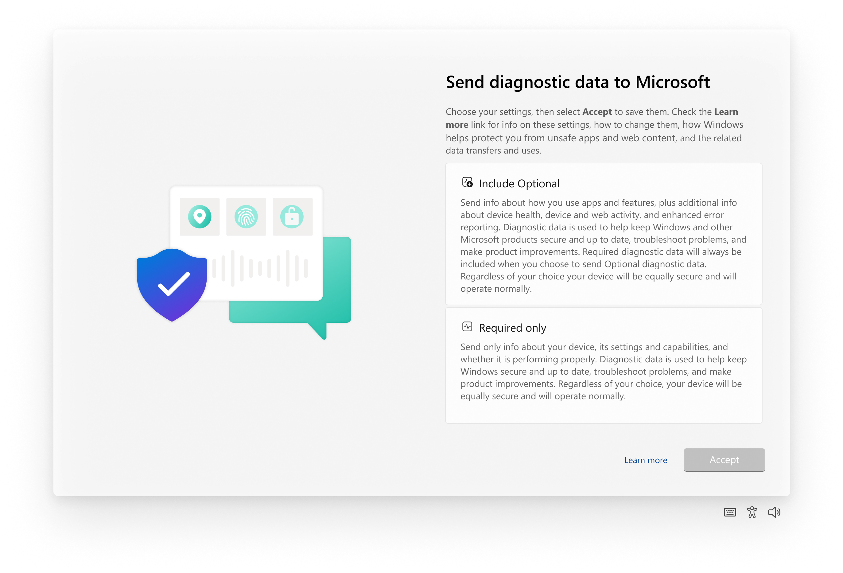
Article 5(2)(b)-(c) – Windows Obtains Consent to Cross-use or Combine Windows Diagnostic Data
Microsoft collects Optional Diagnostic Data with consent and may cross-use or combine this data with personal data from other products and services to debug and improve those products.
If the end-user does not consent to provide Optional Diagnostic Data, then Microsoft collects only Required Diagnostic Data. This data is not combined with personal data from other services without separate consent.
Declining or withdrawing consent for Optional Diagnostic Data does not affect how Windows operates.
Windows Diagnostic Data

Slide 23
Article 6(2) – Microsoft does not use Windows Diagnostic Data in Competition with Business Users
Windows Diagnostic Data includes data about applications installed and running on Windows.
Microsoft will isolate Diagnostic Data relating to third-party applications on Windows and limit access to this data for only permitted purposes.
Microsoft may aggregate data and make it publicly available for everyone to use.

Slide 24
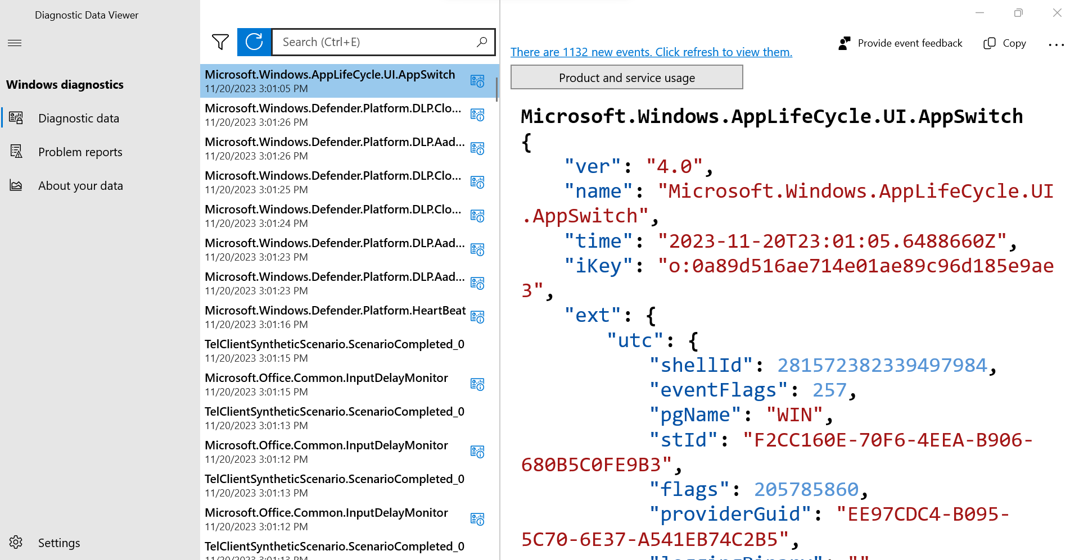
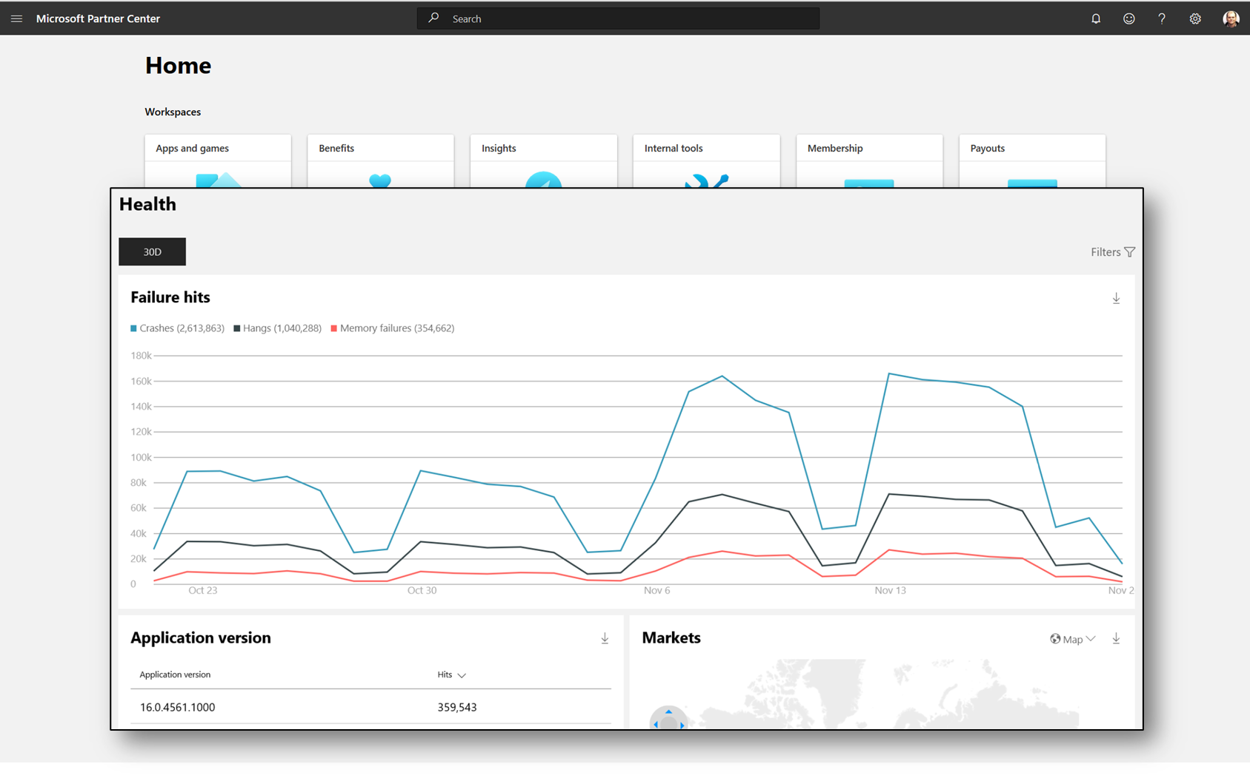
Articles 6(9) and 6(10) – Access to Windows Diagnostic Data for End Users and Business Users
Microsoft makes Windows Diagnostic Data available through the Diagnostic Data Viewer.
If the end-user enables access, third-party applications can access DDV data through an API.
Microsoft makes aggregate reports from Diagnostic Data relating to third-party applications available to business users through Partner Center.

Slide 25
Regulatory landscape - Platforms
Rules of engagement
Always state your name and organisation (in room and via slido)
Questions and comments should be
clear and short = 2 min max,
relevant and on-topic of the specific DMA obligation,
constructive.
One question or comment per intervention
Online questions and comments via: https://app.sli.do/event/prjNqZjsdXHP73Nep8otN8
slido.com - # 3596369

Slide 26
Coffee break

Slide 27
Session 2
LinkedIn
(Articles 5.2, 6.2, 6.5,
6.9 and 6.10)

Slide 28
Article 5(2)
“The gatekeeper shall not do any of the following:
process, for the purpose of providing online advertising services, personal data of end users using services of third parties that make use of core platform services of the gatekeeper;
combine personal data from the relevant core platform service with personal data from any further core platform services or from any other services provided by the gatekeeper or with personal data from third-party services;
cross-use personal data from the relevant core platform service in other services provided separately by the gatekeeper, including other core platform services, and vice versa; and
sign in end users to other services of the gatekeeper in order to combine personal data,
unless the end user has been presented with the specific choice and has given consent within the meaning of Article 4, point (11), and Article 7 of Regulation (EU) 2016/679.
Where the consent given for the purposes of the first subparagraph has been refused or withdrawn by the end user, the gatekeeper shall not repeat its request for consent for the same purpose more than once within a period of one year.
This paragraph is without prejudice to the possibility for the gatekeeper to rely on Article 6(1), points (c), (d) and (e) of Regulation (EU) 2016/679, where applicable.”

Slide 29
Article 6(2)
“The gatekeeper shall not use, in competition with business users, any data that is not publicly available that is generated or provided by those business users in the context of their use of the relevant core platform services or of the services provided together with, or in support of, the relevant core platform services, including data generated or provided by the customers of those business users.
For the purposes of the first subparagraph, the data that is not publicly available shall include any aggregated and non-aggregated data generated by business users that can be inferred from, or collected through, the commercial activities of business users or their customers, including click, search, view and voice data, on the relevant core platform services or on services provided together with, or in support of, the relevant core platform services of the gatekeeper.”

Slide 30
Article 6(5)
“The gatekeeper shall not treat more favourably, in ranking and related indexing and crawling, services and products offered by the gatekeeper itself than similar services or products of a third party.
The gatekeeper shall apply transparent, fair and non-discriminatory conditions to such ranking.”

Slide 31
Articles 6(9) and (10)
“9. The gatekeeper shall provide end users and third parties authorised by an end user, at their request and free of charge, with effective portability of data provided by the end user or generated through the activity of the end user in the context of the use of the relevant core platform service, including by providing, free of charge, tools to facilitate the effective exercise of such data portability, and including by the provision of continuous and real-time access to such data.
10. The gatekeeper shall provide business users and third parties authorised by a business user, at their request, free of charge, with effective, high-quality, continuous and real-time access to, and use of, aggregated and non-aggregated data, including personal data, that is provided for or generated in the context of the use of the relevant core platform services or services provided together with, or in support of, the relevant core platform services by those business users and the end users engaging with the products or services provided by those business users. With regard to personal data, the gatekeeper shall provide for such access to, and use of, personal data only where the data are directly connected with the use effectuated by the end users in respect of the products or services offered by the relevant business user through the relevant core platform service, and when the end users opt in to such sharing by giving their consent.”

Slide 32

LinkedIn

Slide 33
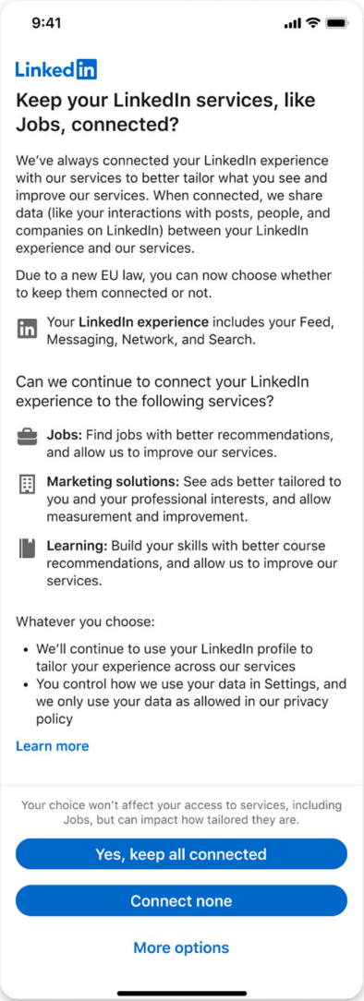
Article 5(2)(a)-(b) – Consent to process and combine personal data

Slide 34
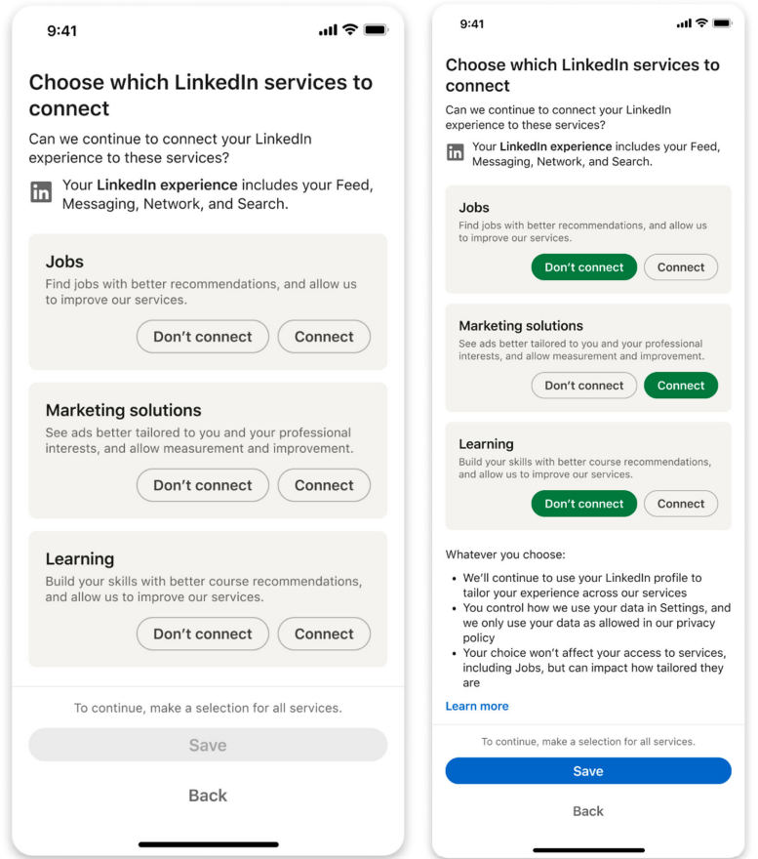
Article 5(2)(a)-(b) – Consent to process and combine personal data

Slide 35
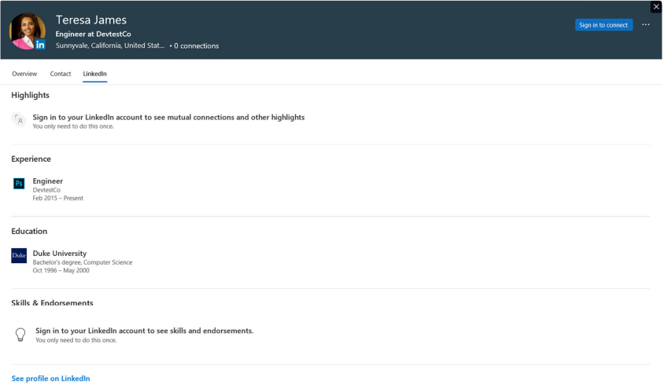
Article 5(2)(c) – Data cross-use
Microsoft uses the LinkedIn People Card (“LPC”) API to display LinkedIn member profile snapshots in Outlook and Teams subject to a new LPC opt-in provided to LinkedIn members.

Slide 36
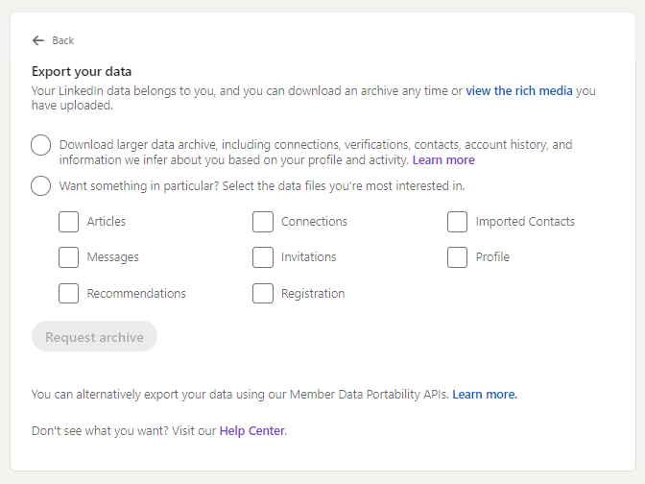
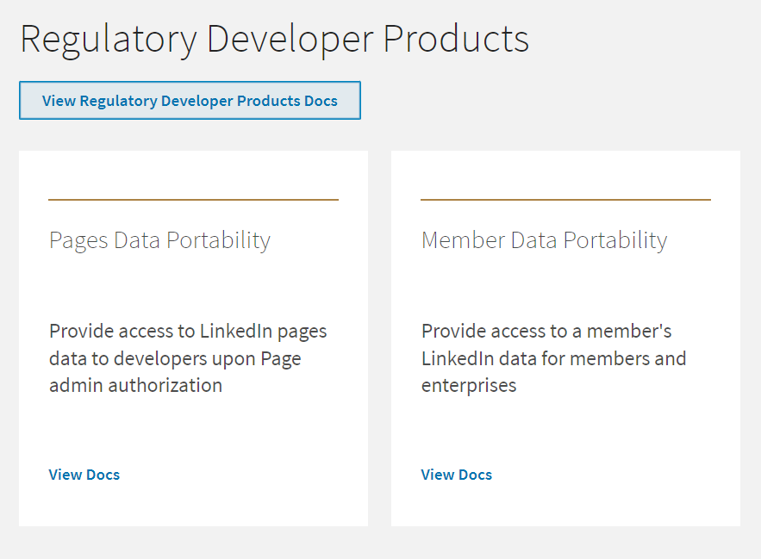
Article 6(9) – Data access for end users
LinkedIn members can access and download their own LinkedIn provided and generated data (e.g., member profile data, list of first-degree connections, messages, likes, comments, shares, follows, ads clicked, and job applications) via an existing export tool.
LinkedIn is also offering a new API program (“Member Data Portability API”) for its members and their authorized third-parties to access the members’ own LinkedIn data in a continuous and real-time manner.
Member Settings - Data Privacy
API Product Catalog

Slide 37
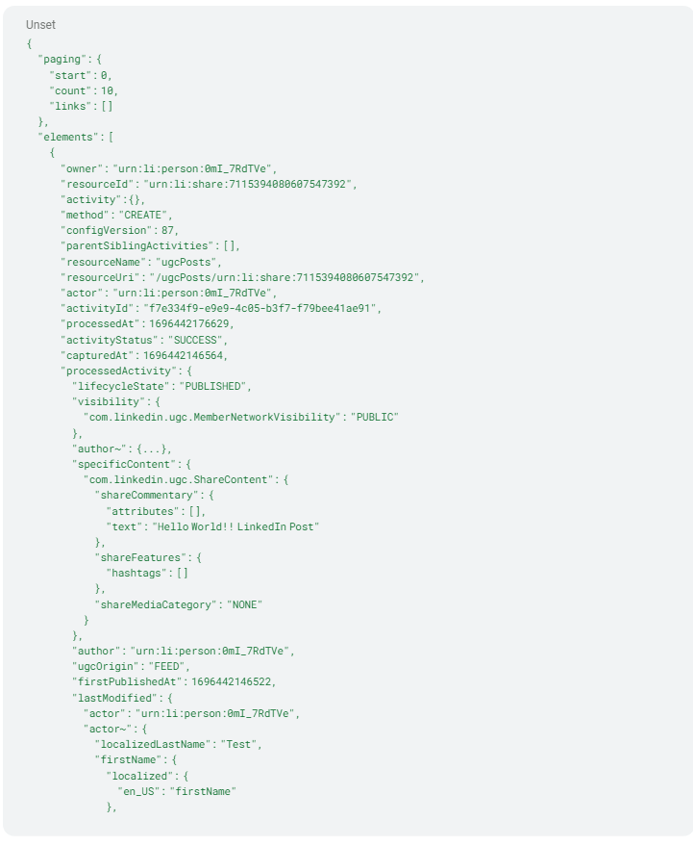
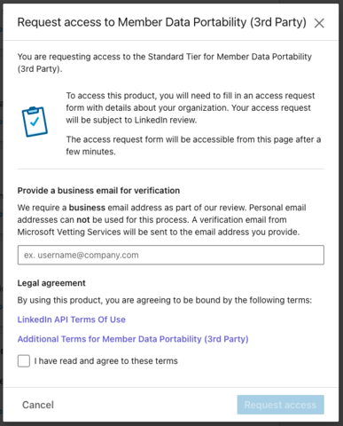
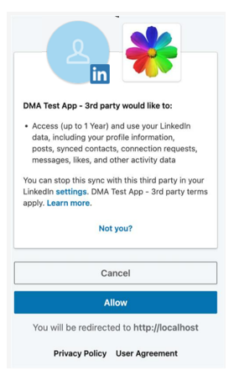
Article 6(9) – Data access for end users
Sample “Post” Data Returned
Third-Party Developer Application Process
Member Data Portability API
Consent Screen

Slide 38
Article 6(10) – Data access for business users
LinkedIn has existing business tool user interfaces (“UIs”) and reporting APIs:
Business users of the LinkedIn CPS and other services (Recruiter, Sales Navigator, Jobs, and Learning) can access their data in their respective UIs and via business user system integrations (e.g., via APIs);
LMS advertisers can access ad performance metrics via Campaign Manager and reporting APIs;* and
Business users of the LinkedIn CPS Pages can access their data in the Pages Admin UI and for a subset of their data, via Community Management APIs.
In addition, LinkedIn has developed a new API program (“Pages Data Portability API”).
*LinkedIn is also offering a new API program (“Article 6(8)-related API”) to enable independent ad verification under Article 6(8).

Slide 39
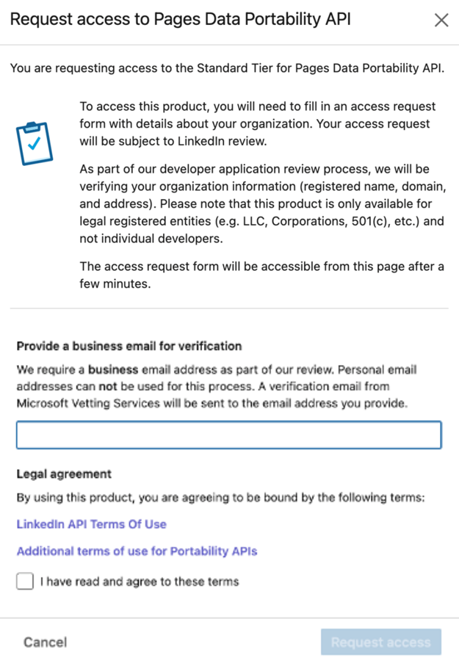
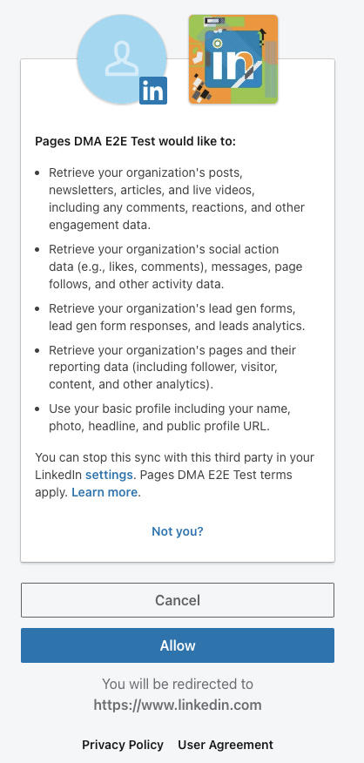
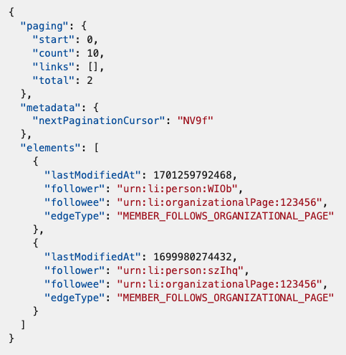
Article 6(10) – Data access for business users
Developer Application Process
Pages Data Portability API
Consent Screen
Sample “Page Follows” Data Returned

Slide 40
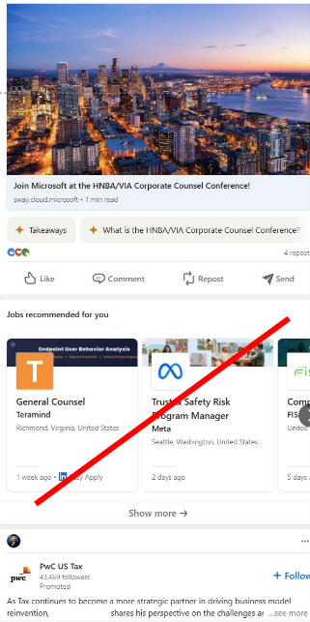
Article 6(5) – Ranking
The LinkedIn CPS feed ranks its content neutrally regardless of source.
LinkedIn previously provided a “Jobs You Might Be Interested In” (“JYMBII”) module populated with job posts (from the distinct Jobs service provided together with the LinkedIn designated CPS) on the CPS feed based on relevance to members who may be actively seeking jobs on LinkedIn.
LinkedIn has removed the JYMBII module from the feed altogether for EEA members.

Slide 41
Article 6(2) – Data not used in competition with business users
LinkedIn prohibits internal use of non-public business user data from its services to compete with business users through:
Internal data access controls across LinkedIn business lines to prevent unauthorized competitive use of business user data;
Specialized business training to all relevant teams and new Article 6(2) policy to prohibit and prevent unauthorized competitive use of business user data; and
Continued access management measures for sharing LinkedIn business user data within Microsoft.

Slide 42
Regulatory landscape - Platforms
Rules of engagement
Always state your name and organisation (in room and via slido)
Questions and comments should be
clear and short = 2 min max,
relevant and on-topic of the specific DMA obligation,
constructive.
One question or comment per intervention
Online questions and comments via: https://app.sli.do/event/prjNqZjsdXHP73Nep8otN8
slido.com - # 3596369

Slide 43
Thank you

